Slide 1
Researching While Teaching Series Workshop #4 Re-design Pedagogy
Convenor
Dr Sarah Hattam

Slide 2
Plan for Workshop
9.30am Acknowledgment of Country & Welcome
9.40 Reporting back – where are we up to?
10.20 Presentation & Discussion: Re-designing Teaching and Learning Activities – what do we take from Biggs Constructive Alignment ?
11:00 Morning tea
11:15 Group Discussion – Which pedagogies are we working with in our projects?
12:00 Project Variation Forms
12.30 Close and next steps

Slide 3
We respectfully acknowledge the Kaurna, Boandik and Barngarla First Nations Peoples and their Elders past and present, who are the First Nations’ traditional owners of the land that are now home to the University of South Australia’s campuses in Adelaide, Mount Gambier and Whyalla.
Acknowledgement of Country

Slide 4
Where are we up to?
Refinement of research question

Slide 5
Suggested Groups
1: Pedagogies of Care & Dialogic F2F(Karen, Ian, Sharron)
2: Dialogic approaches On-line (Anna, Subha, John, Sandy
3: Critical pedagogy and identity (Anne, Katie, Saira, Abdullatif)
4: Authentic Assessment (Lisa, Josephine, Katrina)

Slide 6
Sharron – pedagogies of care
How might pedagogies of care (Motta and Bennett, 2018) within the ‘third space’ (Green, Eady and Tindall-Ford, 2020) inform the process of dialogic praxis (Freire, 1999, p, 68) between pre-service and supervising teachers and the university tutor/supervisor to provide a more care-ful experience that will enhance and improve both the personal and academic outcomes of the final placement experience of regional students?

Slide 7
Subha
How does implementing a more dialogic approach to the development of on-line curriculum that prepares students for case studies increase engagement and improve overall student outcomes.

Slide 8
Josephine
What is the correlation between student and intern pharmacist confidence levels and performance in competency assessment across the final year degree program and pre-registration (internship) and how does enabling pedagogy with an ethos of care in the pre-registration (internship) program influence confidence levels and/or performance in internship competency assessment

Slide 9
John
How does utilising an element of enabling pedagogy, specifically drawing on funds of knowledge and integrating multimodal communication technology, encourage student participation and collaboration in teamwork assessments?

Slide 10
Anna
How can utilising a pedagogy of gamification, specifically implementing research on MOOCS around video production and H5P activities, improve engagement levels of Bachelor of Education students in a first year course as well as their preparedness to learn in tutorials?

Slide 11
Karen
How does utilising improvisation as a pedagogy in the Creative Artistry in Secondary School Course increase dialogic encounters and foster connections in the teaching and learning space, leading to increased application of student understanding in the classroom and within assessment tasks

Slide 12
Anne
Hopeful idea
Hopeful idea is to build students understanding of the power of language and its ability to include/exclude with a focus on words that connote/signify gender/sexuality – and you will implement queer/feminist pedagogy in your teaching intervention that will be revising the curriculum in week 8 of Communication for Academic Purposes
Research question
How does utilising queer/feminist pedagogy in a critical literacy curriculum module build students understanding of the power of language and its ability to include/exclude – specifically words that connote/signify gender/sexuality.

Slide 13
10:10 Presentation & Discussion: Re-designing Teaching and Learning Activities – what do we take from Biggs Constructive Alignment ?
John Biggs (1999) What the Student Does: teaching for enhanced learning, Higher Education Research & Development, 18:1, 57-75.

Slide 14
Robert & Susan
‘The teaching challenge is precisely to change his usual way of learning, not to see it as an impediment to teaching him’ (p. 58)
‘Figure 1, based on a number of studies and observations summarised in Biggs
(1999), postulates a two-way interaction between the degree of learning-related
activity that a teaching method is likely to stimulate, and the academic orientation of the students, as they jointly affect students' levels of engagement in the task’. (p. 58)
‘There may well be endogenous limits to what students can do that are beyond any teacher's control, but there are learning-related aspects that are controllable. Capitalising on them is what good teaching is about. Good teaching is getting most students to use the higher cognitive level processes that the more academic students use spontaneously. Good teaching narrows the gap’.

Slide 15
Theory of teaching
Constructivism: ‘meaning is not imposed or transmitted by direct instruction, but is created by the student's learning activities, well summarised in the term "approaches to learning”’(p. 60)
‘The acquisition of information in itself does not bring about such a change, but the way we structure that information and think with it does. Thus, education is about conceptual change, not just the acquisition of information.’ (p. 60)

Slide 16
This conceptual change takes place when…
1. It is clear to students (and teachers) what is "appropriate", what the objectives are, where all can see where they are supposed to be going, and where these objectives are buried in the assessment tasks.
2. Students experience the felt need to get there. The art of good teaching is to communicate that need where it is initially lacking. "Motivation" is a product of good teaching, not its prerequisite.
3. Students feel free to focus on the task, not on watching their backs. Often, attempts to create a felt need to learn, particularly through ill-conceived and urgent assessments, are counter-productive. The game then becomes a matter of dealing with the test, not with engaging the task deeply.
4. Students can work collaboratively and in dialogue with others, both peers and teachers. Good dialogue elicits those activities that shape, elaborate, and deepen understanding. (pp. 60-61)

Slide 17
Student centred
‘Student-focused strategies see the focus as being on bringing about conceptual change in students' understanding of the world, and it is what students do to achieve understanding that is important, not what teachers do’. (p. 61)
‘Learning outcomes are determined by a whole complex of factors: fixed student-related factors such as ability; teaching-related factors such as curriculum, and methods of teaching and assessing; and the approaches to learning that students use while engaging in any particular task to achieve an outcome. All these factors affect each other, forming an interactive system (Biggs, 1993b). Any system, such as an eco-system, has to be understood as a whole. Components have to be considered as they affect each other, not as acting separately or additively.’ (p. 61)

Slide 18
3 Approaches
Level 1: What the student is - individual differences (good student/bad student) lead to a blame-the-student theory and a transmission approach
‘When students don't learn, it is due to a deficit: ability; attitude; study skills; motivation; even a student's ethnicity (Samuelowicz, 1987). It is not considered that the teaching might have been the problem’. (p. 62)
Level 2: what the teacher does – the performance of the teacher in transmitting complex concepts with ‘effective teaching strategies, leads to blame the teacher approach
‘This advice, useful as it is, is concerned with management, not with facilitating
learning. Good management is important for setting the stage for good learning to
take place—not as an end in itself.’ (p. 62)

Slide 19
3 Approaches
Level 3: What the student does
The Level 3 teacher focuses on what the student does; on what learning is
or is not going on. Level 3 teaching is systemic, taking into account all components
in the system.
This implies a view of teaching that is not just about facts, concepts and principles
to be covered and understood, but about:
1. What it means to understand those concepts and principles in the way we want
them to be understood.
2. What kind of TLAs (teaching/learning activities) are required to reach those kinds
of understandings.

Slide 20
The design of teaching
We have first to be clear about what we want students to learn, and then teach and
assess accordingly in an aligned system of instruction (Biggs, 1996). It is a fully criterion-referenced system, where the objectives define what we should be teaching; how we should be teaching it; and how we could know how well students have learned it. In aligned teaching, there is maximum consistency throughout the system.
The curriculum is stated in the form of clear objectives which state the level of understanding required rather than simply listing the topics to be covered. The teaching methods chosen are those that are likely to realise those objectives; you get students to do the things that the objectives nominate. Finally, the assessment tasks address the objectives, so that you can test to see if the students have learned what the objectives state they should be learning.
All components in the system address the same agenda and support each other. The students are "entrapped" in this web of consistency, optimising the likelihood that they will engage the appropriate learning activities. I call this network constructive alignment (Biggs, 1999).

Slide 21
The value of verbs…
‘In practice, verbs are useful markers for operationalising alignment. Verbs are used in a similar way in Figure 1, where Susan is depicted as spontaneously using high level verbs such as theorise, reflect, generate, apply, and Robert lower level verbs such as recognise, memorise, and so on. The TLAs are then tuned to elicit those verbs, and they are also embedded in the assessment tasks. The content being taught, of course, determines the objects of the verbs’ (p. 64)
‘Practically speaking, we specify the verbs which describe the behaviours which we want students to enact in the context of the content discipline being taught, specifying levels of understanding that can be used for awarding grades’. (p. 64)

Slide 22
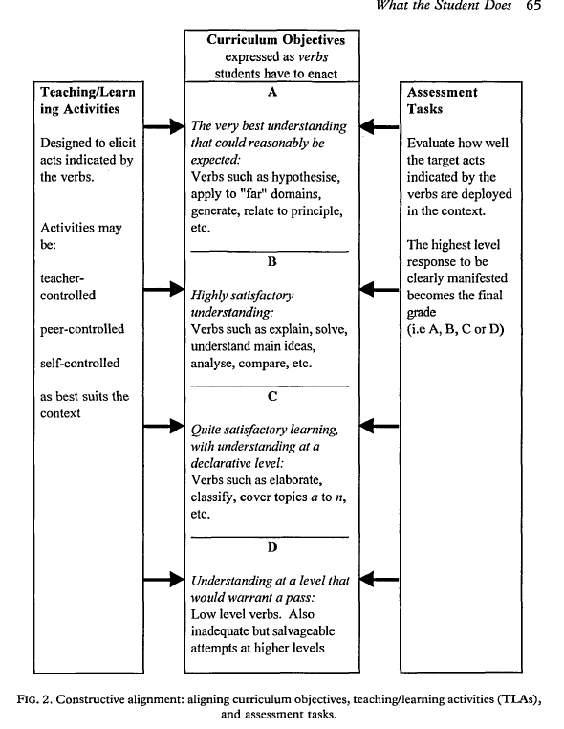
‘The categories are defined by a particular quality of learning and understanding that suits the unit in question, not by the accumulation of marks or percentages. The
assessment tasks, embodying the crucial verbs, denote whether the quality in question is pre
sent or not.’ (p. 66)

Slide 23
Aligning objectives, teaching and assessment
‘The very highest levels of understanding that we want students to display by the end
of a degree program—and in some cases very much before the end—are
"performative"; that is, students act differently when they really understand (Perkins
& Blythe, 1993). Students need to understand to the extent that a particular sector
of their world has changed, and is now coming under their control. They behave
differently towards that which they truly understand. Capturing that difference in
an assessment task is what Perkins and Blythe mean by "performances of understanding".’ (p. 66)

Slide 24
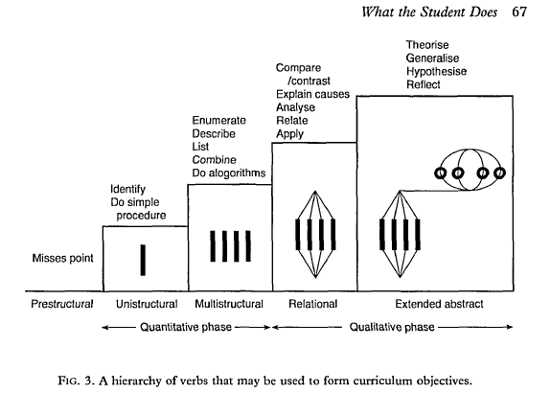
SOLO/Blooms Taxonomy

Slide 25
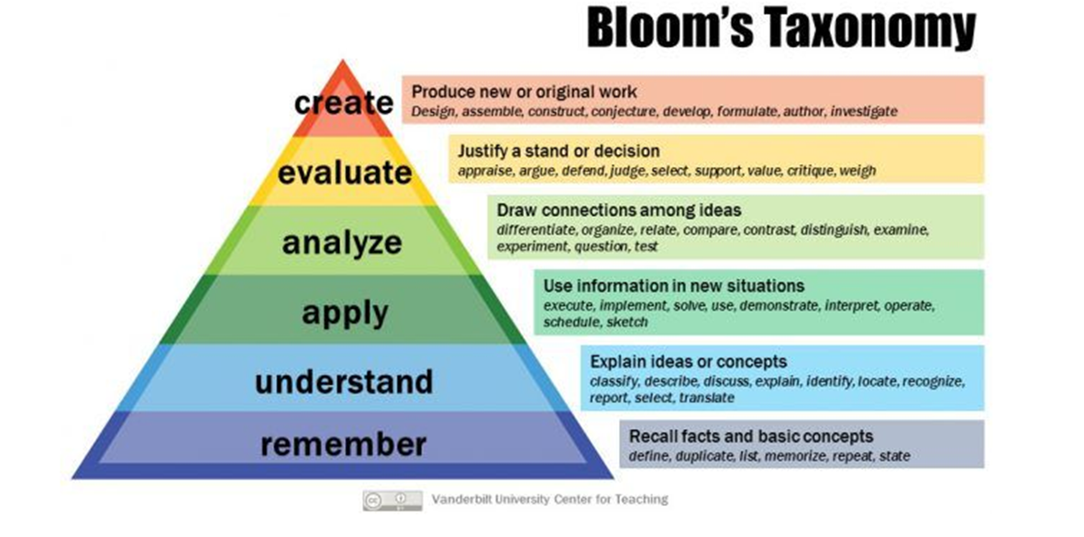

Slide 26
Selecting TLA’s
‘The next step is to set up the teaching/learning context so that students have every encouragement to react with the level of cognitive engagement that the objectives require’ (p. 67)
‘Certainly, students need to know about important concepts, and lecturing is not a bad way of letting them know, but there are better ways’ (p. 67)

Slide 27
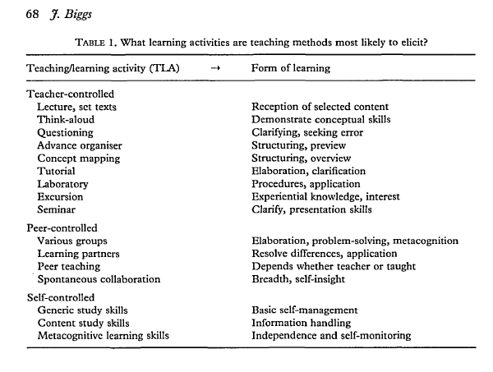

Slide 28
Assessment tasks
‘Assessment in practice has two functions: to tell us whether or not the learning has been successful, and in conveying to students what we want them to learn, as stated by Ramsden (1992): From our students' point of view, the assessment always defines the actual curriculum (p. 187).
Backwash from assessment is not a problem, it is the solution. In a criterion referenced
system, the objectives are embedded in the assessment tasks. So, if students focus on the assessment, they will be learning what the objectives say they should be learning. It is only when the assessment tasks elicit lower level cognitive activities than the objectives nominate that backwash gets a bad name.’ (p. 68)
‘Lack of alignment is a major reason why students adopt a surface approach to learning. Poor alignment often results from such institutional policies as requiring assessment results to be reported in percentages or "marks", or requiring results to be distributed along a pre-determined curve. The first can be mitigated by assessing qualitatively but reporting quantitatively, but the second is crippling. There can be no educational justification for grading on a curve.’ (p. 69)

Slide 29
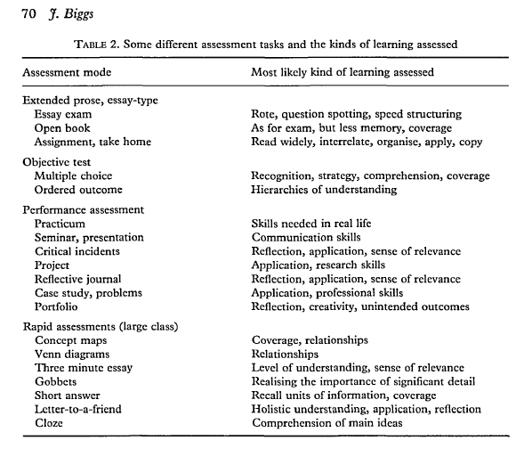
Assessment tasks
‘Criterion-referenced assessment in the constructive alignment model requires
assessment tasks that are likely to elicit the learning verbs that are stipulated in the objectives’. (p. 69).

Slide 30
Summary
In an aligned system of instruction, the teacher's task is to see that the appropriate
verbs are:
1. Nominated in the objectives.
2. Likely to be elicited in the chosen TLAs.
3. Embedded in the assessment tasks so that judgments can be made about how
well a given student's level of performance meets the objectives.
Because the teaching methods and the assessment tasks now access the same verbs
as are in the objectives, the chances are increased that most students will in fact
engage with the appropriate learning activities. This is, by definition, a deep
approach.

Slide 31
11:00 Group Discussion – Which pedagogies are we working with in our projects

Slide 32
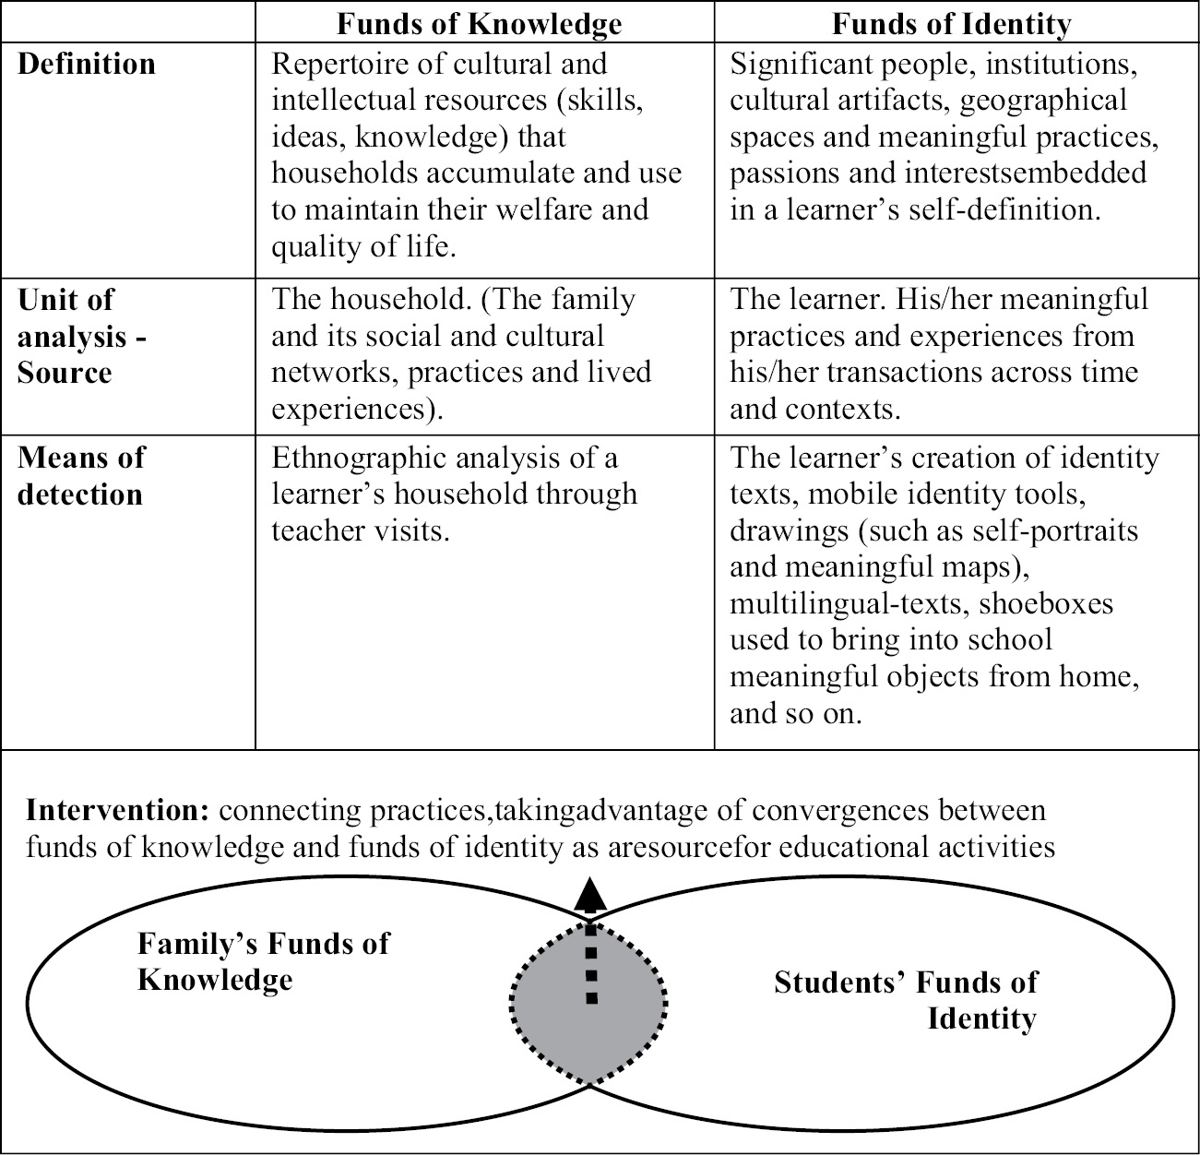
Discussion: Funds of knowledge
In what ways can connecting with the lifeworlds of students & drawing on the resources/knowledges of students support interventions for increased engagement or quality?

Slide 33
In a nutshell….
Moll, Amanti, Neff and Gonzalez 1992 define ‘funds of knowledge’ as the “historically- accumulated and culturally-developed bodies of knowledge and skills essential for household or individual functioning and well-being’’ (p. 133). Thus, it is the knowledge and skills that students develop from their home and community experiences and connections.
Using the knowledge gained from students' life-worlds to build curriculum and consider when planning for learning experiences.
“The funds of knowledge approach is based on a simple premise: regardless of any socioeconomical and sociocultural ‘‘deficit’’ that people may or may not have all families accumulate bodies of beliefs, ideas, skills, and abilities based on their experiences (in areas such as their occupation or their religion). The challenge consists in connecting these bodies of educational resources with teaching practice in order to connect the curriculum with students’ lives. “ (Gutart and Moll p.43)

Slide 34
Themes
Understanding socio-political context of households & communities
Building socio-cultural competence
Trust
Anti-deficit – not focusing on disadvantages of students and not lowering standards
Ideological clarity
Agency
Educational sovereignty
Cross-class networks – middle class teachers
Development of social networks with other households to exchange resources/FoK
‘Transforming students’ diversities into pedagogical assets may be the foremost educational challenge for the future’ (Moll & Gonzales 1992).

Slide 35
Motta, S. C., & Bennett, A. (2018). Pedagogies of care, care-full epistemological practice and ‘other’ caring subjectivities in enabling education. Teaching in Higher Education, 23(5), 631-646.
The affective turn in education as critique of neo-liberalism (discourses of neoliberalism encourage dispositions of competitiveness, individualism, personally profitable exchanges)
'It shines a light on the hegemonic masculinities, which attempt to dissociate teaching and learning from emotion and the embodied' (Motta & Bennett, p. 633)
Dominant construction of teachers' work in HE is to keep 'emotion' out of teaching

Slide 38
Care/carelessness
As Lynch argues (2010, pp. 59-60) 'Caring, and the associated subject of emotional work, have been trivialised and dismissed in philosophy and intellectual thought...The difference between the past and the present is that carelessness was an unnamed assumption in the past; now it is not only accepted, it is expected and morally endorsed' (Motta & Bennett 2018, p. 635).
Can you identify this emphasis on carelessness in the academy as described in this quote?

Slide 39
Care as recognition
'Care as recognition manifests as care-full pedagogical practices which acknowledge the complexities and wisdoms of students that come, often following on from experiences of exclusions and misrecognitions within other forms of education, training and employment' (Motta & Bennett 2018, p. 636)
Strengths based knowledge-making practices
Embrace the whole student
Recognising capacity and capability of the student

Slide 40
Care as dialogic relationality
'The epistemological commitments of care in Enabling ae valued and foregrounded programmatically, rather than considered an individual teacher's emotional approach or disposition as a 'caring' teacher' (p. 640)
'What became clear is a commitments to an ethics of practice based on reflexive re/development which was dialogical in contra-distinction to the monological logics prevalent in hegemonic performances of the teachers in HE' (p. 640).
Scaffolding learning
Narrative practice
Multi-literacies
Real world examples
Not just about content
Listening
Not judging

Slide 41
Care as affective and embodied praxis
'Attention to the affective and embodied elements of pedagogies of care and their relationship to creating careful epistemological work was manifested in the attentiveness that educators paid to the time-spaces of teaching and learning, in terms of fostering feelings of safety and belonging...' (p. 642).
Taking time to make students feel comfortable
Engagement at the visceral level
Emotional labour outside of formal teaching time
Non-judgemental language and tone
Encouraging
Setting up space so its non-threatening and dialogical

Slide 42
Guiding Questions
What are the key take-away points made for your teaching in HE?
What are the challenges of being a 'caring teacher' in university?
If the presupposition is that care-full pedagogies are more than just dispositions of the 'caring' teacher, what are other examples?
How can we challenge the hegemonic discourses of the university so that caring work is attributed with a higher status and value?
What hopeful ideas can we generate about possibilities for increased care?

Slide 43
Guiding Questions
How do you perceive pedagogic care in higher education?
How do you see care manifesting itself at various levels simultaneously?
What do you see as the place of relationships, especially caring ones, within higher education?
What are your reflections on 'care as resistance' and 'caring as less than'

Slide 44
Walker & Gleaves seek to understand ‘how teachers in higher education perceive pedagogic care and as such, establish a caring environment in their teaching and learning – in other words, how they become and exist as ‘caring teachers’ (p. 67)
Caring practices versus caring attributes

Slide 45
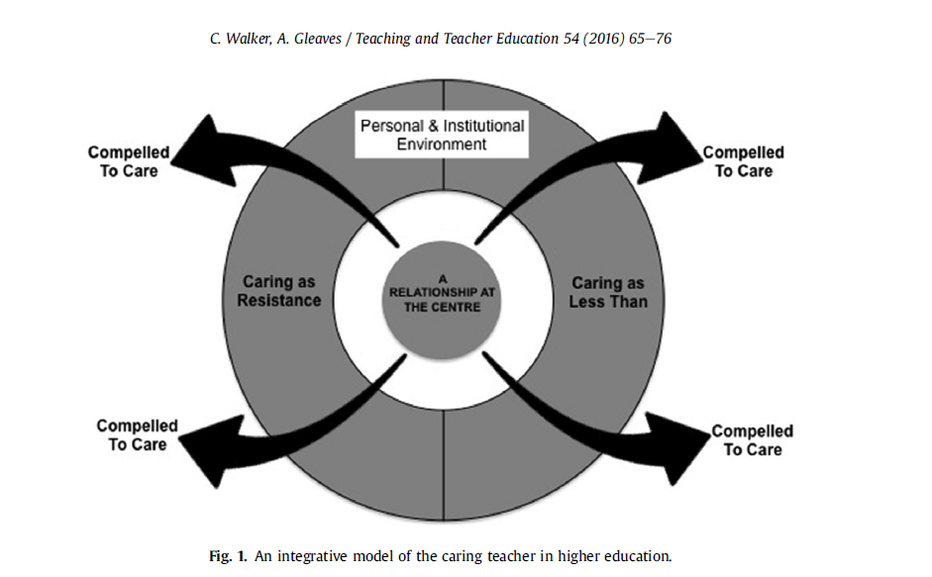

Slide 46
Ethics
How are we going with our project variation forms?

Slide 47
Next steps
Edit ethics protocol to align with your project
Start your re-design of teaching and learning task or assessment
Keep reading literature in your area (pedagogy or other…)
Refine templates and review examples on the resource site

Slide 48
Questions?

