Slide 1
Tutor Training
February 2019
UniSA College
Belonging, Effective Learning & Supporting Students with a Disability

Slide 2
Plan for workshop
Welcome & Introductions
Head of UniSA College, Associate Professor Sharron King
Session 1: Capability and Belonging
Presenter – Sarah Hattam (Diploma Program Director & Lecturer Critical Thinking & Global Issues and Identities)
Session 2: Understanding to be understood: teaching and learning nexus in class
Presenter – Min Pham (Lecturer Foundations of Education & English Language Studies)
Session 3: How to respond to students presenting with risk including concerning, inappropriate and unacceptable behaviours
Presenter – Nadia Rajic (Manager of Student Wellbeing at the Student Engagement Unit)
Drinks and nibbles

Slide 3
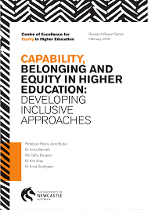
Session 1: Capability and Belonging
Presenter – Sarah Hattam (Diploma Program Director & Lecturer Critical Thinking & Global Issues and Identities)
‘Sensibilities of belonging are formed in relation to constructions of capability; to belong in a field such as higher education, the student must be recognised as having the capability to belong’ (Burke et al 2016: 19).
‘In a 2011 study of 3091 commencing students at 3 SA universities, only 35% of students agreed with the statement I am a capable student and expect to do well at university’ (Scutter et al cited in Burket et al 2016: 11).

Slide 4
I would like to start with two questions…
When you were a student, how important was it for you to feel that you belong at university?
When you were a student, how important was it for you to feel that you were ‘smart’ enough to be at university?
***I am aware that some of you are currently doctorate students, or recently completed PhD’s, so this may be a current emotion.

Slide 5
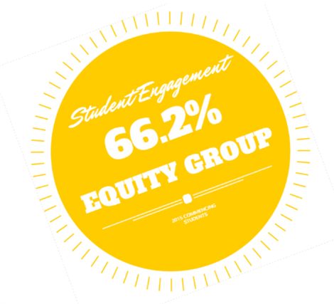
Framing of student success can be problematic…
It highlights the commonality and significance of students negative feelings about their academic ability.
Often it is students from equity groups who are perceived as lacking ‘capability’ to be successful at University; or who have the strongest feelings that they do not belong:
People who are Aboriginal and/or Torres Strait Islander
People from low-socioeconomic (SES) backgrounds
People with a disability
People from NESB
Newly arrived migrants
People from regional and remote areas
Provides us the opportunity to explore how we can create inclusive pedagogical environments in which trust is established and belonging is fostered (Burke et al 2016: 7)
Burke et al’s study into constructions of capability and the impact this has on a students sense of belonging in higher education is relevant for our teaching at the College for a number of reasons:
Highlight the deficit framing of capability to consider alternative framing that we can use in our teaching.

Slide 6
Why is this research important for us at the College?
Students relationships with their tutors deeply shape their pedagogical participation and the quality of their learning… a tutors level of approachability has a significant impact on students confidence in asking questions in tutorials and seminars (Burke et al 2016: 43).
Students’ feelings of belonging are connected to their relationship with their tutors (Burke et al 2016: 45)
Students transitions to university are often fragile, particularly if they have had previous experiences of education which have created a sense of ‘incapability’. Students come to university with a range of educational experiences and expectations and are deeply sensitive to their own position as a university student (Burke et al 2016: 43).
Nuanced account of capability:
Through pedagogical strategies, students capability is not seen as fixed or innate but as something that might develop over time (Burke et al 2016: 43).

Slide 7
Problematic constructions of capability…
‘A lack of awareness about assumptions that operate at the front-and-centre of what it is to be considered capable at university’ (Burke et al 2016: 28)
‘Love of learning’
Time management
‘Right’ attitude
Following instructions
Prioritising study, its value and worth
Willing to work hard and do what is expected
Being smart/intelligent

Slide 8
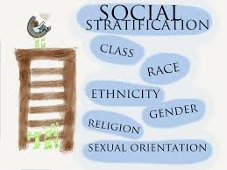
Constructions of capability
Assumptions about SES and ethnicity
Yeah, students who looked a little bit low SES, they didn’t look like they were going to achieve. I don’t know if they did or didn’t. But just that was – yeah, and a lot of the ethnic students, depending on what ethnicity, that also was a major factor in what people thought in terms of whether they were going to achieve or do really well. (student quote, Burke et al 2016: 28)
What is the basis of the assumption regarding success at university linked to social class and ethnicity, where does this come from?

Slide 9
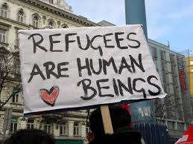
Constructions of capability
Specific cultural issues – refugee background
So they might have a large family that they are part of that in their culture it is part of their responsibility to look after the younger members of the family. …Often they report that their families don’t understand the responsibility that students have to their study and that for them to succeed they need to sometimes give priority to their study over things that happen with their family.
A lot of students that I work with have been given the identity of refugee kid since they’ve been here. You know. ‘You’re that problematic refugee kid’ and how do you move away from that? (teacher quote, Burket et al 2016: 30)

Slide 10
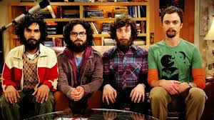
Constructions of capability
Intelligence
I’ve felt dumb all my life and I thought uni was out of my reach. Only smart people – not people like me – went to uni. Yeah…that probably came from my parents. I was always told I was dumb and useless when I was a kid. I remember when I was at school I was in Year 10 and I wanted to go onto Year 12 and I said to my mum – I said ‘I want to go onto Year 12’ and she said ‘No’. She said ‘You’re too dumb for that, go and get a job’ and it always stuck in my mind…I mean, I was told I was dumb all my life so I thought I was dumb. (Student quote, Burket et al 2016: 30).

Slide 11
Misrecognition
Watch the film and reflect on the questions provided on the resource sheet:
https://www.equityhe.com/
Did the students’ accounts resonate with your own experiences of higher education in any ways?
What are the discourses of capability that are at play in the students’ accounts? Do you recognise these discourses in the contexts in which you work?
How do constructions of capability play out differently in different disciplines/subject areas? What are the equity issues this raises?
What might be some of the pedagogical challenges raised by the students’ accounts? How might such discourses be challenged? How might teaching and/or equity practices help develop a student’s sense of capability

Slide 12
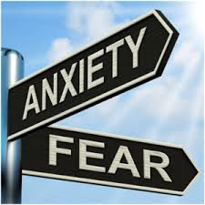
Manifestations of these constructions
Fear and anxiety of being seen as incapable
Arguably those students associated with equity policies and discourses are most at risk of being perceived as ‘undeserving’ and ‘unworthy’ of higher education participation due to the ways that widening participation tends to be connected to anxieties about lowering of standards (Burke et al 2016: 42).
The injuries of misrecognition are often embodied, through the internalisation of shame and self-denigration and the fear of not being ‘good enough’ (Burke et al 2016: 42).

Slide 13
Feelings you don’t belong at university
Legitimisation as a ‘proper’ and ‘deserving’ student of higher education centres on discourses of belonging (Burke et al 2016: 44).
Notions of capability are inextricably tied to such practices, so that those who come through ‘alternative’ routes are already entangled in discourses that construct them (non-traditional students) as lacking capability, because they have not succeeded in achieving an appropriate ATAR score (Burke et al 2016: 44).

Slide 14
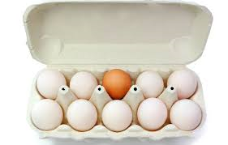
Belonging
Now let’s watch the second film on theme of ‘belonging’ and refer to the resource sheet:
What are the issues around equity that the film raises?
Did the film touch on any memories of institutional spaces in which you or others have experienced a sense of not belonging?
How might universities nurture spaces and feelings of belonging and capability for their students?
What challenges do students’ ‘feelings of not belonging’ raise for developing equitable and inclusive spaces (virtual and physical)?

Slide 15
Pedagogical spaces and practices
Drawing on the section of the report on pedagogical approaches that foster a sense of belonging and capability, in your groups develop a list of practices that you may take into the classroom this study period.
How might you build the confidence levels of the students in your tutorials?
How will you assist students to overcome a fear of failure?

