Slide 1
Some considerations around surveys
Chris Deneen
Researching while Teaching
Monday 15 April 2024

Slide 2
Big picture: Methodological frameworks
Epistemic/Ontological stance
‘This is how I conceptualise and validate ways of knowing/being’
Qualitative, quantitative, both, mixed
Surveys?
Action research
Self-study

Slide 3
You get what you ask for
At their absolute best, surveys unlock what respondents want to tell us, based on their understanding.

Slide 4
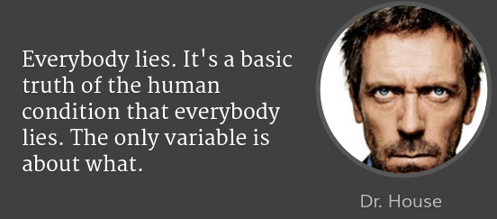
The House Effect
Accuracy vs. truth
When are people most/least likely to provide
Accurate answers?
Truthful answers?
What are the implications of this for the items we use on our surveys?
…but is it a lie if someone believes it’s true? Conversely, does something become true if a person believes it?

Slide 5
Understanding these concepts through a quadrant model
We tend to think survey responses in only one quadrant are valuable. Not true!
We can learn a great deal when participants’ responses
deviate from a ‘normative’ understanding, and/or
seem to be misleading
But we must be able to accurately frame responses
Truthfulness
They believe this, but their belief is inaccurate
They believe this, and that belief is accurate
They don't believe this, and their response is inaccurate.
They don't believe this, but it's the 'right' answer.
Accuracy

Slide 6
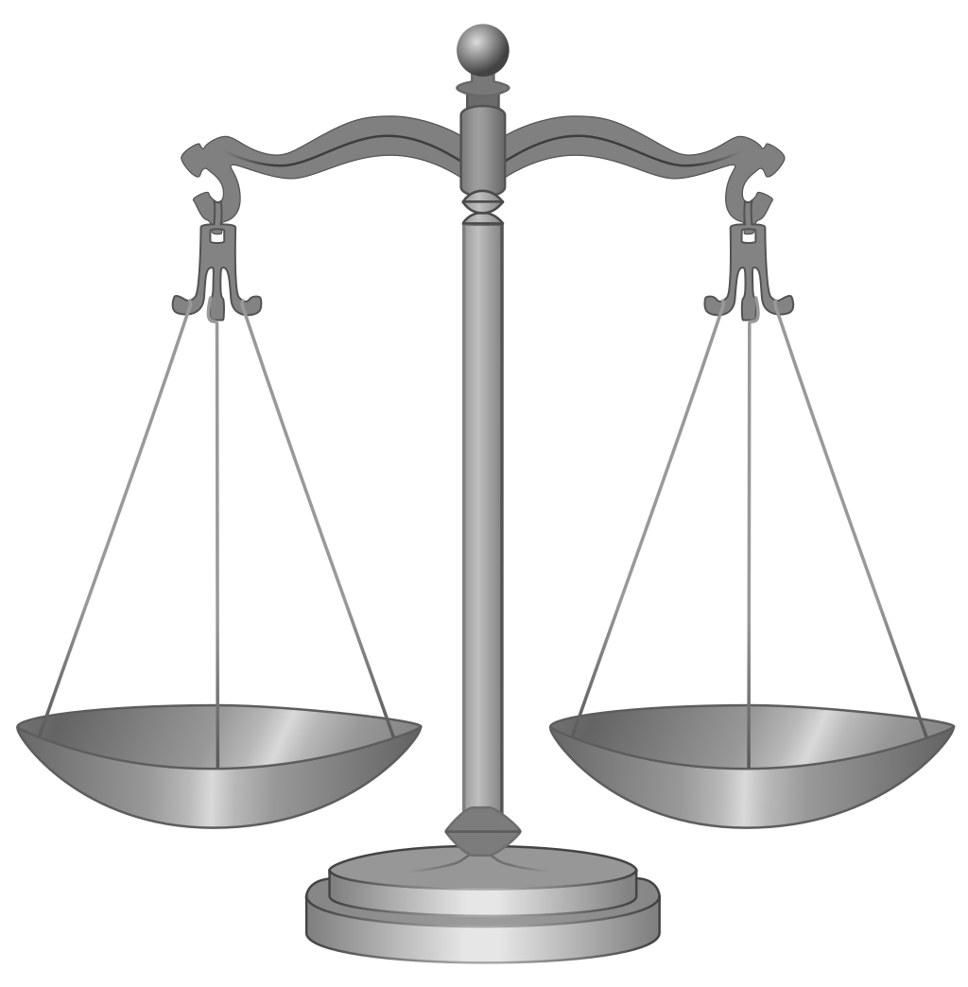
Open vs closed response items
Myth-busting: ‘Quantitative items are inherently more objective/factual/valid’
The operational and interpretive rules of quant can be stricter, but this assumes people follow those rules. Ex: p values & fit statistics
Objectivity is part of an epistemic stance, not an item choice (i.e. open vs. closed)
Consider the trade-offs

Slide 7
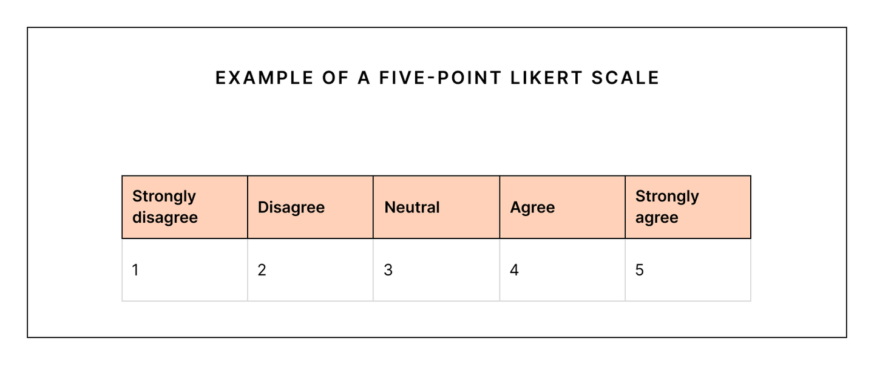
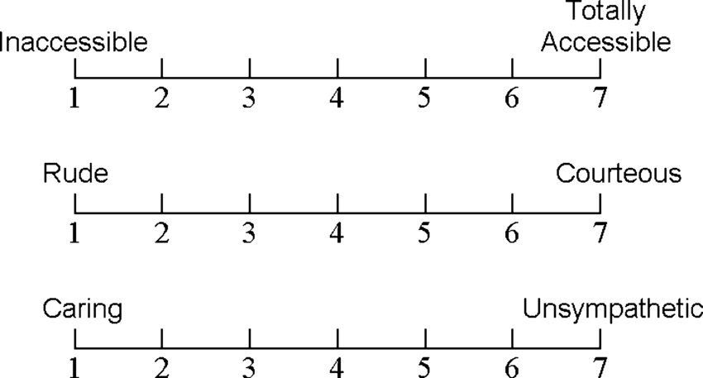
Scales: Likert vs semantic differential
Again, it’s about trade-offs
What, in the balance, works best for the kind of answers you desire?

Slide 8
A few quick words on scales
Let's look at some examples and techniques
A few basic rules
Use only the number of scale points necessary
Match the nature of the scale to the nature of the item(s)
Understand what each point on the scale means, and communicate this, clearly to everyone.
Acknowledge that ‘true measurement’ and ‘perfect intervals’ are aspirational… and adjust expectations, accordingly.

Slide 9
Surveys: Some best practices
Designing
Concept first, item second
Ask the same concept a few ways
Validate/pilot
Deploying
Make it as easy as possible to answer fully and correctly
Draw from your bushel of carrots and your bundle of sticks
Use dress rehearsals and critical friends
Even when we follow the rules, sometimes things get… scary.

Slide 10
Tales of research terror: ‘The Item 8 incident’
My hair-raising experience deploying an in-service teacher survey in Singapore.
I have come to (re)think a lot of my feelings on this experience
Acknowledging our accountability: Collecting data is a meaningful, performative act. It may engage, challenge, or even violate social, cultural, or personal beliefs.
What would you do have done?

Slide 11
Thank you
Chris Deneen

