Slide 1
Scholarship of Teaching and Learning Workshops Education Futures, UniSA Workshop #3 – Redesigning your pedagogy 13th May, 9.00–12.00
Notes:
TW

Slide 2
Acknowledgement of Country
We respectfully acknowledge the Kaurna, Boandik and Barngarla First Nations Peoples and their Elders past and present, who are the First Nations’ traditional owners of the land that are now home to the University of South Australia’s campuses in Adelaide, Mount Gambier and Whyalla.

Slide 3
Plan for session
9.00 Acknowledgment of Country and introduction
9.10 Report back – where are we all up to? (2 minutes each)
9.30-10:00 Presentation: Example of hopeful ideas (Professor Robert Hattam)
10:00-10:15 Morning tea
10.15 – 11:00 Discussion: Your refined hopeful idea?
Task: In small groups, discuss how your research question/hopeful idea has developed (what’s your theory?)
Share to larger group
11:00-11:30 Discussion: Funds of knowledge theory (as per readings)
Discussion: In what ways can connecting with the lifeworlds of students & drawing on the resources/knowledges of students support interventions for increased engagement or quality?
11.30-12:00 Presentation: Introduction to Action Research (Professor Robert Hattam)
12.00 Close

Slide 4
Recommended Readings
Moll, L. & Arnot-Hopfer, E. 2005. Sociocultural competence in teacher education, Journal of Teacher Education, Vol. 56, No. 3, 242-247.
Moll, L. & Gonzalez, N. 1992. Teachers as Social Scientists: Learning about culture from household research.
Gonzalez, N. Moll, L. Tenery, M. Rivera, A. Rendon, P. Gonzales, R & Amanti, C. 1995. Funds of knowledge for teaching in Latino households, Urban Education, Vol. 29, No. 4.

Slide 5
Moll & Arnot-Hopffer hopeful idea
….in teacher education, it does well to always remember that power never goes unchallenged, it always produces resistance and contestation; and schools are not fixed or immutable entities, they are built environments, socially produced and recreated through the actions of human beings, especially teachers, who ultimately must find ways to participate in and mediate their realities for the benefit of the children they teach, even when those realities include significant constraints (2005, p. 246)

Slide 6
9:10 – 9:30 Report back
Task: 2 Minute Thesis – where are we all up to?
Share in the larger group

Slide 7
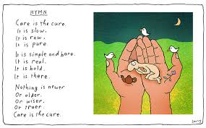
9:30-10:00 Presentation by Professor Robert Hattam: Example of Hopeful ideas

Slide 8
10.00-10:15 Morning tea

Slide 9
10:15 – 11:00 Your refine hopeful idea?
Task: In pairs groups, discuss how your research question/hopeful idea has developed (what’s your theory?)
Share to larger group

Slide 10
Apathy, boredom or misunderstood? Engaging students in the politics of language and the language of politics in a critical literacy course
1. The enabling approaches of scaffolding, setting challenging tasks, supporting democratic teaching and learning spaces and connecting with lifeworlds would increase students engagement with and understanding of ‘politics’ and provide the students with greater understanding of the way that language is utilised to promote a world view (such as progressive/conservative) in the media.
2. Students experience empowerment in their future engagement with texts as they develop awareness of dominant forces in society and helps students to recognise, critique and create change and to give power over the meaning-making process.
3. Paying attention to the affective domain, students could move past discomfort, disconnection and political apathy and engage with political categories and themes in the course to develop an insight to how people and issues are positioned by these categories.

Slide 11
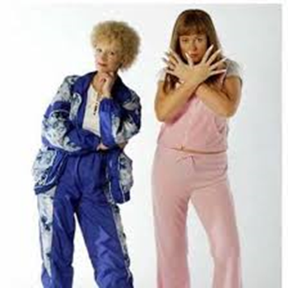
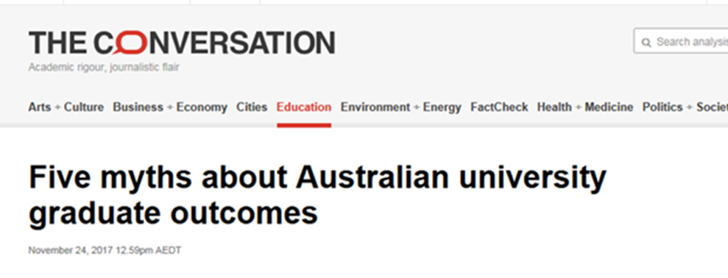
Intervention
Setting ‘challenging tasks’ earlier on as part of the curriculum produced greater confidence with and higher grades overall for the assessment.
Scaffolded approach to introducing different political worldviews with the inclusion of popular culture and examples that spoke to their lifeworlds across a number of weeks.
I conducted a case study of important issues facing students today with a focus on graduate outcomes; costs of education and surviving while studying and asked ‘how are these issues framed or problematised in the media, analyzing the worldview represented in the framing’.

Slide 12
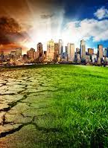
Intervention
Another key intervention involved re-designing the curriculum so students are encouraged to select their own topic for assessment two that enhances the ‘democratic’ element (Shor 1992) in the course.
The students are asked to pick a topic they are passionate about and to find a media text on the topic (some examples of popular topics were domestic violence, mental health, climate change). This also provide opportunities to tap into their ‘lifeworlds’, as they explored a topic that connected with them personally.
As a group we mapped out how these issues they are interested in could be influenced by whether government chooses to legislate or support through policy or provide adequate resources.
Notes:
This was an instrumental part of the learning process in week two of the course, as I began to see a shift in the discussion from expressing views such as ‘I think politics is boring’, or ‘what does it have to do with me’, to a realization that ‘politics is everywhere’ (ref) and the topics they have selected and are discussed in the media texts are often highly contested in political spaces. Most importantly, the students could begin to identify that language was being used to persuade the reader to adopt a particular stance that linked to a progressive or conservative worldview.

Slide 13
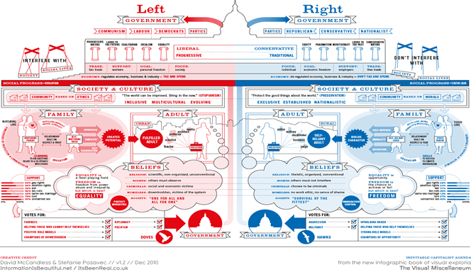
Intervention
I implemented a range of digital media clips in the curriculum that engaged the students in thinking about the different political worldviews, with positive outcomes as featured in this comment: ‘the clips played in the classes were quite helpful (Student comment, MCE 2019).
In the curriculum I also added a number of examples of left/right political worldviews with visual representations (figure 1) compass.

Slide 14
Outcomes
‘Hopeful idea’ number one was brought to fruition, as the student feedback demonstrated an increased understanding of ‘politics’ and the way that language is utilised to promote a world view (such as progressive/conservative) in the media.
‘Before starting this course, I had very little understanding of politics, despite many people attempting to explain the concept to me in the past. I certainly had no idea political bias exists in the media. I’m now not only aware it exists, but I am able to identify it’ (Student feedback, Survey 2019).
This skepticism is echoed in this student comment ‘I am definitely better at recognizing and identifying worldviews and now have a more skeptical approach to consuming media as well as a bigger interest in politics’ (Student feedback, Survey 2019).
Another student reflects on their increased confidence: ‘Before this course I stayed in a bubble and had no ideas about politics. After doing this course I have found myself watching the news and to try and follow what is happening…I feel more confident about understanding what I watch, read and listen to’ (Student feedback, Survey 2019)..

Slide 15
Another student reflected ‘I was unaware of how much minorities were not represented in the media. I previously never thought much about the voices that were excluded’ (Student feedback, Survey 2019). ‘Seeing biased articles and news had always upset me, but being able to identify methods of bias and manipulation and poor research makes it easier for me to understand’ (Student feedback, Survey 2019).
Outcomes
Other students reflected on how the course assisted their understanding of politics more broadly; ‘I finally understand what political parties stand for and what they try and do. Do I like politics….NO! I think most of them are dumb. However, the course has helped me understand what the media and politics is trying to do (Student feedback, Survey 2019).
My interest in politics has not changed. I still don’t have a view on it but now when I see the media exposing it, I do look up key words on the topic to gain a better understanding about what the media was wanting to expose’ (Student feedback, Survey 2019); ‘I never really had a thought when it came to politics, however with media I have learnt not to also rely on what is being shown without looking it up with evidence’ (Student feedback, Survey 2019)
Notes:
This suggests the student has developed the knowledge and awareness of how the media manipulates and persuades its audience to adopt specific viewpoints, that link to the representation of specific political interests of particular groups of people.
This reflection demonstrates a shift from apathy or boredom with ‘politics’ to an increased interest and awareness of how the political machinery impacts their life personally.

Slide 16
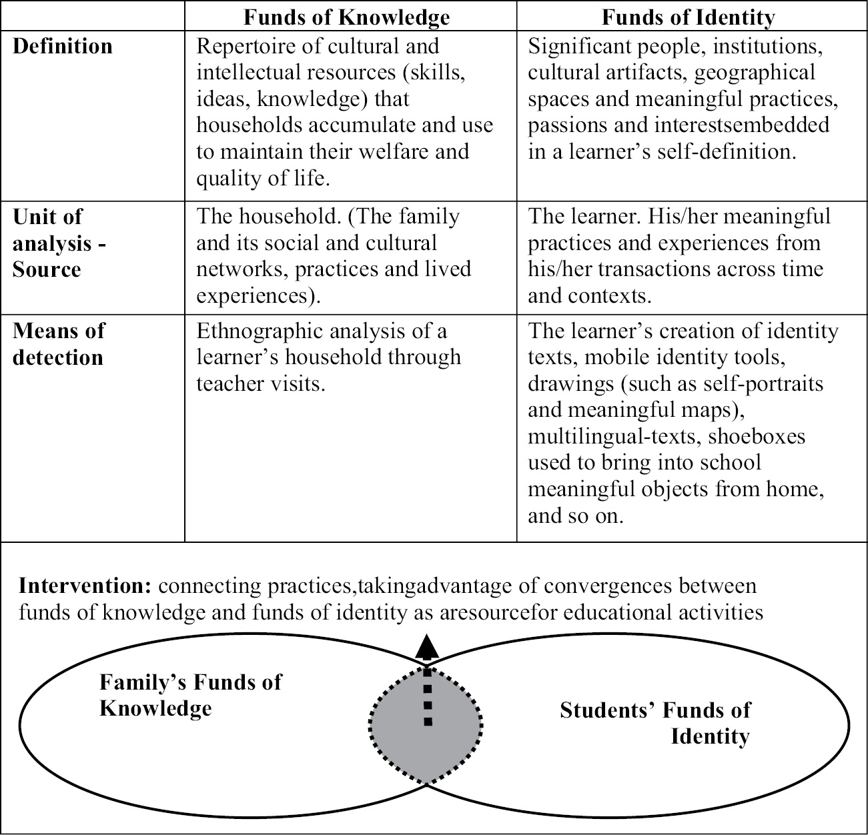
11:00-11:30 Discussion: Funds of knowledge (as per the readings)
In what ways can connecting with the lifeworlds of students & drawing on the resources/knowledges of students support interventions for increased engagement or quality?

Slide 17
Themes
Understanding socio-political context of households & communities
Building socio-cultural competence
Trust
Anti-deficit – not focusing on disadvantages of students and not lowering standards
Ideological clarity
Agency
Educational sovereignty
Cross-class networks – middle class teachers
Development of social networks with other households to exchange resources/FoK
‘Transforming students’ diversities into pedagogical assets may be the foremost educational challenge for the future’ (Moll & Gonzales 1992).

Slide 18
In a nutshell….
Moll, Amanti, Neff and Gonzalez 1992 define ‘funds of knowledge’ as the “historically- accumulated and culturally-developed bodies of knowledge and skills essential for household or individual functioning and well-being’’ (p. 133). Thus, it is the knowledge and skills that students develop from their home and community experiences and connections.
Using the knowledge gained from students' life-worlds to build curriculum and consider when planning for learning experiences.
“The funds of knowledge approach is based on a simple premise: regardless of any socioeconomical and sociocultural ‘‘deficit’’ that people may or may not have all families accumulate bodies of beliefs, ideas, skills, and abilities based on their experiences (in areas such as their occupation or their religion). The challenge consists in connecting these bodies of educational resources with teaching practice in order to connect the curriculum with students’ lives. “ (Gutart and Moll p.43)

Slide 19
Funds of identity
“We use the term funds of identity to refer to the historically accumulated, culturally developed, and socially distributed resources that are essential for a person’s self-definition, self-expression, and self-understanding. Funds of knowledge—bodies of knowledge and skills that are essential for the well-being of an entire household—become funds of identity when people actively use them to define themselves. “ (Guitart and Moll, p. 31)
“In our view, funds of knowledge become funds of identity when people actively internalize family and community resources to make meaning and to describe themselves.”
“It could be argued that students learn and remember new information best when it is linked to relevant prior knowledge, specifically ‘‘prior funds of identity.’’ Understanding the student’s funds of identity helps teachers to select the appropriate instructional materials and to connect the curriculum content to student’s culture, identity, and experience. Encouraging the learning of new funds of identity is an instructional task that occurs between children and adults outside of school, and students and teachers inside of school. “ (Guitart and Moll p.44)

Slide 20
Dark funds of knowledge
“vital matter of social-educational justice to continue the work of making lifeworld “funds” richly and deeply curricular” (Zipin 2009 p. 330)
Zipin (2009) observes the curriculum being developed around the ‘light’(positive) knowledge, but not the ‘dark’(negative), of student’s lifeworlds.
“focus on positive solutions, combating a ‘depressed’ sense that there may be no solutions.”(Zipin p. 321)
“In letting dark sides of students’ lives into articulate classroom consciousness, ‘normal’ themes of instituted curricula now seem like ‘going through the motions’ and avoiding ‘big questions’ that could vitalise curriculum.” Zipin, p321

Slide 21
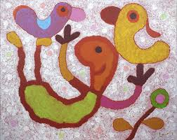
11:30-12:00 Presentation Professor Robert Hattam : Introduction to Action Research
12:00 Homework & Close

