Slide 1
Scholarship of Teaching and Learning Workshops Education Futures, UniSA Workshop #2 – Provocation of teaching challenge(s) and hopeful idea(s)
Notes:
TW

Slide 2
Acknowledgement of Country
We respectfully acknowledge the Kaurna, Boandik and Barngarla First Nations Peoples and their Elders past and present, who are the First Nations’ traditional owners of the land that are now home to the University of South Australia’s campuses in Adelaide, Mount Gambier and Whyalla.

Slide 3
Plan for session
9.00 Acknowledgment of Country and Introduction
9.15 Sharing your pedagogical challenge
Task: In small groups, discuss (i) What are your pedagogical challenge[s]
Share in the larger group
10:00 Presentation: Turn–around pedagogies
10.15 Morning tea
10.30 Presentation: Examples of hopeful ideas used in action research
10.45 Discussion
11.00 Share your own hopeful ideas
Task: In small groups, discuss (i) What are your pedagogical challenge[s]
Share in the larger group
12.00 Close

Slide 4
Recommended Readings
Comber, B. & Kamler, B. (2004) 'Getting Out of
Deficit: Pedagogies of reconnection', Teaching Education, 15:3, 293 — 310.
Prosser, B., Luca, B., Reid, A. (eds) (2010) Connecting Lives and learning: renewing pedagogy in the middle years, Wakefield Press, SA.

Slide 5
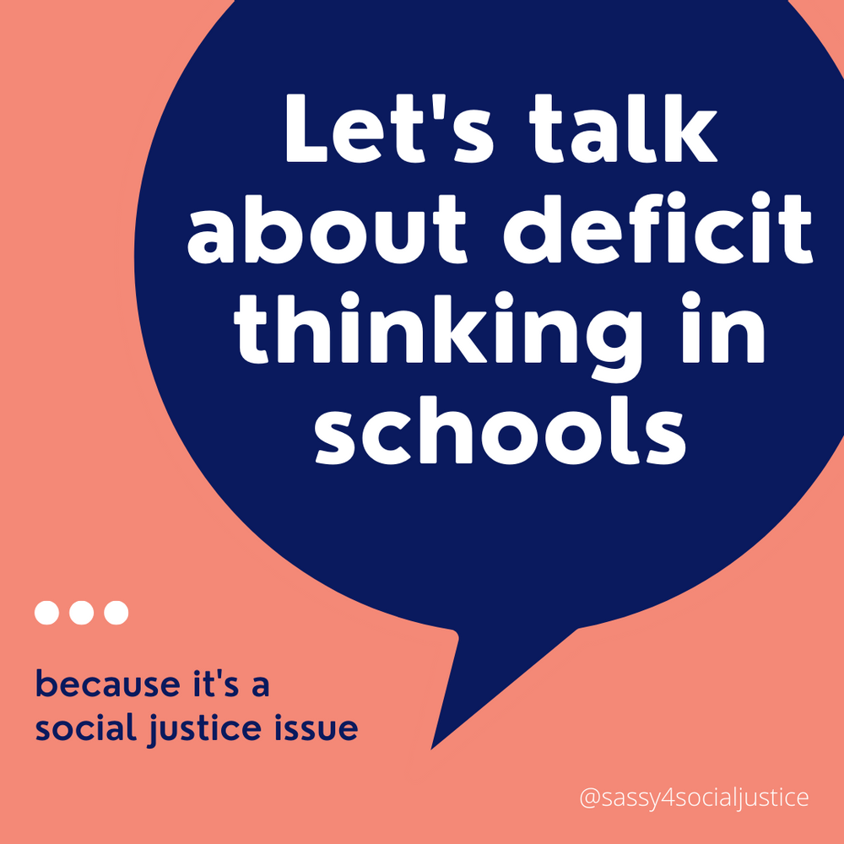
Comber, B. & Kamler, B. (2004) 'Getting Out of
Deficit: Pedagogies of reconnection', Teaching Education, 15:3, 293 — 310.
But one thing is clear. These teachers, Marc and Nola, and their colleagues will never again take educational failure as inevitable. It is not that Marc and Nola have some riddle solved once and for all, but they have assembled a sociological and analytical perspective on their teaching that allows them to address new challenges differently (p. 308).

Slide 6
Prosser, B., Luca, B., Reid, A. (eds) (2010) Connecting Lives and learning: renewing pedagogy in the middle years, Wakefield Press, SA.
Yet, both the current generation and of (soon to retire) teachers and the next generation of teachers to follow are faced with choices. Do we say its all too hard and continue as we have, or do we respond to the challenges by attempting more sustainable and innovative pedagogical practices? Do we accept the inevitability of inequity, exclusion and failure, or do we seek better opportunities and futures for our students and their communities? Do we locate the challenge in some deficit quality of the student rather than in our pedagogy, and in so doing, condemn our best pedagogical efforts (and ultimately our role as teachers) to irrelevance (p. 2)

Slide 7
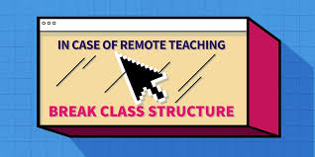
9:15 – 9:40 Sharing your pedagogical challenge
Task: In pairs, discuss (i) What are your pedagogical challenge[s]. This may be the same challenge as last time that is further refined by your thinking/reading or a different challenge.
9:40 – 10:00 Share in the larger group

Slide 8
10:40-10:50 Presentation by Professor Barbara Comber on Turn-around Pedagogies

Slide 9
10.50 Presentation by Professor Robert Hattam: Examples of hopeful ideas used in action research
11:00 – 11:15 Discussion

Slide 10
11.15-11:30 Share your own hopeful ideas
Task: In pairs, discuss (i) What are your hopeful idea[s] in relation to overcoming your teaching challenges.
11:30 Share in the larger group
11:50 Concluding remarks and homework

Slide 11
Apathy, boredom or misunderstood? Engaging students in the politics of language and the language of politics in a critical literacy course
1. The enabling approaches of scaffolding, setting challenging tasks, supporting democratic teaching and learning spaces and connecting with lifeworlds would increase students engagement with and understanding of ‘politics’ and provide the students with greater understanding of the way that language is utilised to promote a world view (such as progressive/conservative) in the media.
2. Students experience empowerment in their future engagement with texts as they develop awareness of dominant forces in society and helps students to recognise, critique and create change and to give power over the meaning-making process.
3. Paying attention to the affective domain, students could move past discomfort, disconnection and political apathy and engage with political categories and themes in the course to develop an insight to how people and issues are positioned by these categories.

Slide 12
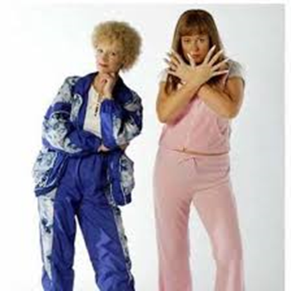
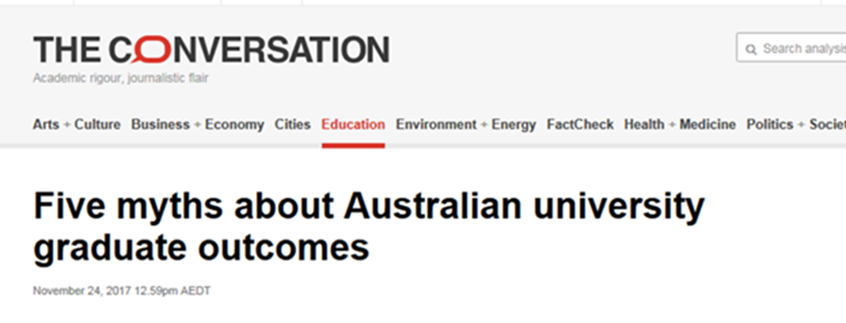
Intervention
Setting ‘challenging tasks’ earlier on as part of the curriculum produced greater confidence with and higher grades overall for the assessment.
Scaffolded approach to introducing different political worldviews with the inclusion of popular culture and examples that spoke to their lifeworlds across a number of weeks.
I conducted a case study of important issues facing students today with a focus on employment prospects; costs of education and surviving while studying and asked ‘how are these issues framed or problematised in the media, analyzing the worldview represented in the framing’.

Slide 13
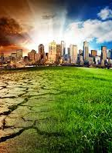
Intervention
Another key intervention involved re-designing the curriculum so students are encouraged to select their own topic for assessment two that enhances the ‘democratic’ element (Shor 1992) in the course.
The students are asked to pick a topic they are passionate about and to find a media text on the topic (some examples of popular topics were domestic violence, mental health, climate change). This also provide opportunities to tap into their ‘lifeworlds’, as they explored a topic that connected with them personally.
As a group we mapped out how these issues they are interested in could be influenced by whether government chooses to legislate or support through policy or provide adequate resources.
Notes:
This was an instrumental part of the learning process in week two of the course, as I began to see a shift in the discussion from expressing views such as ‘I think politics is boring’, or ‘what does it have to do with me’, to a realization that ‘politics is everywhere’ (ref) and the topics they have selected and are discussed in the media texts are often highly contested in political spaces. Most importantly, the students could begin to identify that language was being used to persuade the reader to adopt a particular stance that linked to a progressive or conservative worldview.

Slide 14
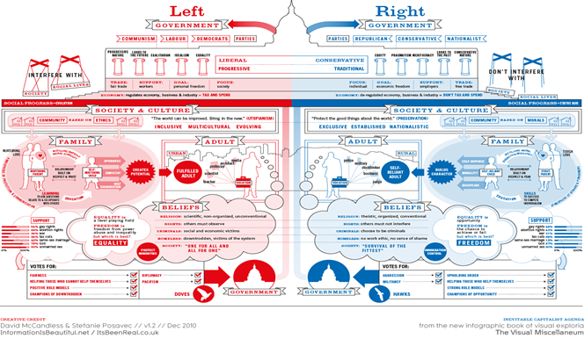
Intervention
I implemented a range of digital media clips in the curriculum that engaged the students in thinking about the different political worldviews, with positive outcomes as featured in this comment: ‘the clips played in the classes were quite helpful (Student comment, MCE 2019).
In the curriculum I also added a number of examples of left/right political worldviews with visual representations (figure 1) compass.

Slide 15
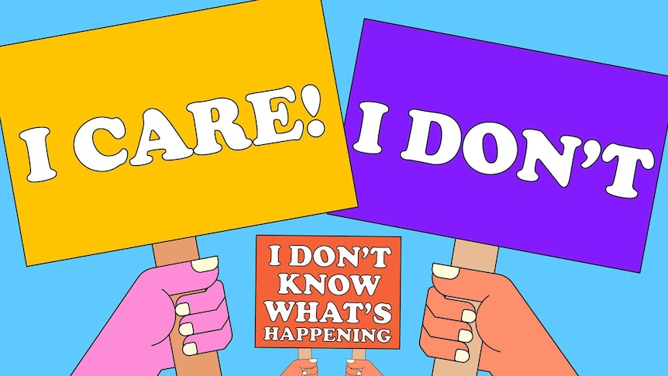
Outcomes
‘Hopeful idea’ number one was brought to fruition, as the student feedback demonstrated an increased understanding of ‘politics’ and the way that language is utilised to promote a world view (such as progressive/conservative) in the media.
‘Before starting this course, I had very little understanding of politics, despite many people attempting to explain the concept to me in the past. I certainly had no idea political bias exists in the media. I’m now not only aware it exists, but I am able to identify it’ (Student feedback, Survey 2019).
This skepticism is echoed in this student comment ‘I am definitely better at recognizing and identifying worldviews and now have a more skeptical approach to consuming media as well as a bigger interest in politics’ (Student feedback, Survey 2019).
Another student reflects on their increased confidence: ‘Before this course I stayed in a bubble and had no ideas about politics. After doing this course I have found myself watching the news and to try and follow what is happening…I feel more confident about understanding what I watch, read and listen to’ (Student feedback, Survey 2019)..

Slide 16
Another student reflected ‘I was unaware of how much minorities were not represented in the media. I previously never thought much about the voices that were excluded’ (Student feedback, Survey 2019). ‘Seeing biased articles and news had always upset me, but being able to identify methods of bias and manipulation and poor research makes it easier for me to understand’ (Student feedback, Survey 2019).
Outcomes
Other students reflected on how the course assisted their understanding of politics more broadly; ‘I finally understand what political parties stand for and what they try and do. Do I like politics….NO! I think most of them are dumb. However, the course has helped me understand what the media and politics is trying to do (Student feedback, Survey 2019).
My interest in politics has not changed. I still don’t have a view on it but now when I see the media exposing it, I do look up key words on the topic to gain a better understanding about what the media was wanting to expose’ (Student feedback, Survey 2019); ‘I never really had a thought when it came to politics, however with media I have learnt not to also rely on what is being shown without looking it up with evidence’ (Student feedback, Survey 2019)
Notes:
This suggests the student has developed the knowledge and awareness of how the media manipulates and persuades its audience to adopt specific viewpoints, that link to the representation of specific political interests of particular groups of people.
This reflection demonstrates a shift from apathy or boredom with ‘politics’ to an increased interest and awareness of how the political machinery impacts their life personally.

Slide 17
To borrow from hooks (1994, p. 21), ‘any classroom that employs a holistic model of learning will also be a place that teachers grow, and are empowered by the process. That empowerment cannot happen if we refuse to be vulnerable while encouraging students to take risks’.
Participating in a collective action research project gave me the confidence to face my vulnerability and overcome teaching challenges that has contributed to increased student engagement, outstanding student outcomes of high challenge curricula and increased hope for the students: I have doubted myself for most of my life but I am finally starting to realise that I am capable, I just have to believe in myself a bit more (student email communication, 2020).

