Slide 1
Researching While Teaching Series Workshop #4 Re-design Pedagogy
Convenors
Dr Sarah Hattam, Associate Professor Anna Bennett, Dr Jo Hanley

Slide 2
Plan for Workshop #4
2:00 Presentation & Discussion: Re-designing Teaching and Learning Activities – what do we take from Biggs Constructive Alignment ?
2:45 Back in small groups or pairs, review the examples of projects from UniSA and their approach to re-design. Is anything useful here for your own project?
3.30 Afternoon Break
3:45 Discussion of Schratz reading and develop plan for your data collection – What data? Survey, Interviews, Focus groups, reflective journal? Review example of survey/focus group questions (writing/thinking time)
4:30 Ethics – How to approach ethics to publish research
5:00 Next steps & close

Slide 3
Acknowledgement of Country
The University of Newcastle acknowledges the traditional custodians of the lands within our footprint areas: Awabakal, Darkinjung, Biripai, Worimi, Wonnarua, and Eora Nations. We also pay respect to the wisdom of our Elders past and present.

Slide 4
Presentation & Discussion: Re-designing Teaching and Learning Activities – what do we take from Biggs Constructive Alignment ?
John Biggs (1999) What the Student Does: teaching for enhanced learning, Higher Education Research & Development, 18:1, 57-75.

Slide 5
Robert & Susan
‘The teaching challenge is precisely to change his usual way of learning, not to see it as an impediment to teaching him’ (p. 58)
‘Figure 1, based on a number of studies and observations summarised in Biggs
(1999), postulates a two-way interaction between the degree of learning-related
activity that a teaching method is likely to stimulate, and the academic orientation of the students, as they jointly affect students' levels of engagement in the task’. (p. 58)
‘There may well be endogenous limits to what students can do that are beyond any teacher's control, but there are learning-related aspects that are controllable. Capitalising on them is what good teaching is about. Good teaching is getting most students to use the higher cognitive level processes that the more academic students use spontaneously. Good teaching narrows the gap’.

Slide 6
Theory of teaching
Constructivism: ‘meaning is not imposed or transmitted by direct instruction, but is created by the student's learning activities, well summarised in the term "approaches to learning”’(p. 60)
‘The acquisition of information in itself does not bring about such a change, but the way we structure that information and think with it does. Thus, education is about conceptual change, not just the acquisition of information.’ (p. 60)

Slide 7
This conceptual change takes place when…
1. It is clear to students (and teachers) what is "appropriate", what the objectives are, where all can see where they are supposed to be going, and where these objectives are buried in the assessment tasks.
2. Students experience the felt need to get there. The art of good teaching is to communicate that need where it is initially lacking. "Motivation" is a product of good teaching, not its prerequisite.
3. Students feel free to focus on the task, not on watching their backs. Often, attempts to create a felt need to learn, particularly through ill-conceived and urgent assessments, are counter-productive. The game then becomes a matter of dealing with the test, not with engaging the task deeply.
4. Students can work collaboratively and in dialogue with others, both peers and teachers. Good dialogue elicits those activities that shape, elaborate, and deepen understanding. (pp. 60-61)

Slide 8
Student centred
‘Student-focused strategies see the focus as being on bringing about conceptual change in students' understanding of the world, and it is what students do to achieve understanding that is important, not what teachers do’. (p. 61)
‘Learning outcomes are determined by a whole complex of factors: fixed student-related factors such as ability; teaching-related factors such as curriculum, and methods of teaching and assessing; and the approaches to learning that students use while engaging in any particular task to achieve an outcome. All these factors affect each other, forming an interactive system (Biggs, 1993b). Any system, such as an eco-system, has to be understood as a whole. Components have to be considered as they affect each other, not as acting separately or additively.’ (p. 61)

Slide 9
3 Approaches
Level 1: What the student is - individual differences (good student/bad student) lead to a blame-the-student theory and a transmission approach
‘When students don't learn, it is due to a deficit: ability; attitude; study skills; motivation; even a student's ethnicity (Samuelowicz, 1987). It is not considered that the teaching might have been the problem’. (p. 62)
Level 2: what the teacher does – the performance of the teacher in transmitting complex concepts with ‘effective teaching strategies, leads to blame the teacher approach
‘This advice, useful as it is, is concerned with management, not with facilitating
learning. Good management is important for setting the stage for good learning to
take place—not as an end in itself.’ (p. 62)

Slide 10
3 Approaches
Level 3: What the student does
The Level 3 teacher focuses on what the student does; on what learning is
or is not going on. Level 3 teaching is systemic, taking into account all components
in the system.
This implies a view of teaching that is not just about facts, concepts and principles
to be covered and understood, but about:
1. What it means to understand those concepts and principles in the way we want
them to be understood.
2. What kind of TLAs (teaching/learning activities) are required to reach those kinds
of understandings.

Slide 11
The design of teaching
We have first to be clear about what we want students to learn, and then teach and
assess accordingly in an aligned system of instruction (Biggs, 1996). It is a fully criterion-referenced system, where the objectives define what we should be teaching; how we should be teaching it; and how we could know how well students have learned it. In aligned teaching, there is maximum consistency throughout the system.
The curriculum is stated in the form of clear objectives which state the level of understanding required rather than simply listing the topics to be covered. The teaching methods chosen are those that are likely to realise those objectives; you get students to do the things that the objectives nominate. Finally, the assessment tasks address the objectives, so that you can test to see if the students have learned what the objectives state they should be learning.
All components in the system address the same agenda and support each other. The students are "entrapped" in this web of consistency, optimising the likelihood that they will engage the appropriate learning activities. I call this network constructive alignment (Biggs, 1999).

Slide 12
The value of verbs…
‘In practice, verbs are useful markers for operationalising alignment. Verbs are used in a similar way in Figure 1, where Susan is depicted as spontaneously using high level verbs such as theorise, reflect, generate, apply, and Robert lower level verbs such as recognise, memorise, and so on. The TLAs are then tuned to elicit those verbs, and they are also embedded in the assessment tasks. The content being taught, of course, determines the objects of the verbs’ (p. 64)
‘Practically speaking, we specify the verbs which describe the behaviours which we want students to enact in the context of the content discipline being taught, specifying levels of understanding that can be used for awarding grades’. (p. 64)

Slide 13
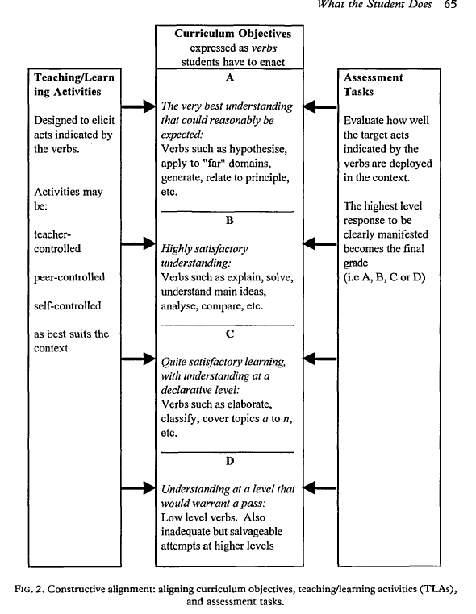
‘The categories are defined by a particular quality of learning and understanding that suits the unit in question, not by the accumulation of marks or percentages. The
assessment tasks, embodying the crucial verbs, denote whether the quality in question is pre
sent or not.’ (p. 66)

Slide 14
Aligning objectives, teaching and assessment
‘The very highest levels of understanding that we want students to display by the end
of a degree program—and in some cases very much before the end—are
"performative"; that is, students act differently when they really understand (Perkins
& Blythe, 1993). Students need to understand to the extent that a particular sector
of their world has changed, and is now coming under their control. They behave
differently towards that which they truly understand. Capturing that difference in
an assessment task is what Perkins and Blythe mean by "performances of understanding".’ (p. 66)

Slide 15
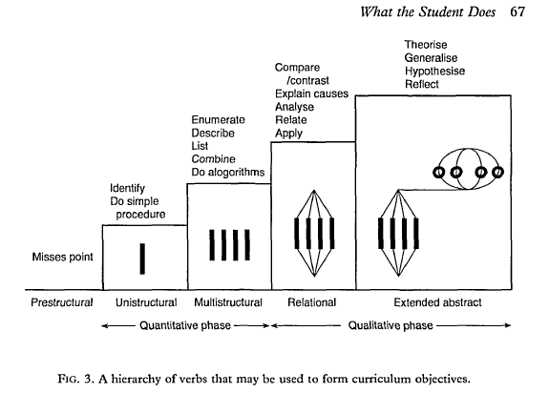
SOLO Taxonomy

Slide 16
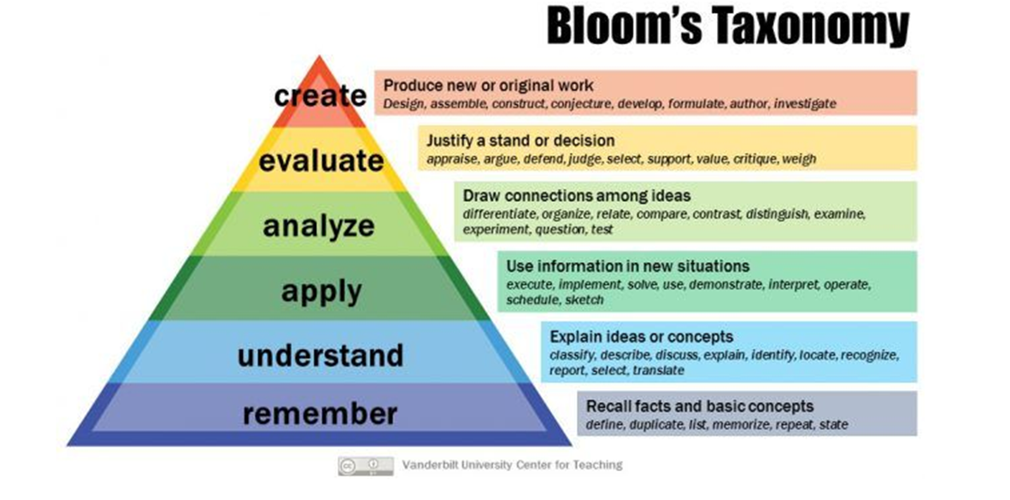

Slide 17
Selecting TLA’s
‘The next step is to set up the teaching/learning context so that students have every encouragement to react with the level of cognitive engagement that the objectives require’ (p. 67)
‘Certainly, students need to know about important concepts, and lecturing is not a bad way of letting them know, but there are better ways’ (p. 67)

Slide 18
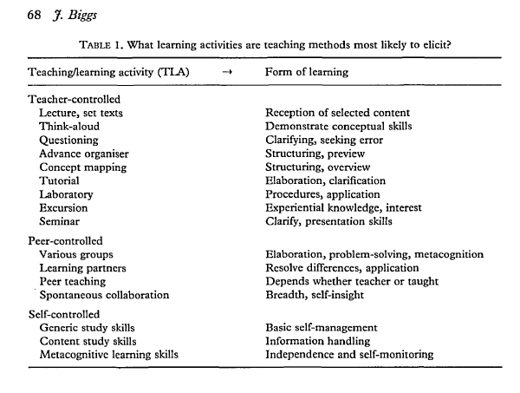

Slide 19
Assessment tasks
‘Assessment in practice has two functions: to tell us whether or not the learning has been successful, and in conveying to students what we want them to learn, as stated by Ramsden (1992): From our students' point of view, the assessment always defines the actual curriculum (p. 187).
Backwash from assessment is not a problem, it is the solution. In a criterion referenced
system, the objectives are embedded in the assessment tasks. So, if students focus on the assessment, they will be learning what the objectives say they should be learning. It is only when the assessment tasks elicit lower level cognitive activities than the objectives nominate that backwash gets a bad name.’ (p. 68)
‘Lack of alignment is a major reason why students adopt a surface approach to learning. Poor alignment often results from such institutional policies as requiring assessment results to be reported in percentages or "marks", or requiring results to be distributed along a pre-determined curve. The first can be mitigated by assessing qualitatively but reporting quantitatively, but the second is crippling. There can be no educational justification for grading on a curve.’ (p. 69)

Slide 20
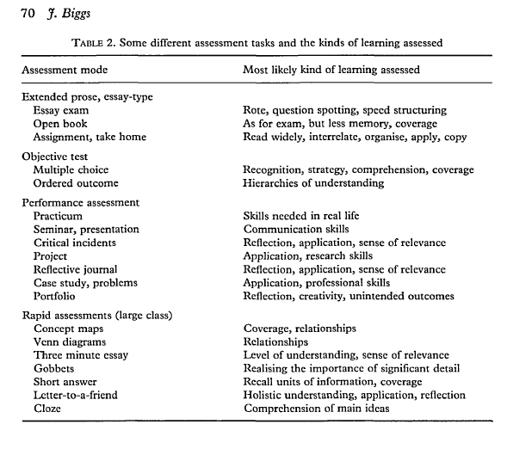
Assessment tasks
‘Criterion-referenced assessment in the constructive alignment model requires
assessment tasks that are likely to elicit the learning verbs that are stipulated in the objectives’. (p. 69).

Slide 21
Summary
In an aligned system of instruction, the teacher's task is to see that the appropriate
verbs are:
1. Nominated in the objectives.
2. Likely to be elicited in the chosen TLAs.
3. Embedded in the assessment tasks so that judgments can be made about how
well a given student's level of performance meets the objectives.
Because the teaching methods and the assessment tasks now access the same verbs
as are in the objectives, the chances are increased that most students will in fact
engage with the appropriate learning activities. This is, by definition, a deep
approach.

Slide 22
2:45 Back in small groups or pairs, review the examples of projects from UniSA and their approach to re-design. Is anything useful here for your own project?
3.30 Afternoon Break

Slide 23
3:45 Discussion of Schratz reading and develop plan for your data collection – What data? Survey, Interviews, Focus groups, reflective journal? Review example of survey/focus group questions (writing/thinking time)

Slide 24
Schratz, M. (1992) Researching while teaching: an action research approach in higher education, Studies in Higher Education, 17(1), 81-95.
Schratz article provides a technical/methodological/critical lens to consider action research process.
Instruments for action research:
Instant feedback – handing out 2 questions at the end of the lesson to students
Questionnaire – multiple choice questions
Sentence completion – phrases indicating the beginnings of evaluative statements (such as feelings, opinions, values etc)
Open Letter – writing a letter to the class to support overcoming a challenge
Journal book – Tracking personal thoughts and professional experiences – can be adopted by both educator and student
Classroom observation – invite a person you trust to offer supportive observation of teaching in action (teaching squares)
Audio-visual – offers potential for ‘critical’ lens of teaching performance
Interview triangle – with in-put from educator, student & 3rd person

Slide 25
Questions
Which instruments appealed to you as useful for your project?
What are your perspectives on the qualitative/quantitative binary to search for evidence of your teaching impact?

Slide 26
Provocation
Smyth argues that teachers have to ‘critically’ confront their work in the classroom, that is, in the act of teaching itself. “The starting point lies in the teachers theorising their own practice in ways that involves them in coming to see how their own understandings have become limited and distorted by non-educational forces, such as institutional structures and political constraints” (cited in Schratz 1992, p. 90).
What are the institutional structure and political constraints that potentially limit your understandings of your own teaching?

Slide 27
Ethics

Slide 28
Action Research Design & Risk Questions
Data sources? Will you be collecting data from children/learners?
If yes, you will need to plan to get consent from parents/guardians of children.
You will need to have a current Working with Children Check.
How will you avoid students feeling coerced?
Are you planning to do something that is different from/outside usual teaching and learning practices?
If yes, how will you manage the risk of disrupting student learning or imposing extra work?
Could students become distressed by the research process? Eg Recalling difficult experiences?
How will you provide support to students experiencing distress?
What would you do if a student revealed/you observed a problem of abuse, bullying or unprofessional staff conduct?
Know who to report to, and what needs to be reported. Have a plan.

Slide 29
Language Matters
Key communications with participants – Information sheet and Consent form
Will all participants be fluent in speaking, reading and writing English? How will you manage variations of language and capacity?
Is your choice of words and expression appropriate for your audience?
How will you make sure that participants understand what they are being asked to consent to?

Slide 30
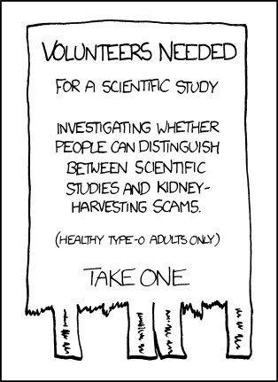
Participant Information Sheets
Participant information sheets are public documents and are used to obtain informed consent. They should be presentable and contain all relevant information about the research project, what participants are required to do and data use and publication outcomes

Slide 31
Participant Requirements
What will participants be asked to do?
Why? What does the research aim to find out?
Where? At work? At home? Online?
When?
How long will it take?
What should they do if they change their mind or become upset?
What will happen with the data?
How will COVID be managed?

Slide 32
Research Tools
You will need to provide the data collection tools you intend to use.
Interview/survey/focus group questions
Observation templates
Data collection recording sheets or instruments
Instructions for reflective journals, or digital data collection such as photographs or videos or other activities

Slide 33
Next steps
Ethics protocol to align with your project
Keep reading literature in your area (pedagogy or other…)
Refine templates and review examples on the resource site

Slide 34
Questions?

