Slide 1
Plan for the session
Look at the tool
15 minutes back story and the research
30 minutes exploring and using the tool in some detail
Initial thoughts
De Bono hats. (Table cloths)
Web site: http://coursehandover.net
Support for this project/activity has been provided by the Australian Government Office for Learning and Teaching. The views in this project/activity do not necessarily reflect the views of the Australian Government Office for Learning and Teaching
Notes:
Thank you…people here and participants., OLT and SA branch of HERDSA
We want to show you our ..probably our third attempt ..we are expecting many more and we are expecting to move beyond a PDF which you will see…but we think there is value in a low tech approach
Hopefully you can think of a course and have a look at one component..
We would like to open this up to a general discussion about the issue

Slide 2
The Challenge
2011 support for a new curriculum
Often asked to look at courses that used to work- but something has happened
Support for new staff
Increased focus on “program” in the sector
Reflected in the development of threshold learning outcomes

Slide 3
Nursing Handover
Can’t find any literature directly related
Lots on curriculum design / mapping / alignment
-Handover is more to do with the communication
Lots on course coordination: more about the job in general:
-Handover is more about the course than the job
We did find local “tick sheets” which address some of the admin requirements ..these are general but very helpful…….but not handover

Slide 4
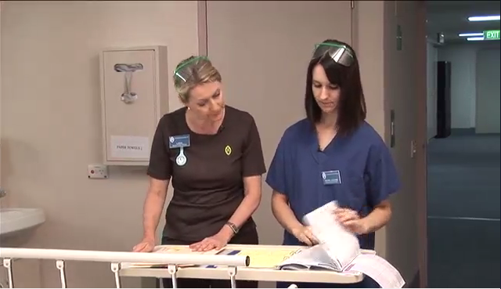
Nursing Handover
Clinical Handover
Notes:
We see two nurses handing over a patient in a process called clinical handover.
What I want you to see is the structure / that there is a process
Patients are unique individuals (infinte complexity) that’s important because complexity is a potential challenge for this tool
Address the complexity by process called ISBAR which structures the handover ----
both the person receiving the handover and the person giving the handover know what is coming next.
Takes 2.47 secs…we start at 1 minute
The nurses doesn’t own the patient..they are the caretakers…but at the same time their judgment is critical

Slide 5
Interviewed
21 Course coordinators (11 new + 10 over 2 years experience)
6 Program directors
5 Heads of school
3 Universities in 3 states
Qualitative and exploratory
Focus groups / individual interviews based on opportunity or need

Slide 6
4 focus areas
Previous experience of receiving or giving a course handover
Led to
Whether they supported the idea, or not (is it really a problem?) very important
What should be in the tool
What would stop them using it / how to embed the tool

Slide 7
I think that this concept of a handover is really quite important. You look at any system, for it to be efficient you need that, like the succession planning and also the handover. I think it's crazy, at the levels that we work at, that you don't have that handover. ………But I think at our level and to make sure everything flows smoothly, it seems sensible to have some sort of a handover.
(experienced course coordinator)

Slide 8
Critical events and hidden traps
History
Assessment
Teaching quality
Staff
Students

Slide 9
Would you like to have a go?
Groups of 2 or 3
Great if you can do something in all sections but ! Time
‘C’ and ‘A’ are the academic design aspects

Slide 10
Keep your information brief and to the point. Dot points are preferable.
Create the tool as a ‘standalone’ document. However, it is best used to guide a conversation between the outgoing coordinator and the new coordinator.
Remember a new coordinator maybe new not only to the course, but also new to higher education and maybe new to Australia.
Not all aspects of the tool will be relevant for every course. Some questions may require a link to an external document.
Some parts of the tool need only be readdressed when the course is formally modified. Other parts will need updating each time the course is taught.

Slide 11
Evaluation : De Bono 6 hats
Way of separating components of analysis ….rather than try and analyse
You look through a lens

Slide 12
Evaluation : De Bono 6 hats
If you could maybe spend 5 minutes at your table…….brief report back
Open movement
11.45….last feedback

