Slide 1
I would like to acknowledge that the University of South Australia is built on the traditional country of the Kaurna people of the Adelaide Plains. I recognise and respect their cultural heritage, beliefs and relationship with the land, and I acknowledge that they are of continuing importance to the Kaurna people living today.

Slide 2
Notes:
The idea for a Forum sprang out of the 2014 EPHEA Conference at the University of WA where a group of Aboriginal Employment Officers got together for a network meeting as part of the Conference. It took over a year for a Forum to happen. In 2015 NATSIHEC started a project looking at Aboriginal Employment in our sector and as a result of discussions the Forum idea started to take shape.

Slide 3
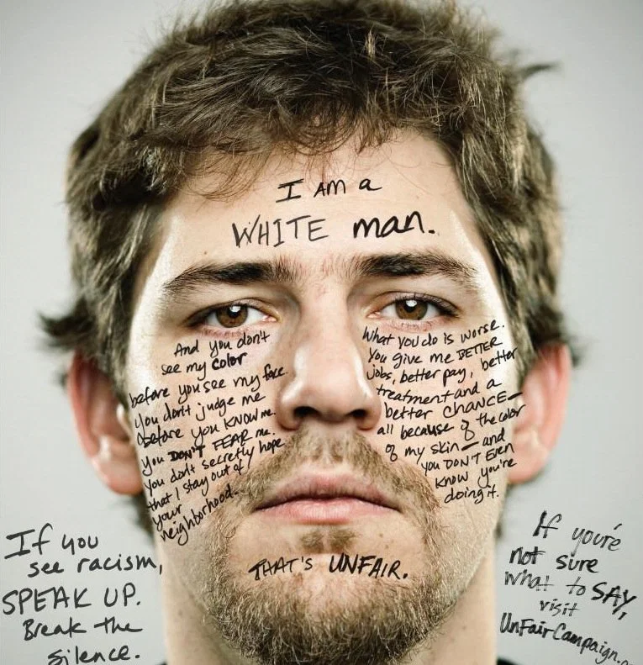
Notes:
And in July 2015 we came together at UniSA.
You’ll see some familiar faces here but also there are some colleagues who have moved on and I want to pay tribute to their work which has benefitted us all.
Kelly Maxwell from University of Adelaide and myself met with colleagues from the NATSIHEC executive and with the support of Professor Peter Buckskin at UniSA we came up with a program for our first ever official forum. It made sense to have both our universities involved as Kelly and I worked together quite a lot to ensure that we had the best possible employment outcomes for our mob.
Because NATSIHEC was meeting in Adelaide at the same time we had visitors including Deans, School Managers and other staff who were attending the NATSIHEC meeting.

Slide 4
There is no starting point or endpoint in a circle and therefore all things in the circle have an equal and valid place where there is no ‘other’ but you are recognised as ‘another’.
Karen Martin, 2008 Noonuccal, Quandamoopah and Bidjara woman

