Slide 1
Researching While Teaching Series Workshop #3 Re-design Your Pedagogy
Convenors: Dr Sarah Hattam & Associate Professor Chris Deneen
Guest Presenters: Associate Professor Elspeth McInnes (Chairperson of Human Research Ethics Committee) and Dr Bec Neil (Education Futures Human Research Ethics Adviser)

Slide 2
We respectfully acknowledge the Kaurna, Boandik and Barngarla First Nations Peoples and their Elders past and present, who are the First Nations’ traditional owners of the land that are now home to the University of South Australia’s campuses in Adelaide, Mount Gambier and Whyalla.
Acknowledgement of Country

Slide 3
Plan for Workshop
9.30 Acknowledgment of Country & Welcome
9:40 Sharing of hopeful ideas – Sarah to share examples from Education Futures
9:50 Sharing of development of hopeful ideas on template (led by Chris)
Task: In break-out rooms, building on your discussions last time with Rob’s guidance, share your template.
Share in the larger group
10. 50 Morning Tea
11: 00 Reflection on readings (led by Chris and Sarah)
Schratz, M. (1992) Researching while teaching: an action research approach in higher education, Studies in Higher Education, 17(1), 81-95.
Stephen Kemmis (2009) Action research as a practice‐based practice, Educational Action Research, 17:3, 463-474
11.30 Presentation: Associate Professor Elspeth McInnes (Chairperson of Human Research Ethics Committee) and Dr Bec Neil (Education Futures Human Research Ethics Adviser) – Best Practice Approaches to the Ethics Protocol
12:30pm Next steps and close

Slide 4
Presentation: Examples of hopeful ideas used in action research
Research Question needs to connect to hopeful idea
Pedagogy – re-design learning task – achieve an outcome (that is measurable)

Slide 5
Critical Enabling & Inclusive pedagogies at UniSA
Enabling educators attempt to shift attention away from ‘deficit discourses to directing attention to transforming institutional spaces, systems and practices, which are implicated in reproducing exclusions and inequalities at cultural, symbolic and structural levels’ (Burke, Crozier and Misiaszek 2017, p. 30).
In enabling:
We set challenging tasks (Luke 2000)
We focus on the ‘cultural geography’ (Smyth & Hattam 2004) of our unit through cultural messages about who belongs
Adopt dialogic and democratic approaches (Freire and Shor 1987)
Promote funds of knowledge approaches (Molls and Gonzales 1992)
Connect with student lifeworlds, popular culture and scaffold learning (Luke 2000)
Focus on the ‘affective’ (Ahmed 2004) elements of teaching and adopting care-full pedagogies (Motta and Bennett 2018) to be ‘emotional champions’ (O’Shea 2019).
Notes:
Ira Shor and Paulo Freire (1987) offer the transformative and empowering function of education that happens through ‘dialogic’ and democratic approaches. Moll and Gonzales (1992) promote the concept of funds of knowledge that addresses elements of belonging. Allan Luke (2000) conveys the connection to students’ ‘lifeworlds’ and popular culture and supports the scaffolding necessary for students learning of difficult academic themes and concepts. Ahmed offers a focus on the ‘affective’ (Ahmed 2004) elements of teaching students who lack confidence in their capabilities by introducing the necessity of adopting an ethics of care or ‘care-full pedagogies’ (Motta & Bennett 2018). Specifically for my version of ‘critical enabling pedagogy’, I look to Ira Shor (1992) for his critical teaching framework that lists eleven values that underpin his empowering approach, including: participatory, affective, problem-posing, situated, multicultural, dialogic, desocialising, democratic, researching, interdisciplinary and activist. Shor’s explicit practices of the ‘critical’ dialogic teacher include:
doing analysis with the students participation; avoiding jargon or obscure allusions that intimidate students into silence; posting thought provoking, open-ended problems to students so that they feel challenged in thinking them through; avoiding short answer question which make students feel like robots; be patient in listening to students and in giving them time to think on their feet; invite students to speak from experience, integrating that material into social issues and academic themes and invite students to suggest themes for study and ask them to select reading matter (1992, pp. 95-96).

Slide 6
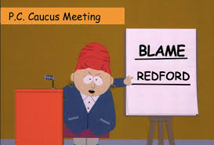
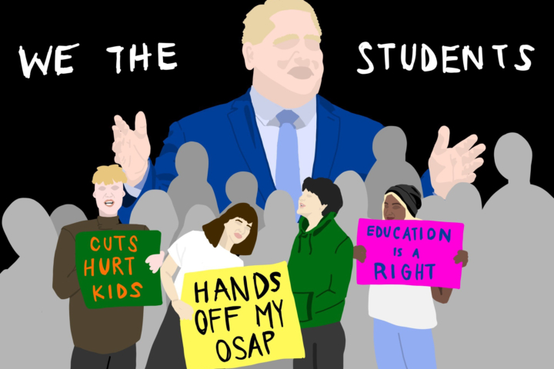
Case Study: Sarah Hattam
My teaching challenge?
How I teach competing political world-views in the course ‘Critical Thinking: Media and Academia’, as reflected in the stance of the author presented in media texts?
Writers have beliefs about an issue
world view
↓
They express their position or stance
perspective
↓
They provide arguments to support their perspective
arguments
↓
They provide evidence to support each argument
evidence
Notes:
Ideology/Discourse are key concepts taught in the ‘Critical Thinking: Media and Academia’ course. The students are required to demonstrate an understanding of the ideology/discourses that informs the perspective presented in their chosen media text in the second assessment ‘The Guided Critical Review’, by identifying specific language techniques/framing adopted/utilised by the author.
Many students can identify the stance of the author as condemning or commending and engaging with binary approaches to perspectives, but not as many trace the ideological basis or discourses that constitute the perspective.
Over the course, we have looked at generation of ‘fake news’ in politics and highlighted this significance which has ideological implications, and then also looked more specifically at the meaning of ideology and the binary of progressive/conservative to help them make sense of the polarisation that exists. These categories are mobilised more so now with Trump and other ‘right’ wing politicians and with Murdoch’s media.
Reflections on student’s engagement with ideology, left and right wing. This led to detailed discussion about the different types of government in my tutorial, with many questions about the current political climate.

Slide 7
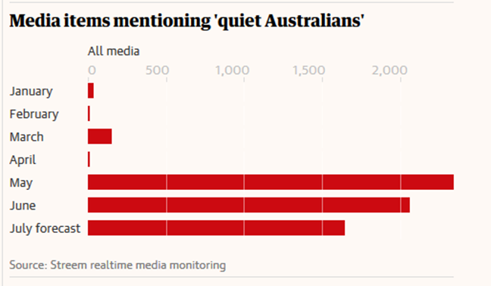
Case Study: Sarah Hattam
My research question?
How does utilising elements of enabling pedagogy - specifically connecting to student lifeworlds, scaffolding, setting challenging tasks and transformation- increase students engagement with and understanding of ‘politics’ and provide the students with greater understanding of the way that language is utilised to promote a world view (such as progressive/conservative) in the media?
My hopeful idea?
The empowerment of the students in their future engagement with texts as they develop awareness of dominant forces in society and helps students to recognise, critique and create change and to give power over the meaning-making process.
Students could move past discomfort, disconnection and political apathy and engage with political categories and themes in the course to develop an insight to how people and issues are positioned by these categories.
‘There are those willing to walk down the path of critical thinking with me, who find their world-views shattered, but simultaneously engage in creatively rebuilding a sense of meaning and coherence in the face of ambiguity’ (Boler 2004, p. 117).

Slide 8
Case Study: Natasha Wilson
My teaching challenge:
To improve attendance at lectures and engagement with challenging content
The hopeful idea:
Using active demonstrations and serious play in lectures will break up the tension when exposing students to challenging physiology concepts, and also hopefully make lectures more enjoyable
My research question:
Can using serious play and live demonstrations in lectures improve student engagement and understanding of challenging concepts?

Slide 9
What did I learn about:
My students:
Were more excited and less fearful after first lecture than previous cohort
Asked more questions in lectures with demonstrations/serious play style elements
But…attendance still drops off significantly over the semester and some concepts are still fear/panic inducing!
My Practice:
Finding new ways to help students relate to challenging concepts was more enjoyable and rewarding
I’ve become more comfortable with building in some flexibility that allows student questions about the human body to take us on interesting tangents
My Action Research:
Allows me to prioritise (some) time for my own scholarship during the semester
Joining the UniSA College Action Research group has given me much needed space for reflection, and this has given me opportunities to improve my teaching

Slide 10
Case Study 4: Enhancing group work through technology (Future Ideas: Information & the Internet) (Jennifer Stokes)
The teaching challenge: Collaborative or group work is in strong demand from employers and perceived as a key ‘transferable skill’ needed for success in the 21st Century (FYA 2018, p. 19). However, it is also an area fraught with difficulties for students, including interpersonal conflicts, different levels of commitment to assessment, and lack of interest in topics.
The hopeful idea: New technology and communication practices could be embedded to better support student engagement, group work, and enhance learning outcomes.
The research question: How can technology be implemented to better negotiate meaningful student-centred topics, enhance group work and lead to greater learning outcomes?
This research particularly focuses on two areas of our enabling pedagogy: student-centred learning and activities, and curriculum design that provides choice; these are achieved by connection with the life worlds of students (Stokes 2014, pp. 119-121).
The work has been piloted in the UniSA College information literacy course in 2018.

Slide 11
Case Study: Breathe and focus: Using mindfulness to combat exam anxiety (Introduction to Human Behaviour) Tanya Weiler
The teaching challenge: Performance under time pressure is required for strong academic practice, yet College students express high levels of anxiety about these tasks, particularly around perceived powerlessness to control their responses in these situations.
The hopeful idea: Learning Mindfulness techniques to employ in situations of anxiety will give students agency over their stress response, enabling better performance.
The research question: How can the regular practice of mindfulness build focus and concentration to optimise performance under pressure?
This research is underpinned by an Ethos of Care, where 'attentiveness to students' experiences, histories and needs are of foremost importance' (Bennett et al 2018). In addition, this explores recognising moments of discomfort as learning opportunities, and democratising the learning environment as vital to student experience.

Slide 12
Enhancing Global Citizenship and Agency in Intro to Global Issues & Identities (Snjezana Bilic)
The teaching challenge: Previously introduction to social structures left students feeling overwhelmed with world’s global issues and to extent powerless.
The hopeful idea: Being an ethical global citizen and people having power over their lives are key concepts taught in the ‘Introduction to Global Issues and Identities’ course. The students are required to demonstrate an understanding and praxis of this.
The research question/challenge: How does utilising elements of enabling pedagogy – specifically being culturally responsive in an attempt to achieve transformation and enhance student’s social justice commitment - increase students' engagement with and understanding of complex sociological concepts and enhance student’s sense of agency

Slide 13
Enhancing Global Citizenship and Agency in Intro to Global Issues & Identities (cont.)
Outcomes:
What have I learned about my practice?
Introduction of an additional reflective post entry on agency –enhanced student's reflection about agency; in the final essay most students selected 'global citizenship' question arguing it is very important;
Personal challenge to overcome pragmatic IR power-relations- thinking
Providing a balanced approach has impacted positively on my own pedagogy – seeing a sense of hope, agency and activism in students has enthused me to continue with this practice
What have I learned about collaborative action research?
Sharing ideas, discussing teaching challenges and how my colleagues have dealt with these has been enormously beneficial to improving my own pedagogical approaches

Slide 14
Suggested Groups
1: Pedagogies of Care & Dialogic F2F(Karen, Ian, Sharron)
2: Dialogic approaches On-line (Anna, Subha, John, Sandy
3: Critical pedagogy and identity (Anne, Katie, Saira, Abdullatif)
4: Authentic Assessment (Lisa, Josephine, Katrina)

Slide 15
9:50 Sharing of development of hopeful ideas on template (Chris)
Task: In break-out rooms, building on your discussions last time with Rob’s guidance, share your template.
Share in the larger group

Slide 16
10.50 Morning Tea

Slide 17
11: 00 Reflection on readings (Chris and Sarah)
Schratz, M. (1992) Researching while teaching: an action research approach in higher education, Studies in Higher Education, 17(1), 81-95.
Stephen Kemmis (2009) Action research as a practice‐based practice, Educational Action Research, 17:3, 463-474.

Slide 18
Schratz, M. (1992) Researching while teaching: an action research approach in higher education, Studies in Higher Education, 17(1), 81-95.
Schratz article provides a technical/methodological/critical lens to consider action research process.
Instruments for action research:
Instant feedback – handing out 2 questions at the end of the lesson to students
Questionnaire – multiple choice questions
Sentence completion – phrases indicating the beginnings of evaluative statements (such as feelings, opinions, values etc)
Open Letter – writing a letter to the class to support overcoming a challenge
Journal book – Tracking personal thoughts and professional experiences – can be adopted by both educator and student
Classroom observation – invite a person you trust to offer supportive observation of teaching in action (teaching squares)
Audio-visual – offers potential for ‘critical’ lens of teaching performance
Interview triangle – with in-put from educator, student & 3rd person

Slide 19
Questions
Which instruments appealed to you as useful for your project?
What are your perspectives on the qualitative/quantitative binary to search for evidence of your teaching impact?

Slide 20
Provocation
Smyth argues that teachers have to ‘critically’ confront their work in the classroom, that is, in the act of teaching itself. “The starting point lies in the teachers theorising their own practice in ways that involves them in coming to see how their own understandings have become limited and distorted by non-educational forces, such as institutional structures and political constraints” (cited in Schratz 1992, p. 90).
What are the institutional structure and political constraints that potentially limit your understandings of your own teaching?

Slide 21
Kemmis, S. (2009) Action research as a practice‐based practice, Educational Action Research, 17:3, 463-474.
Kemmis article offers an epistemological lens for how and why practitioners engage in action research.
‘Transforming our practices means transforming what we do; transforming our understandings means transforming what we think and say; and transforming the conditions of practice means transforming the ways we relate to
others and to things and circumstances around us. I will speak about these three things as “sayings”, “doings” and “relatings”’ (p. 463).

Slide 22
Kemmis, S. (2009) Action research as a practice‐based practice, Educational Action Research, 17:3, 463-474.
‘For a professional practitioner in any field today – like education, social work, nursing or medicine – to live a ‘philosophical life’ is a matter of:
(1) living a ‘logic’ by thinking and speaking well and clearly, avoiding irrationality and falsehood;
(2) living a ‘physics’ by acting well in the world, avoiding harm, waste and excess; and
(3) living an ‘ethics’ by relating well to others, avoiding injustice and exclusion.
These three come together in a unitary praxis – that is, morally committed action oriented and informed by traditions of thought. This praxis comes together and coheres in a way of life, a way of orienting oneself in any and all of the uncertain situations we encounter’ (p. 465).

Slide 23
Practice architectures – mediating preconditions
Schatzki (2002, 98) describes practices as ‘prefigured’ because social interaction in established practices generally follows these familiar shapes or patterns. For example, what education means (thinking, saying) to a teacher is always already shaped by ideas that pre-exist in various discourses of education; how education is done (doing) is always already shaped by the material and economic resources made available for the task; and how people will relate to one another in educational settings and situations (relating) is always already shaped by previously established patterns of social relationships and power (cited in Kemmis 2009, p. 466).
Action research processes offer new ways of saying, doing and relating, and each impacts on the other.

Slide 24
Provocations of action research
Technical – improve outcomes through focusing on the self, one way relationship of process. Participant as ‘object’
Practical – self-directed but others have a voice, participant is ‘subject’, open to the views of others, transitive and reciprocal
Critical - aim to change their social world collectively, by thinking about it differently, acting differently, and relating to one another differently – by constructing other architectures to enable and constrain their practice in ways that are more sustainable, less unsustainable.

Slide 25
Provocation
‘The student who suffers bullying in a school, the student whose life experience is not recognised by a sexist curriculum, the student who is indoctrinated into irrational beliefs, the student whose life opportunities are diminished by forms of teaching that serve the interests of particular groups at the expense of others’ interests – all endure consequences wrought by practice architectures that are flawed and in need of reconstruction’ (p. 471).

Slide 26
11.30 Presentation: Associate Professor Elspeth McInnes (Chairperson of Human Research Ethics Committee) and Dr Bec Neil (Education Futures Human Research Ethics Adviser) – Best Practice Approaches to the Ethics Protocol
12.30 Next steps and close

Slide 27
What’s next
Pedagogies…..
Affect in education: Pedagogies of care
Co-construction: Turn around pedagogy
Connecting with lifeworlds – strength based and responsive
Research question/ what data to collect/ethics

Slide 28
What’s next
Pedagogies…..
Affect in education: Pedagogies of care
Co-construction: Turn around pedagogy
Connecting with lifeworlds – strength based and responsive
Research question/ what data to collect/ethics

Slide 29
Questions?

