Slide 1
Researching While Teaching Series Workshop #3 Re-design Pedagogy
Convenor
Dr Sarah Hattam
Guest Presenter Professor Barbara Comber

Slide 2
Plan for Workshop
10.00 Acknowledgment of Country & Welcome
10:10 Break-out room discussion- sharing of templates and research questions
10:50 Morning tea
11:00 Presentation: Professor Barbara Comber – Turn-around pedagogy
11:30 Group Discussion – Which pedagogies are we working with in our projects
12:00 Group Discussion – Ethics
12:20 Next steps and close

Slide 3
We respectfully acknowledge the Kaurna, Boandik and Barngarla First Nations Peoples and their Elders past and present, who are the First Nations’ traditional owners of the land that are now home to the University of South Australia’s campuses in Adelaide, Mount Gambier and Whyalla.
Acknowledgement of Country

Slide 4
10:10 Break-out room discussion- sharing of templates
10:50 Morning tea

Slide 5
Introducing Professor Barbara Comber
Barbara Comber is a (newly retired) Research Professor in the School of Education.
Barbara has collaborated on and conducted a number of competitively funded research projects concerned with literacy development, teaching and socioeconomic disadvantage.
She has developed or contributed to language and literacy teacher education materials in a number of Australian states, the US and Canada.
She has authored a book, edited 10 books and published numerous articles and chapters for teachers and teacher educators on critical literacy, teachers' work and social justice.
Her current research focusses on how young children are learning to write now and also how early career teachers understand and attempt to enact quality teaching in schools located in low socio-economic status areas.

Slide 6
11:30 Group Discussion – Which pedagogies are we working with in our projects

Slide 7
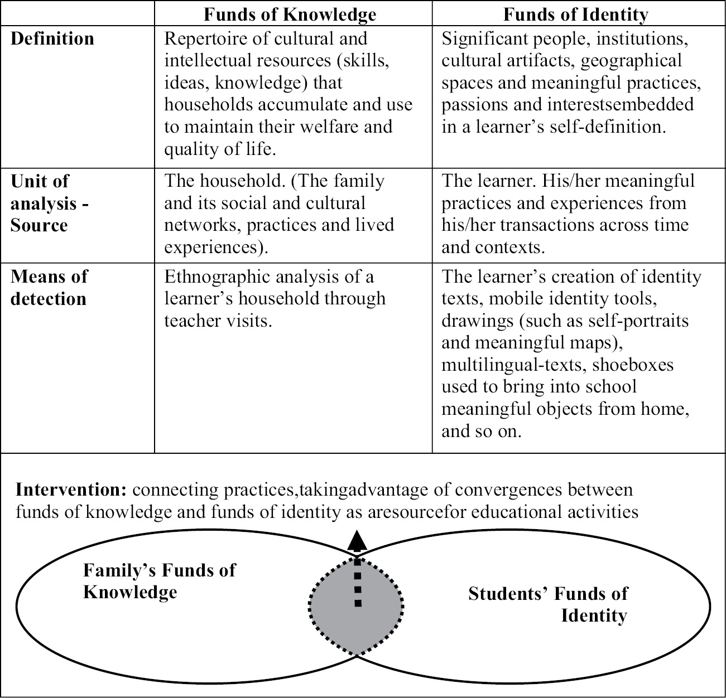
Discussion: Funds of knowledge
In what ways can connecting with the lifeworlds of students & drawing on the resources/knowledges of students support interventions for increased engagement or quality?

Slide 8
In a nutshell….
Moll, Amanti, Neff and Gonzalez 1992 define ‘funds of knowledge’ as the “historically- accumulated and culturally-developed bodies of knowledge and skills essential for household or individual functioning and well-being’’ (p. 133). Thus, it is the knowledge and skills that students develop from their home and community experiences and connections.
Using the knowledge gained from students' life-worlds to build curriculum and consider when planning for learning experiences.
“The funds of knowledge approach is based on a simple premise: regardless of any socioeconomical and sociocultural ‘‘deficit’’ that people may or may not have all families accumulate bodies of beliefs, ideas, skills, and abilities based on their experiences (in areas such as their occupation or their religion). The challenge consists in connecting these bodies of educational resources with teaching practice in order to connect the curriculum with students’ lives. “ (Gutart and Moll p.43)

Slide 9
Themes
Understanding socio-political context of households & communities
Building socio-cultural competence
Trust
Anti-deficit – not focusing on disadvantages of students and not lowering standards
Ideological clarity
Agency
Educational sovereignty
Cross-class networks – middle class teachers
Development of social networks with other households to exchange resources/FoK
‘Transforming students’ diversities into pedagogical assets may be the foremost educational challenge for the future’ (Moll & Gonzales 1992).

Slide 10
Motta, S. C., & Bennett, A. (2018). Pedagogies of care, care-full epistemological practice and ‘other’ caring subjectivities in enabling education. Teaching in Higher Education, 23(5), 631-646.
The affective turn in education as critique of neo-liberalism (discourses of neoliberalism encourage dispositions of competitiveness, individualism, personally profitable exchanges)
'It shines a light on the hegemonic masculinities, which attempt to dissociate teaching and learning from emotion and the embodied' (Motta & Bennett, p. 633)
Dominant construction of teachers' work in HE is to keep 'emotion' out of teaching

Slide 13
Care/carelessness
As Lynch argues (2010, pp. 59-60) 'Caring, and the associated subject of emotional work, have been trivialised and dismissed in philosophy and intellectual thought...The difference between the past and the present is that carelessness was an unnamed assumption in the past; now it is not only accepted, it is expected and morally endorsed' (Motta & Bennett 2018, p. 635).
Can you identify this emphasis on carelessness in the academy as described in this quote?

Slide 14
Care as recognition
'Care as recognition manifests as care-full pedagogical practices which acknowledge the complexities and wisdoms of students that come, often following on from experiences of exclusions and misrecognitions within other forms of education, training and employment' (Motta & Bennett 2018, p. 636)
Strengths based knowledge-making practices
Embrace the whole student
Recognising capacity and capability of the student

Slide 15
Care as dialogic relationality
'The epistemological commitments of care in Enabling ae valued and foregrounded programmatically, rather than considered an individual teacher's emotional approach or disposition as a 'caring' teacher' (p. 640)
'What became clear is a commitments to an ethics of practice based on reflexive re/development which was dialogical in contra-distinction to the monological logics prevalent in hegemonic performances of the teachers in HE' (p. 640).
Scaffolding learning
Narrative practice
Multi-literacies
Real world examples
Not just about content
Listening
Not judging

Slide 16
Care as affective and embodied praxis
'Attention to the affective and embodied elements of pedagogies of care and their relationship to creating careful epistemological work was manifested in the attentiveness that educators paid to the time-spaces of teaching and learning, in terms of fostering feelings of safety and belonging...' (p. 642).
Taking time to make students feel comfortable
Engagement at the visceral level
Emotional labour outside of formal teaching time
Non-judgemental language and tone
Encouraging
Setting up space so its non-threatening and dialogical

Slide 17
Guiding Questions
What are the key take-away points made for your teaching in HE?
What are the challenges of being a 'caring teacher' in university?
If the presupposition is that care-full pedagogies are more than just dispositions of the 'caring' teacher, what are other examples?
How can we challenge the hegemonic discourses of the university so that caring work is attributed with a higher status and value?
What hopeful ideas can we generate about possibilities for increased care?

Slide 18
Guiding Questions
How do you perceive pedagogic care in higher education?
How do you see care manifesting itself at various levels simultaneously?
What do you see as the place of relationships, especially caring ones, within higher education?
What are your reflections on 'care as resistance' and 'caring as less than'

Slide 19
Walker & Gleaves seek to understand ‘how teachers in higher education perceive pedagogic care and as such, establish a caring environment in their teaching and learning – in other words, how they become and exist as ‘caring teachers’ (p. 67)
Caring practices versus caring attributes

Slide 20
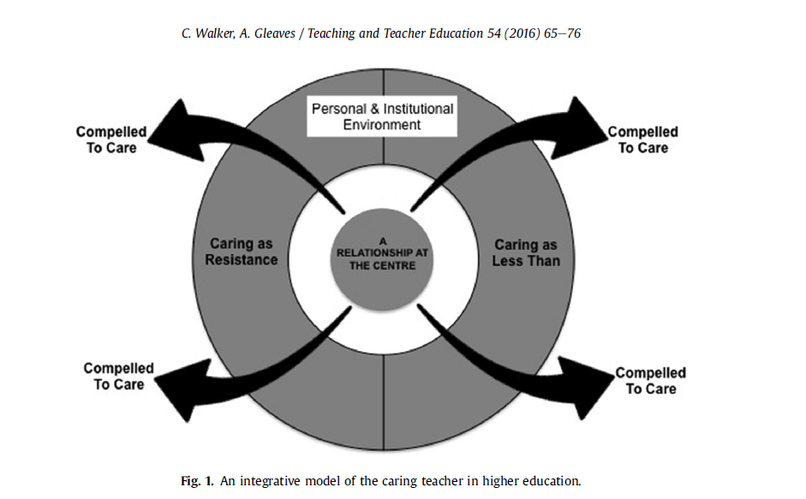

Slide 21
Schratz, M. (1992) Researching while teaching: an action research approach in higher education, Studies in Higher Education, 17(1), 81-95.
Schratz article provides a technical/methodological/critical lens to consider action research process.
Instruments for action research:
Instant feedback – handing out 2 questions at the end of the lesson to students
Questionnaire – multiple choice questions
Sentence completion – phrases indicating the beginnings of evaluative statements (such as feelings, opinions, values etc)
Open Letter – writing a letter to the class to support overcoming a challenge
Journal book – Tracking personal thoughts and professional experiences – can be adopted by both educator and student
Classroom observation – invite a person you trust to offer supportive observation of teaching in action (teaching squares)
Audio-visual – offers potential for ‘critical’ lens of teaching performance
Interview triangle – with in-put from educator, student & 3rd person

Slide 22
Questions
Which instruments appealed to you as useful for your project?
What are your perspectives on the qualitative/quantitative binary to search for evidence of your teaching impact?

Slide 23
Provocation
Smyth argues that teachers have to ‘critically’ confront their work in the classroom, that is, in the act of teaching itself. “The starting point lies in the teachers theorising their own practice in ways that involves them in coming to see how their own understandings have become limited and distorted by non-educational forces, such as institutional structures and political constraints” (cited in Schratz 1992, p. 90).
What are the institutional structure and political constraints that potentially limit your understandings of your own teaching?

Slide 24
Kemmis, S. (2009) Action research as a practice‐based practice, Educational Action Research, 17:3, 463-474.
Kemmis article offers an epistemological lens for how and why practitioners engage in action research.
‘Transforming our practices means transforming what we do; transforming our understandings means transforming what we think and say; and transforming the conditions of practice means transforming the ways we relate to
others and to things and circumstances around us. I will speak about these three things as “sayings”, “doings” and “relatings”’ (p. 463).

Slide 25
Kemmis, S. (2009) Action research as a practice‐based practice, Educational Action Research, 17:3, 463-474.
‘For a professional practitioner in any field today – like education, social work, nursing or medicine – to live a ‘philosophical life’ is a matter of:
(1) living a ‘logic’ by thinking and speaking well and clearly, avoiding irrationality and falsehood;
(2) living a ‘physics’ by acting well in the world, avoiding harm, waste and excess; and
(3) living an ‘ethics’ by relating well to others, avoiding injustice and exclusion.
These three come together in a unitary praxis – that is, morally committed action oriented and informed by traditions of thought. This praxis comes together and coheres in a way of life, a way of orienting oneself in any and all of the uncertain situations we encounter’ (p. 465).

Slide 26
Practice architectures – mediating preconditions
Schatzki (2002, 98) describes practices as ‘prefigured’ because social interaction in established practices generally follows these familiar shapes or patterns. For example, what education means (thinking, saying) to a teacher is always already shaped by ideas that pre-exist in various discourses of education; how education is done (doing) is always already shaped by the material and economic resources made available for the task; and how people will relate to one another in educational settings and situations (relating) is always already shaped by previously established patterns of social relationships and power (cited in Kemmis 2009, p. 466).
Action research processes offer new ways of saying, doing and relating, and each impacts on the other.

Slide 27
Provocations of action research
Technical – improve outcomes through focusing on the self, one way relationship of process. Participant as ‘object’
Practical – self-directed but others have a voice, participant is ‘subject’, open to the views of others, transitive and reciprocal
Critical - aim to change their social world collectively, by thinking about it differently, acting differently, and relating to one another differently – by constructing other architectures to enable and constrain their practice in ways that are more sustainable, less unsustainable.

Slide 28
Provocation
‘The student who suffers bullying in a school, the student whose life experience is not recognised by a sexist curriculum, the student who is indoctrinated into irrational beliefs, the student whose life opportunities are diminished by forms of teaching that serve the interests of particular groups at the expense of others’ interests – all endure consequences wrought by practice architectures that are flawed and in need of reconstruction’ (p. 471).

Slide 29
12:00 Group Discussion – Ethics
12:20 Next steps and close

Slide 30
Ethics
Refer to DRAFT protocol
204652 : Researching While Teaching Project

Slide 31
Next steps
Edit ethics protocol to align with your project
Keep reading literature in your area (pedagogy or other…)
Refine templates and review examples on the resource site

Slide 32
Questions?

