Slide 1
Ethics
Topic 3

Slide 2
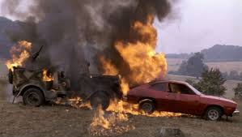
Let us start with a case study in Ethics
(Ford Pinto)

Slide 3
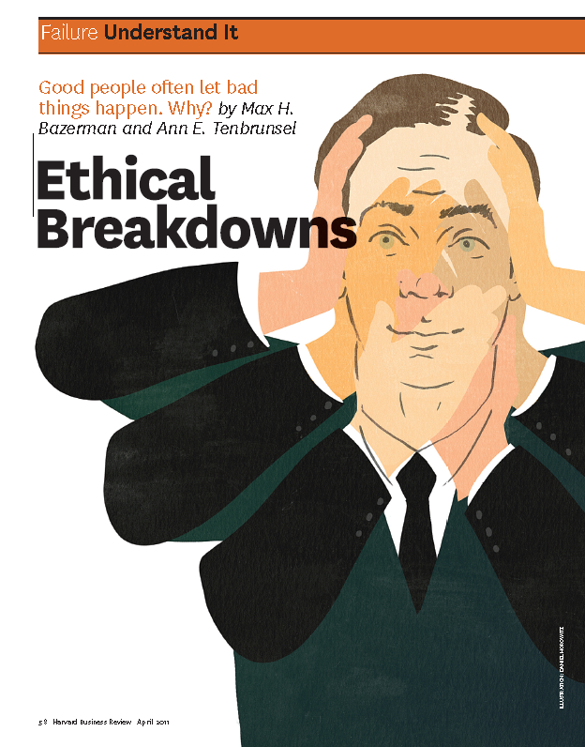

Why do good people that bad things happen?

Slide 4
Ethical Fading?
Ill-conceived goals
Motivated blindness
Indirect blindness
The slippery slope
Overvaluing outcomes

Slide 5
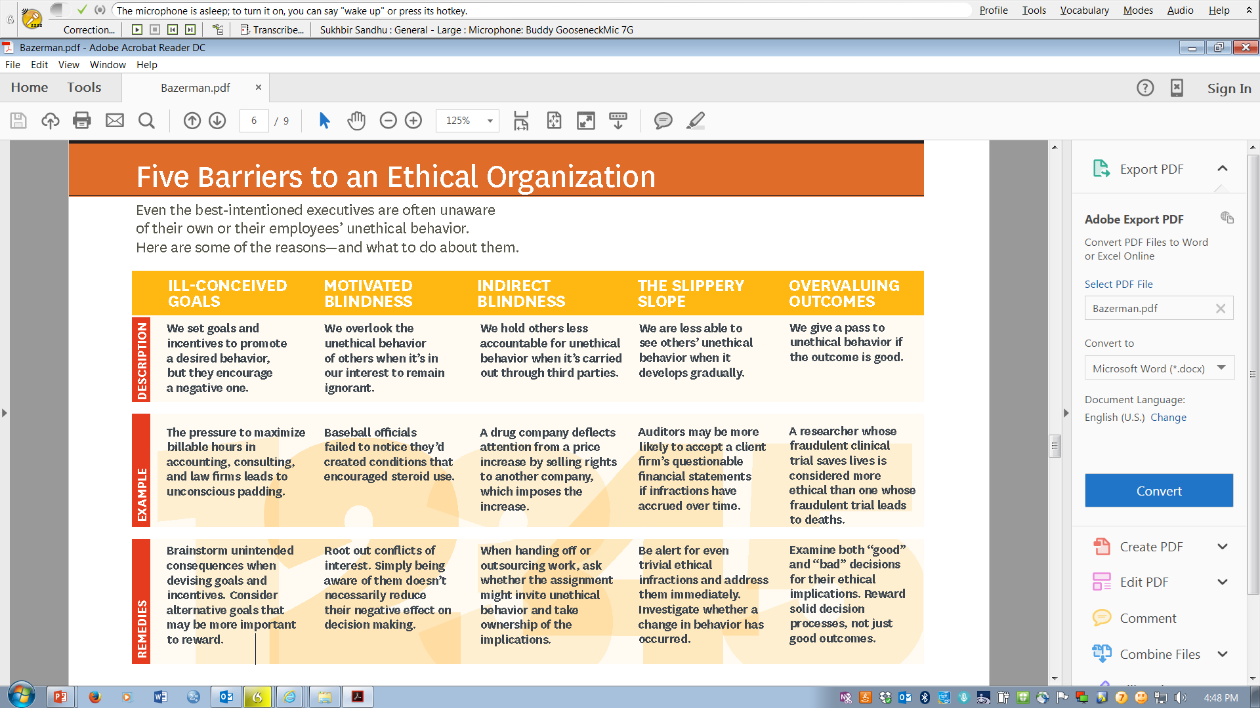

Slide 6
What is this thing called ethics?
Sociologist Raymond Baumhart asked business people, "what is ethics mean to you?”
"Ethics has to do with what my feelings tell me is right or wrong."
"Ethics has to do with my religious beliefs."
"Being ethical is doing what the law requires."
"Ethics consists of the standards of behaviour our society accepts."
"I do not know what the word means."

Slide 7
What is this thing called ethics?
What, then, is ethics?
Ethics is two things.
First, Ethics refers to well-founded standards of right and wrong that prescribes what humans ought to do, usually in terms of rights, obligations, benefits to society, fairness, or specific virtues.
Second, ethics refers to the study and development of one's ethical standards. As we discussed, feelings, laws, and social norms can deviate from what is ethical. So it is necessary to constantly examine one’s standards to ensure that these are reasonable and well-founded. Ethics also means, then, the continuous effort of studying our own moral beliefs and our moral conduct, and striving to ensure that we, and the institutions we help to shape, live up to standards that are reasonable and solidly based.

Slide 8
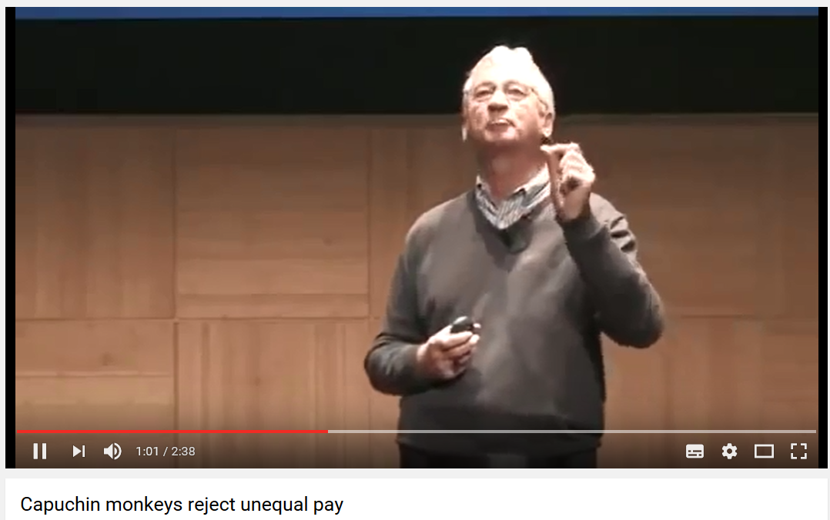
Let us be fair ☺
https://www.youtube.com/watch?v=lKhAd0Tyny0

Slide 9
How do we identify ethical standards?
There are two fundamental problems in identifying the ethical standards
1. On what to we base our ethical standards?
2. How do those standards get applied to specific situations we face?

Slide 10
Ethical Frameworks
Four sources of ethical standards:
The consequentialist approach
The utilitarian approach
The deontological approach
The virtues approach

Slide 11
The consequentialist approach
This approach to ethical decision-making is goals/outcome based where actions are considered to be right or wrong based on their outcomes.
In practice, consequentialism, translates to setting a desired outcome (say, a public policy goal regarding income distribution), and then putting in place the mechanisms to go about achieving this goal.
Where there is a conflict between the general good, and group or individual rights, the general good takes priority.

Slide 12
Utilitarianism
This is based on the idea that we should promote that which produces the greatest good for the greatest number.
In its classical form, utilitarianism seeks the greatest aggregate good through summing the individual welfare outcomes.
Utilitarianism can also produce outcomes that are oppressive to minorities by placing the interests of the many over those of the few.
One of the modern-day tools for making utilitarian decisions is the cost benefit analysis (with the costs and benefits of a certain action (say, introducing regulations to discourage smoking, building a road, opening of forest logging,…) are determined and if the benefits outweigh the costs, then the action is acceptable one to pursue.

Slide 13
Deontological approach
The deontological approach is based on the morality of the actions themselves, independently of the outcome that will follow (" what acts am I obliged to perform or not perform?")
The deontological approach is based on principles of justice, basic rights, duties, obligations, responsibilities, proper conduct, and inherent natural rights of others.
For Immanuel Kant, an act can be seen as morally right if it can be judged by all reasoning people to be a universal principle of conduct regardless of whether a person is the doer of an act, the receiver, or an observer.
The golden rule "do unto others as you would have done unto yourself."

Slide 14
Deontological approach
Principle of universality: act only according to the maxim by which you can at the same time will that it should become a universal law.
Principle of humanity: act so that you can treat humanity, whether in your own person or in that of another, always as an end and never as a means only

Slide 15
Rights approach
Rawls theory of Justice:
Social rules of conduct should be made under a “veil of ignorance”. This idea of a veil of ignorance sees people needing to assume what Rawls calls an “original position” – where the rules by which a society will operate, and hence what is right or wrong in the way our social systems work should be made without anyone knowing what they are lot will be.
To the greatest benefit of the least advantaged.

Slide 16
Virtues approach
A virtue ethics is based on the consideration of what comprises a good human life and the personal qualities/virtues that provide the basis for such a life.
The virtual approach then, asks the question "what kind of person should I be?" - with ethical decision-making based on living up to these virtues.
This approach is not based on a set of rules but rather a set of personal characteristics that, if practised, will see a person likely to make sound choices when confronted with ethical matters.

Slide 17
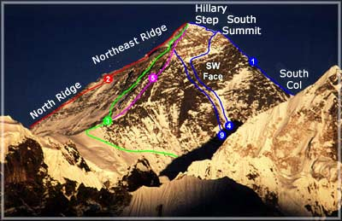

Slide 18
How did I live today?
Did I practice any virtues (e.g., integrity, honesty, compassion)?
Did I do more good than harm?
Did I treat others with dignity and respect?
Was I fair and just?
Was my community better because I was in it? Was I better because I was in my community?

