Slide 1
Academic writing : Language focus

Slide 2
Copyright
COMMONWEALTH OF AUSTRALIA
Copyright Regulations 1969
WARNING
This material has been produced and communicated to you by or on behalf of the University of South Australia pursuant to Part VB of the Copyright Act 1968 (the Act).
The material in this communication may be subject to copyright under the Act. Any further reproduction or communication of this material by you may be the subject of copyright protection under the Act.
Do not remove this notice.

Slide 3
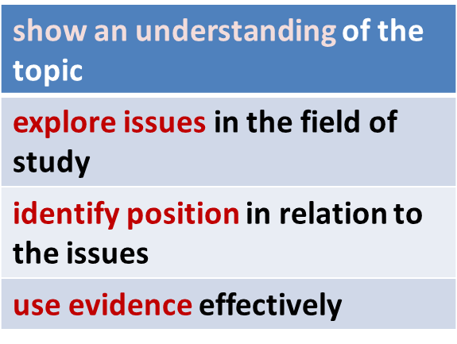
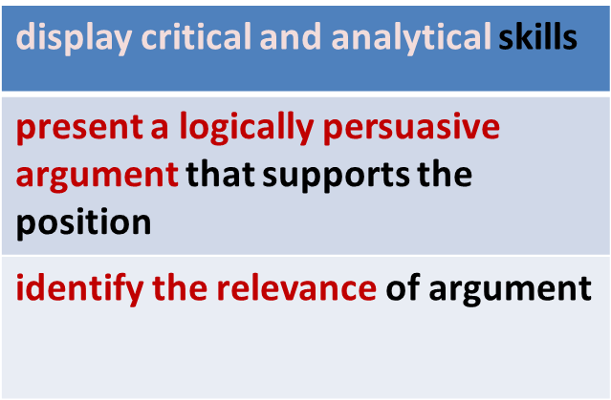
Academic writing
Assignments must be written in an appropriate style.
Style must be consistent and appropriate for audience
Your writing should:
3

Slide 4
Academic writing: Style
Writing style can differ in different disciplines. Look at texts that you read to identify what is acceptable in your area of study. The following rules generally apply:
Rule | Example
Do not use idiomatic or colloquial vocabulary. | (‘man’ instead of ‘guy’)
Use vocabulary accurately. | (‘rule’ or ‘law’; ‘currency’ or ‘money’)
Be precise as possible when dealing with facts or figures. | (‘approximately 50 years ago’ instead of ‘hundreds of years ago’)
Conclusions should use tentative language. | (education tends to reduce crime)
Avoid adverbs that show your personal attitude. | (luckily, surprisingly, etc.).
Do not contract verb forms. | (write ‘do not’ instead of ‘don’t’)
Source adapted from: Bailey, S 2006, Academic writing: a handbook for international students, 2nd edn, Routledge, UK
4

Slide 5
Academic writing: Style (cont’d)
Rule | Example
Do not overuse passive forms. Active forms have their place in academic writing too. | (Angelino and Natvig (2009) argue that effectively engaging students early in their program is a key strategy to reducing student attrition) - Active It is widely agreed that effective student engagement reduces student attrition) - Passive
Do not use question forms. Use statements instead. | (“The factors that contributed to the decline…’ instead of ‘What were the factors that contributed to the decline in…..?’)
When writing lists, avoid using ‘etc.’ or ‘and so on’. | (Students studying in an online environment require more activities that are engaging, ‘talk time’ and scaffolding)
Avoid using two-word verbs | (‘go on’; ‘bring up’. Use ‘continue’ and ‘raise’ instead)
Source adapted from: Bailey, S 2006, Academic writing: a handbook for international students, 2nd edn, Routledge, UK
5

Slide 6
Verbs (formal & modals)
Use formal rather than informal verbs | Early childhood educators are an integral part of the education system. Not Early childhood educators are really important for the education system.
Modal verbs and their functions | Ability: Although ‘may’ or ‘can’ are similar, ‘can’ is more commonly used. e.g. The findings may be interpreted in various ways. e.g. The findings can be interpreted in various ways. ‘Will’ and ‘should’ are used for predictions of near certainty but ‘will’ is stronger. e.g. The findings indicate that a positive stimuli will induce intended behaviours. e.g. Students should be able to master the literacies of their discipline with proper scaffolding.
6
Source adapted from: Bailey, S 2006, Academic writing: a handbook for international students, 2nd edn, Routledge, UK

Slide 7
Verbs: Modals (cont’d)
Modal verbs and their functions | ‘May’ and ‘might’ both suggest possibility. e.g. Online delivery may reduce many of the barriers associated with attending university. e.g. Effectively engaging students early in their program might reduce student attrition. ‘Would’ and ‘could’ are used in conditional situations. e.g. An understanding of the online experience would help inform about better ways to engage with students. e.g. Forging positive relations with teaching staff and students could play a significant role in student satisfaction. ‘Must’ suggests strong obligation and ‘should’ is used for recommendations. e.g. Improvements in learning must occur as the level of student engagement increases. e.g. Learner engagement should manifest in the development of critical thinking skills and higher grades.
7
Source adapted from: Bailey, S 2006, Academic writing: a handbook for international students, 2nd edn, Routledge, UK

Slide 8
Verbs: The passives
The function of passives | Used when the writer wants the reader to focus on the result and not the cause. e.g. Engagement theory was developed in response to educators’ teaching experiences in electronic and educational settings (passive). e.g. Educators developed engagement theory in response to their teaching experiences in electronic and educational settings (active). Note: In the first sentence the emphasis is on engagement theory. In the second sentence the emphasis is on educators. In academic writing, the passive is often used when the cause (person or thing) is less important or unknown.
 | The passive is also used in academic writing to demonstrate a more impersonal style. e.g. The theory was intended as a conceptual framework for technology- based learning and teaching.
8
Source adapted from: Bailey, S 2006, Academic writing: a handbook for international students, 2nd edn, Routledge, UK

Slide 9
Verbs and Prepositions
There are some verbs that are generally used with prepositions
add to | Having access to students from a range of different institutions added to the opportunity to research this field.
agree with | Michael (2012) agreed with other researchers who found that there was resistance to embrace new technologies.
associate with | The practice of teaching is associated with teacher beliefs, values and practices.
believe in | A survey identified that 50 per cent of academics believed in alternative modes of lecture delivery.
blame for | Resistance from some staff about changing their face-to-face teaching is often blamed for the failure of successful integration of technology in teaching.
concentrate on | Researchers argue that there is a need to concentrate on the nature of student engagement given the increased volume of university programs offered in an online mode.
consist of | Some of the challenges that online users encounter consist of uncertainties about interpreting others’ attitudes and values, lack of real-time communication and concerns about where one ‘fits’ in the group.
9
Source adapted from: Bailey, S 2006, Academic writing: a handbook for international students, 2nd edn, Routledge, UK

Slide 10
Verbs and Prepositions (cont’d)
depend on | The authors acknowledge that their theory depends on particular aspects of other learning theories.
derive from | The framework itself derives from five distinctive yet intersecting non-hierarchical elements of engagement.
divide into | Challenges associated with online learning can be divided into two categories.
invest in | Educators need to invest in their teaching in order for reciprocal benefits to flourish in both teaching and learning.
learn from | Both academics and students can learn from the findings highlighted in the study.
pay for | Many students in higher education pay for their degrees by working part-time.
point out | It must be pointed out that both the survey and interview questions covered topics that included decisions around applying for online study.
specialise in | Not many academics specialise in e-technologies.
Source adapted from: Bailey, S 2006, Academic writing: a handbook for international students, 2nd edn, Routledge, UK
10

Slide 11
Reference
Bailey, S 2006, Academic writing: a handbook for international students, 2nd edn, Routledge, UK.
11

