Slide 1
Using sources from your reading to write
Notes:
Slide 1: Introduction
As a student you will be expected to read widely and critically in order to complete the different assessments in your study program. This requires reading from different sources, understanding what you read, identifying and synthesizing key issues from various sources and seeing their link to the overall context. You would then need to quote, paraphrase and summarise the information and use it in your own writing. This presentation introduces you to aspects of citing and referencing. The presentation also introduces you to what and when you need to quote, paraphrase and summarise.

Slide 2
Citing your sources
A process for:
acknowledging the source of your information.
identifying where your evidence comes from.
encouraging and enabling the reader to verify information.
adhering to academic writing conventions.
2
Notes:
Slide 2: Citing your sources
Citing or referencing is a process for acknowledging the source of your information. This is an important process in academic writing as you are expected to acknowledge the source of your information. You also need to identify where your evidence comes so that you can encourage and enable the reader to verify the information that you have presented. Referencing is also an important practice because by doing so, you will be adhering to academic writing conventions.

Slide 3
Why is referencing important?
Good referencing practices:
demonstrate that a range of ideas and approaches have been sought and reflected upon.
emphasise that expert and reliable information have been sought.
prevent circumstances where academic misconduct (plagiarism) can occur.
Notes:
Slide 3: Why is referencing important?
It is important to undertake good referencing practices as by doing so you will be demonstrating to your readers that a range of ideas and approaches have been sought and reflected upon. You would also be emphasising that expert and reliable information have been sought. By referencing, you will be preventing circumstances where academic misconduct can occur. These are all important aspects of academic writing and is expected of you.

Slide 4
Different referencing styles
UniSA Harvard
Harvard
American Psychological Association (APA)
Chicago Manual of Style
Modern Language Association (MLA)
Note: Each of these styles follow different referencing conventions
4
Notes:
Slide 4: Different referencing styles
There are different referencing styles that are used in academic writing and recommended by journal publications. Sometimes these referencing styles are specific to a particular discipline. In UniSA, the recommended referencing convention is UniSA Harvard. However, particular disciplines and schools recommend that their students use other referencing conventions. It is important that you check with your school or Program Director to ensure that you use the correct referencing conventions in your assignments.

Slide 5
When to reference?
You need to include in-text references when you:
include someone else’s words, ideas or information in your assignment.
paraphrase or summarise someone else’s ideas in your own words.
quote someone else’s ideas in their exact words.
5
Notes:
Slide 5: When to reference?
When you produce your assessment, you are expected by your instructors to present a well-researched and critical discussion. This would mean reading widely and critically and using information produced by other expert researchers and authors on the topic to defend your own point of view. When you use other people’s words, ideas or information in your assignment, you need to include in-text references. You would generally paraphrase or summarise the information that you have obtained from other sources and you would need to reference this. A reference is also required when you quote someone else’s ideas in their exact words.

Slide 6
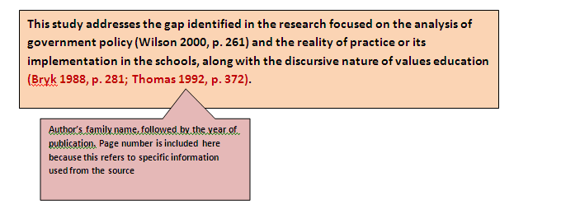
How to reference?
You need to insert in-text reference each time you refer to ideas or information from other sources
You need to include the following details:
the author’s family name (do not include the first name)
the year of publication
Page numbers when appropriate (see below)
6
* Note: the style will change according to the referencing convention you use
Notes:
Slide 6: How to reference?
You need to insert in-text reference each time you refer to ideas or information from other sources. When you reference your source, you need to include the author’s family name, the year of publication and page numbers when appropriate. What does appropriate mean? Refer to the next slide to identify when you need to include page numbers.

Slide 7
When to include page numbers?
You include page numbers in your in-text citation when you:
use a direct quote from a particular source.
summarise a key idea from a particular page.
Copy/adapt tables or figures and present specific information like dates or statistics.
Note: You must include a reference list with your assignment. The reference list provides full bibliographic details for all the sources referenced in your assignment. This helps others to locate the source.
7
Notes:
Slide 7: When to include page numbers?
You include page numbers in your in-text citation when you use a direct quote from a particular source. You would also include page number when you summarise a key idea from a particular page. A page number is also required when you copy and/or adapt tables or figures and present specific information like dates or statistics.
You must also remember to include a reference list of all your in-text citations at the end of your assignment. The reference list provides full bibliographic details for all the sources referenced in your assignment. This helps others to locate the source if they require.

Slide 8
When to quote?
Instances in your writing where you need to quote:
The author has stated the idea in a concise manner and to paraphrase the statement would change its meaning.
The author has made a strong claim and the statement would lose its impact if you changed it.
You cannot communicate the message in any other manner.
The critical orientation popularised in the 1970s and linked to the rise a host of other reform movements like feminism, gay liberation and postcolonialism, ‘aims to engage students more actively in social issues and action’ (Kemmis et al. 1983, p. 129).
The words from the original source are copied directly within quotation marks
‘et al.’ is used when referring to four or more authors in the in-text citation. Only the first author’s family name is used followed by et al. This is followed by the year of publication and page number
Notes:
Slide 8: When to quote?
There are instances in your discussion when you need to quote. This can be when the author of the source that you have been reading has stated the idea in a concise manner and paraphrasing the statement would change its meaning. You also quote when the author has made a strong claim and the statement would lose its impact if you changed it. Moreover, you would also quote when you cannot communicate the message in any other manner. On this slide you can see an example of how quoting of a source is undertaken.

Slide 9
Quoting
A quote may be words you read or hear
Original source must be copied exactly within quotation marks (‘…’)
Quote must be accompanied by a citation (Mott-Smith 2011, p. 7)
A quote is always followed by a page number.
Notes:
Slide 9: Quoting
A quote may be of words you read or hear. The original source must be copied exactly within quotation marks. The quote must be accompanied by an in-text citation. A quote is always followed by the year of publication and page number.

Slide 10
Paraphrasing
A paraphrase is an idea taken from another source but written in one’s own words:
The paraphrase can be of an oral or written source
The words from the original source must not be copied
The paraphrase is not enclosed in quotation marks
The paraphrase must be accompanied by a citation
Notes:
Slide 10: Paraphrasing
A paraphrase is an idea taken from another source but written in one’s own words. The paraphrase can be of an oral or written source. The words from the original source must not be copied. The paraphrase is not enclosed in quotation marks. The paraphrase must be accompanied by a citation.

Slide 11
Paraphrasing example
Original Text
The conservative orientation to education prevailed before the 1960s with schools and teachers taking an authoritative approach and inculcating students with the dominant values, beliefs and practices of the time. Students are seen as passive recipients of this knowledge. Basically educations is seen as preparation for work (Kemmis et al. 1983). Conservative values education approach vary. They can be based on religious or secular conceptions of morality. However, they can be distinguished by their focus on preparing the student to fit or follow the conventions of the social, civil, religious or local community.
Not too many words have been copied from the original. Text is not enclosed in quotation marks. Citation to acknowledge original source.
Paraphrase
Education in the conservative realm took a very authorative approach in that values were always imposed on students who were seen as passive beneficiaries. Schools, generally, prepared students for work (Kemmis et al, cited in Jones 2009). The context of values education in the conservative approach will vary depending on what the definitions of morality is in a particular instance (Jones 2009).
Indirect voice
Notes:
Slide 11: Paraphrasing example
On this slide you can see an example of paraphrasing.

Slide 12
Summarising
A summary is a condensed version of a text:
in the writer’s own words.
with only the main points and no details (examples) included.
that provides a broad overview and is shorter than the original.
with citations of the original source.
Notes:
Slide 13: Summarising
A summary is a condensed version of a text. It is written in the writer’s own words with only the main points. No examples are included. The summary provides a broad overview and is shorter than the original. You need to include citations of the original source when you summarise information.

Slide 13
Summarising example
If key scenes from a novel are pruned for film, audiences often react negatively. However, fidelity is not an appropriate measure for evaluating a film adaptation’s success, as numerous scholars concur (Desmond & Hawkes 2006; Leitch 2008; McFarlane 1996; Miller & Stam 2004).
The writer has consulted different sources on the topic and has summarised the main theme that has been discussed by different researchers.
Notes:
Slide 13: Summarising example
On this slide, you can see an example of a summary.

Slide 14
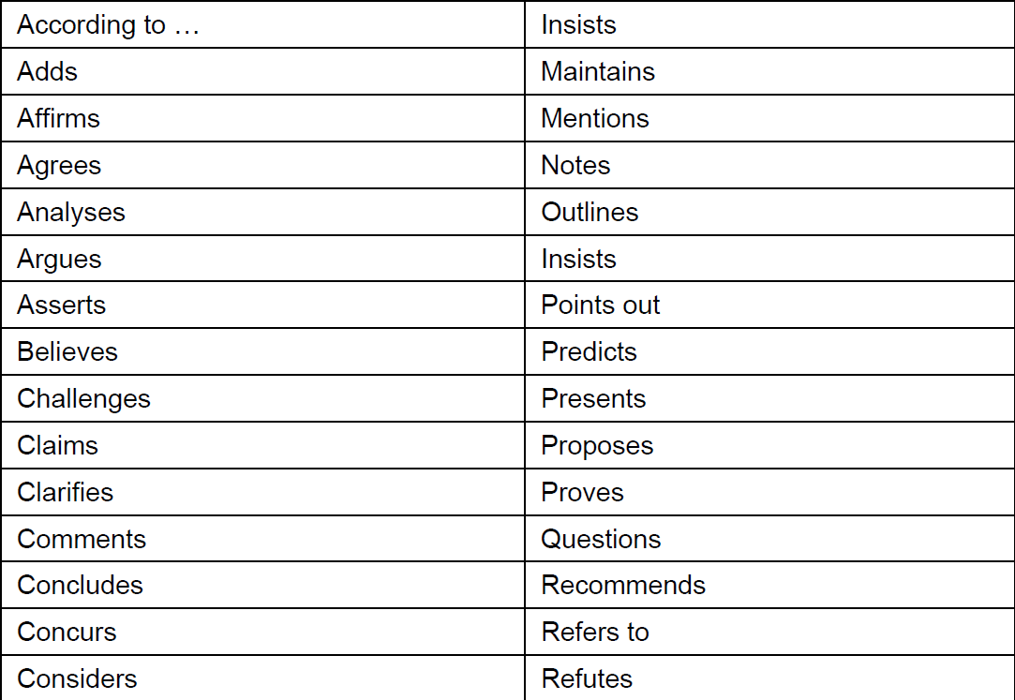
Reporting verbs
W
S
W
Weak
N
N
N
W
N
neutral
N
W
N
W
S
strong
S
S
S
W
N
N
Where you place your references can add/reduce the strength of argument (author prominence)
S
N
S
N
N
N
N
S
N
N
N
W
N
S
Notes:
Slide 14: Reporting verbs
When you refer to ideas and information from others, you would be using reporting verbs to support your discussion. There are many reporting verbs that you can use. On this slide you are introduced to some of them. You can make your argument weak or strong by using the appropriate reporting verbs.

