Slide 1
Reading efficiently
Notes:
Slide 1: Introduction
As a student you will be expected to read widely and critically in order to complete the different assessments in your study program. This requires reading from different sources, understanding what you read, identifying and synthesizing key issues from various sources and seeing their link to the overall context. You also need to be critical about what you read. Being critical means to think more deeply about the information, interpret and evaluate, compare and contrast and assess the text’s credibility, purpose, relevance, currency, strengths and weaknesses. This presentation complements the ‘Reading for writing’ presentation. While the ‘Reading for writing’ presentation focused on the different stages of reading and reading critically, the ‘Reading efficiently’ presentation draws your attention to some strategies that you could use to read more efficiently.

Slide 2
Reading for the assignment
Read for general understanding
Read extensively on the 3 or 4 issues
Identify key issues
Set boundaries by choosing 3 or 4 issues
Read up on issues
2
Notes:
Slide 2: Reading for the assignment.
You would not be able to produce a good quality assignment without doing extensive reading about the topic that you would be addressing. The starting point for doing your assignment is getting the reading done. Once you have understood the task and interpreted what is it that you are required to do, it would be a good idea to begin reading about the topic. This will give you a general understanding about the topic. This is very important as you will not be able to write a good argument if you do not know anything about the topic. Once you begin reading about the topic, you will be aware of the many issues that are related to the topic. Once you know what the issues are, then you can start reading up on the issues in detail. Generally, there will be many issues that are associated with a topic. You would not be able to discuss all of them in your assignment. Hence, you will need to select three or four issues that you will focus on in your assignment. This will of course depend on the word count of your assessment. However, your instructors would rather you choose a few issues and do an in-depth discussion of the issues rather than have a laundry list of issues that are superficially discussed. Once you have selected the issues that you would be addressing in your assignment, you will then have to widely read about the issues. This is so that you are able to present an objective and critical argument about the topic. As you begin writing on your topic, you may realise that you do not have enough content and may have to start the process all over again. Remember, reading is a cyclical process. You will be reading throughout your writing process.

Slide 3
Reading for specific information
Understand
What is the text about? What do the terms mean?
Identify key points
What are the main ideas?
Note key points
Use a note-taking system to record main ideas and referencing details
Summarise key points
Restate main ideas in your own words
Distinguish the significance
Identify how the main ideas contribute to the overall context
Link key points to obtain a context
Synthesise key points from different sources to obtain a context
Notes:
Slide 3: Reading for specific information
Once you have identified the issues that you want to focus on in your assignment, then you would have to read for specific information. *The most important thing when you are reading is to understand what is it that you are reading about. Some texts are more difficult to read than others. Do not be discouraged by the difficulty level of the text. You could look for simpler texts that discuss the same issue. However, you cannot always read simple texts. So, you would probably need to know what the text is about and what the terms in the text mean. *Once you understand the discussion in the text, you would then be able to identify the key points. This will be able to help you identify the main ideas in the text. It is important for you to note the key points as you would be reading a lot and if you do not record what you read, you may forget where you got the information or not be able to find it when you look for it. *You can use a note-taking system that you are familiar with or one that works for you. Remember to note the details about the source such as the author’s name, year of publication, page number, etc. *It is not a good idea to copy word for word from the source. So do try to summarise what you read in your own words. This is a good way to test your understanding of the discussion. If you are able to restate something in your own words, then you probably understand what the author is communicating. Summarising or paraphrasing also comes in handy when you begin writing. *Do also try to distinguish the significance of the key points to the overall context. How are they important to the topic? *While you are reading, you would also have to link the key points to others that you have read about, compare and contrast and interpret what all of this means to the context that you are researching about.

Slide 4
Strategies for efficient reading
Read with a purpose
Practice different reading approaches
Practice active reading
Why am I reading this? What particular answers am I looking for?
Scanning, Skimming, Surveying, Light study reading, Detailed reading, Deep study reading
Underline, Highlight, Use margin to note key words/phrases, Find answers to questions, Summarise
Notes:
Slide 4: Strategies for efficient reading
As you will not have plenty of time to read, you need to make sure that the time you spend reading is used efficiently. *Always ensure that you are reading with a purpose. Be aware of why you are reading the text and what particular answers are you looking for in the text. It would be a good idea to have a list of questions that you want answered. You can come up with a list by looking at the headings, diagrams, etc. or as you are reading something you may come across a question that you want answered.
*Do practise using different reading approaches such as scanning, skimming, surveying, light study reading, detailed reading and deep study reading. You would scan when you want to find a particular item or information. You will skim when you want to gain a quick impression of a text or article. You would survey when you want to uncover the structure and overview of a text or article. When you do light study reading, you would read passively for factual information, general background, and/or with no specific purpose. You would do detailed reading when you read actively for specific knowledge acquisition or for grasp of pre-determined concepts, procedures or theories. When you read to make connections, meaning, consider implications and evaluate arguments, you would be practising deep study reading (Brown & Atkins, 2002, p. 174).
*You need to engage with what you are reading by practising active reading. Otherwise your mind will start wandering and you may lose concentration. Underline or highlight key points or main ideas. You can also use the margin of your text to note key words or phrases in order to summarise the main ideas. You can also actively try to find answers to the questions that you have with regards to the topic that you are reading about. Remember to summarise the information that you read about in your own words. Try not to look at the text when you do this.

Slide 5
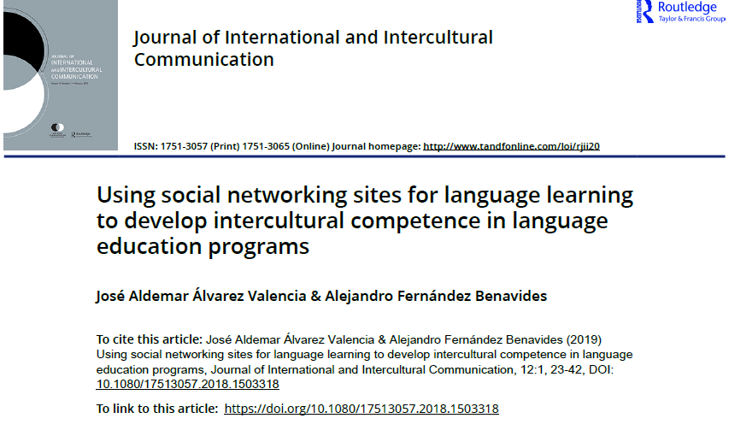
Structure of a text: Title page
Name of journal
Title of article
Name of authors
Publication year
Digital object identifier or doi (the online link)
Notes:
Slide 5: Structure of a text
Each text will have its own layout and structure. As you would be reading many journal articles, the example in this presentation refers to the structure of a journal article. The title page carries information about the name of the journal, the title of the article, the author and the year of publication. These details are important when you cite this source.

Slide 6
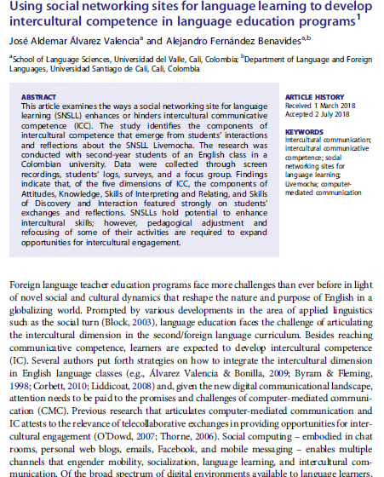
Title of article
Authors
Authors’ affiliation
Abstract
Keywords
Introduction
Notes:
Slide 6: Structure of a text
Generally, you will not be able to read from cover to cover and every section of your text and still keep on top of all your reading. For example, you may need to read a journal article titled ‘Using social networking sites for language learning to develop intercultural competence in language education programs’ in order to complete an assignment. You may have to read the title so that you would be able to identify the content through the key words. The keywords are useful when doing online searches for similar articles on the topic. It will also give you a quick view about the concepts that the article discusses. It would also be a good idea to read the abstract as it provides a brief overview of the discussion. If you are reading a report, the abstract is called the Executive Summary. You then would have to read the introduction as it provides the background, identifies the problems or gaps in the area that is being discussed, states the aim of the discussion and outlines the structure of the argument. Reading all of these sections will help you decide if you could use the information to produce your assignment. However, sometimes you may find valuable information in the body of the article even though the introduction may not match what you are looking for. So, it is a good idea to quickly scan and skim the whole text.

Slide 7
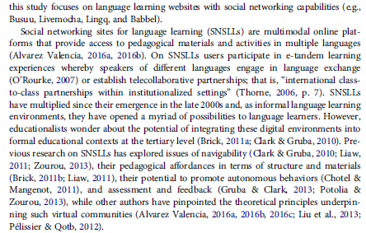
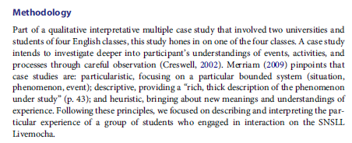
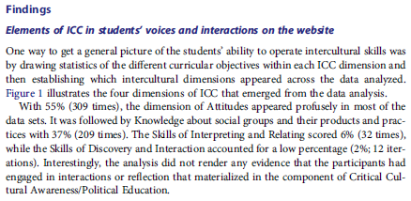
The body
The methodology
The findings
Notes:
Slide 7: The body
The body of the text presents the framework of the argument. It is usually divided into different sections with headings. Some articles will have a literature review, methodology, results, discussion and findings section in the body of the article. The methodology and results section is not important unless you want to replicate the study. The literature review, findings and/or discussion section of an article may be relevant to your assignment as they highlight what the study found and this may be useful to support your own discussion about the topic.
Generally, unless specified by the journal where the article is published, there are no hard and fast rules as to how an author should organise their discussion in the article, so you may come across different structures to a text.

Slide 8
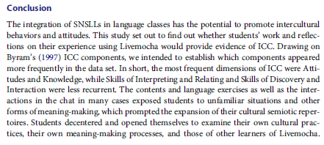
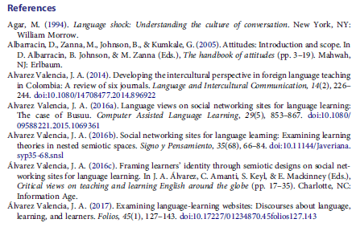
Conclusion
References
Notes:
Slide 8: The Conclusion
The conclusion restates the thesis statement or the main message and recaps main points identified in the body. In a report the conclusion is usually followed by recommendations. Reading the conclusion section helps the reader refocus on the argument or discussion raised in the text.
The author of this text has included a reference list at the end of their article. Sometimes it is useful to scan through the reference list of journal articles as they direct you to other similar articles about the topic. It is also recommended that you list the references you use in your assignment at the end of your discussion. You should use the recommended referencing convention for your assessments.

Slide 9
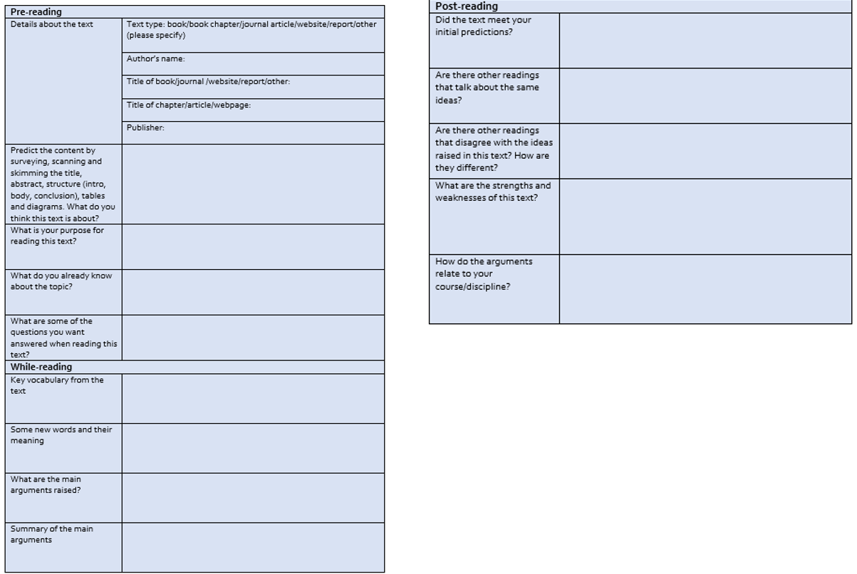
Use a reading log
Notes:
Slide 9: Use a reading log
Using a reading log certainly helps you read more efficiently. A reading log is like a journal that you maintain about the texts that you read. On this slide you can see an example of a reading log. In this reading log, the reading activity has been divided into three categories: pre-, while- and post-reading. Maintaining a reading log similar to the example provided here will also help you with your assignment as you do not have to keep going back to the texts that you read. A reading log will also help you read more efficiently.

Slide 10
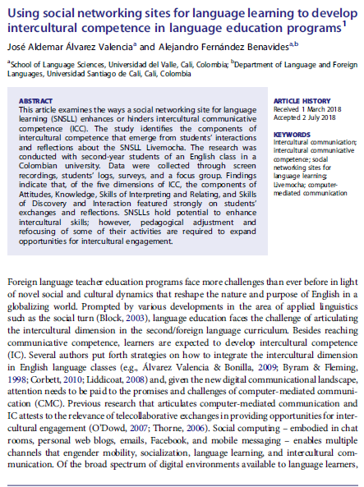
Look at the title. What can you predict about the content from the title? What do you already know about this topic?
Look at the abstract. What is the author’s purpose? From which perspective is the author going to address his main argument?
Look at the topic sentence. What is the main point that will be discussed in this paragraph? How does the author support his main point in this paragraph?
Notes:
Slide 10: Unpacking the text
Let’s look at the text now. *Begin by examining the title of this text. The title reads ‘Using social networking sites for language learning to develop intercultural competence in language education programs’. *Look at the abstract. What is the author’s purpose? From which perspective is the author going to address the main argument? The key words are ‘intercultural communication, intercultural communicative competence, social networking sites for language learning, live mocha and computer-mediated communication’. Based on the key words, what do you think this article will discuss? What do you already know about the article? Look at the topic sentence. The topic sentence is the mini introduction to the discussion in the paragraph. What do you think is the main point that will be discussed in this paragraph? How does the author support his main point in this paragraph?

Slide 11
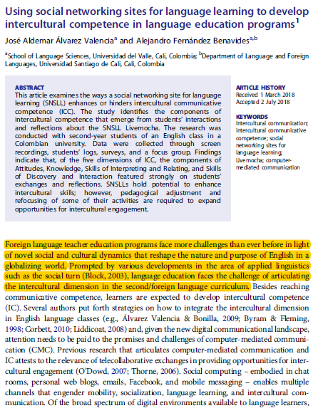
Reading for answers
What is this article about?
What are the main points highlighted in the introduction section?
Why does the author say that foreign language teacher education programs are facing more challenges compared to the past?
Summarising
Developments in applied linguistics such as the social turn has resulted in increased challenges in foreign language teacher education programs more than in the past.
Increased challenges in foreign language teacher education programs.
Learners are expected to acquire communicative and intercultural competence.
Notes:
Slide 11: Active reading strategies
On this slide you can see examples of different active reading strategies that have been used to unpack the text. *Begin by scanning the text to identify new terminology, words or phrases. Use your dictionary to find the meaning. Have a glossary of these words. You not only build on your vocabulary but can also use these words in your assignment. *Having a list of questions before you read helps you focus and have a purpose. You will be engaging with the text as you will be actively trying to find answers to the questions you have. Underlining or highlighting key ideas in the text is another strategy that you could use while you are reading. However, you do have to be careful so as not to highlight and underline everything on the text. A lot of what is presented in a text comprises examples to make a main idea clearer. This is usually not important. *You can also use the margin of a text to summarise key ideas. You can use two or three words to restate the key ideas in your own words. This will be very useful when you are citing this information in your assignment as you have already paraphrased or summarised the information. *Finally, a good strategy to use would be to summarise what you read. This will ensure that you have understood the writer’s arguments. Try not to look at the text when you summarise but do remember to check to see if you have captured the meaning correctly. There are other techniques that you could use such as mind-mapping, using visuals, tables, etc. to help you unpack the discussion.

Slide 12
Practice using the reading strategies
https://www.tandfonline.com/doi/full/10.1080/17513057.2018.1503318
Notes:
Slide 12: Practise using reading strategies
The link on this slide will take you to the full article. Click on the PDF icon to access the article. Do use the article to practise the different strategies that have been introduced thus far. Do also watch the ‘Reading for writing’ presentation to identify how to read more critically. Use the reading log to guide you through your reading of the article.

