Slide 1
Reading for writing
Notes:
Slide 1: Introduction
This presentation draws focuses on reading for all your assessment tasks. The presentation among others will draw your attention to the types of texts you would need to read, your tutor’s expectations, strategies to practice efficient reading and processes to undertake critical reading. You will find that the amount of reading you do will impact on the writing that you produce for the tasks. You will be expected to read widely and critically. In order to do that, you would have to practice efficient reading strategies.

Slide 2
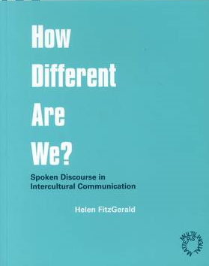


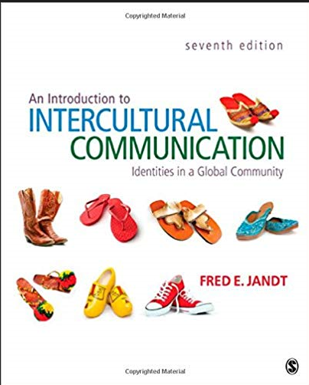
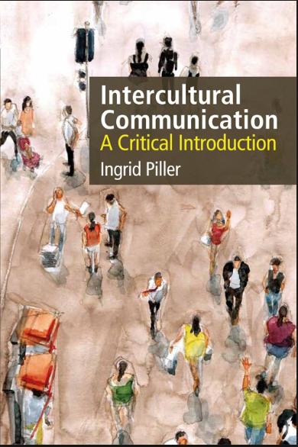

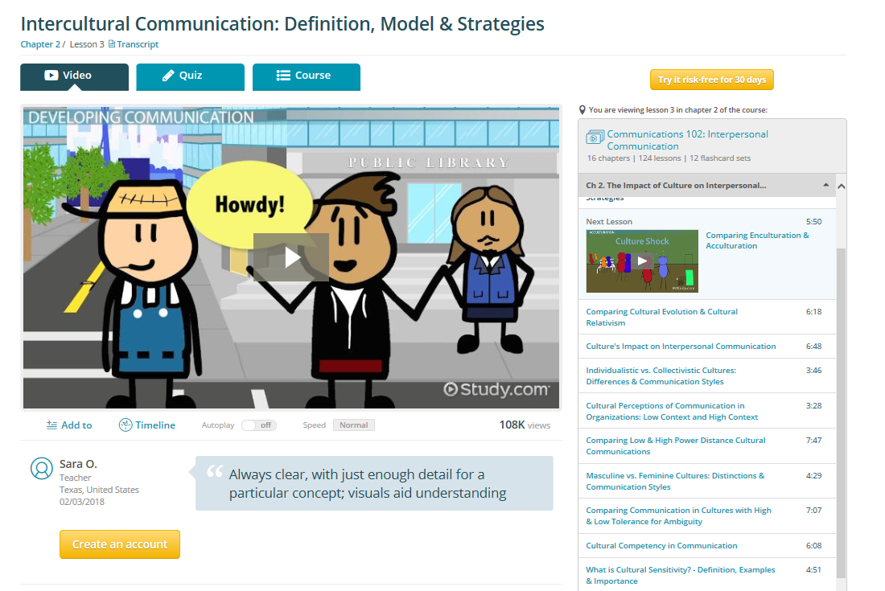
Types of academic texts
Textbooks
Journals
Reports
Websites
Policy documents
2
Notes:
Slide 2: Types of academic texts
You will be expected to read widely and critically for the different assessment tasks for this course. The textbook will give you a general understanding about the concepts for this course. You should not start and end with the textbook but go beyond that. Look at the different journals that may be relevant. Journal articles present the latest research and findings about a topic compared to textbooks. Do also read reports that have been published as they will afford you with the underlying principles as to why something was undertaken in a particular manner. Look at websites but be careful of websites like Wikipedia as anyone can post on these websites, you will not be able to identify the credibility of the information. It would be a good idea to use credible databases. The library has got many scholarly and peer-reviewed sources. Other sites such as those ending in .org or .edu are usually credible as well. If you are not sure, talk to an Academic Librarian about this. Do not forget to refer to the presentations on how to search for sources from the library website.

Slide 3
Your tutor’s expectations
When you read for your assignments, you :
explore current debates in your field;
identify the issues;
consider the different perspectives of researchers;
distinguish evidence that would support your arguments;
interpret and evaluate the information; and
practise critical reading.
3
Notes:
Slide 3: Your tutor’s expectations
Your tutors expect you to demonstrate that you have engaged with the readings associated with the topics. You need to explore the current debates related to the topic and identify the issues that are being discussed. Identify what different researchers are saying about the topic. You need to provide an objective account of the topic. This means you need to identify that there are people who agree and disagree with the proposition. You have to be critical and only select evidence that would support your arguments. Your tutors would be able to tell if you understand what you read and are able to apply these in your discussion, when they see the evidence that you have used. They also expect you to interpret and evaluate what you read. If you just describe everything that you have read, then your tutors will know that you have not been able to do this or did not engage with what you had read.

Slide 4
Practise efficient reading
4
Notes:
Slide 4: Practise efficient reading
You will be reading quite a bit for your different courses. In order to keep up with your reading load, it is really important that you practise efficient reading. Efficient reading simply means practising the pre-, while and post-reading strategies. Always begin by identifying why you are reading a particular text. This will help you find the answers or information that you are looking for. Reading without a purpose will make you waste a lot of time because you will not be able to find information that you want. Do not begin with detailed reading as soon as you get something. Always scan the text quickly. To scan is to move your eyes quickly across the page looking for a particular word or phrase. Once you have found it then you have to skim the sentence quickly to identify if this is what you are looking for. If it is not, then continue scanning the rest of the text. It will be useful to scan and skim the title of texts, abstracts, the introduction, conclusion or any other visuals in the text. You would save a lot of time if you practise pre-reading strategies before you actually start reading because you will be able to screen through a lot of unwanted material right at the start. Do also use your background knowledge about the topics to engage with the texts. Ask yourself what you already know about the topic. What do you need to look for or explore further, what are key terminologies, etc. Write down words or phrases associated with a topic and try to locate them in the texts while you scan. This will give you some direction.

Slide 5
Practise efficient reading : While
5
Notes:
Slide 5: Practise efficient reading: While
Only when you have found the information that you are looking for should you begin detailed reading. Try to interact and engage with what you are reading. Otherwise, you will find that you forget what you read or cannot engage with what you are reading. In order to interact and engage with the texts you read, have a list of questions for which you are seeking answers to. Highlight key words or phrases but remember not to highlight everything you read. You have to be very selective. Take notes while you read. One good technique is to use the margin of texts you read to condense an idea into two or three words. This not only forces you to understand what you read but also to paraphrase and summarise key ideas. You can use mnemonics. This is a strategy where you take the first letter of a concept and string them together to create a statement that makes sense only to you. For example, in order to remember the colours in a rainbow, you might write down something like this: Vivian (Violet) is (Indigo) buying (blue) greenish (green)-yellow (yellow) ornamental (orange) robes (red). You can also use mind maps to take notes as well. There are many forms of mind maps that you could use. A google search will show you how to draw up a mind map. Finally, you can also summarise what you read as a form of note-keeping. This is a very efficient way of note-taking as you will be forced to identify only the key ideas and to write short and concise information. Remember to jot down the full references of the sources where you get the information from, no matter which form of note-taking you employ.

Slide 6
Practise efficient reading : Post
6
Notes:
Slide 6: Practise efficient reading: Post
Always remember to review what you read. You may have misinterpreted or misquoted something. Do also reflect on what you read. Ask yourself if this information could be related to something else that you read in the past. Is this similar or different to other ideas? Are there a group of people saying the same thing? Can this be applied to your context?, etc.

Slide 7
Critical reading for writing
Critical Reading
Critical Writing
What do you have to do when you read critically?
Think more deeply about your learning
Understand, interpret and evaluate
Apply the theories and concepts that you have learnt
Compare and contrast different debates and discussions
Assess what you read by identifying the author’s purpose, credibility of information, relevance, currency, strengths, weaknesses, etc.
7
Notes:
Slide 7: Critical reading for the essay
Critical reading will transform into critical writing. When you read critically, you will think more deeply about your learning. You will be able to relate the concepts and theories that you have been introduced to the information that you read. You would be able to understand, interpret and evaluate what you read based on what you have already been introduced to. When you read critically, you would compare and contrast the different debates and discussions and select as well synthesise the information that is relevant to your own arguments. You would also not accept everything you read at face value. You would be able to identify the author’s purpose, the credibility of information presented, its relevance to your own essay, how current the information is, its strengths and weaknesses, etc. If you are able to do this effectively, you will notice that you are also able to produce a critical piece of writing.

Slide 8
Questions to ask when reading critically
What position is the writer presenting? | √ | Have I encountered this argument before? | √
What is the writer’s argument? | √ | Have I encountered a different argument somewhere else? | √
What is the writer’s perspective? | √ | Is the writer basing their arguments on a particular theory/approach? | √
What evidence has the writer given to support their position? | √ | Are the writer’s claims reasonable? | √
Is the evidence presented accurately? | √ | How does the writer’s claims compare with others in the field? | √
Is the evidence valid? | √ | What is the writer’s final point? | √
Has the evidence been collected using appropriate methods? | √ | Do I agree with the position the writer is presenting? Why? | √
8
Cottrell, S. 2011, Critical thinking skills: developing effective analysis and argument , 2nd edn, Palgrave Macmillan. Basingstoke, Hampshire.
Notes:
Slide 8: Questions to ask when reading critically
What does it mean to be critical? On this slide you will see a list of questions that you could ask yourself when you are reading a text. These questions will help you towards critical reading. If you practise this enough, soon it will become part of everything that you read.

Slide 9
Transforming critical reading into writing
Begin with the title to identify key debates or conflicts | √
Be clear about your own perspective/stand on the issue/topic | √
Consider how you will convince other people of your point of view (a line of reasoning, a set of reasons presented in a logical manner to support the conclusion) | √
Identify and evaluate evidence to see if it supports your argument | √
Engage actively in the debate with different points of views (read, reflect, question, evaluate, weigh up arguments and identify the strengths and weaknesses) | √
Structure your argument in a clear and logical manner | √
9
Cottrell, S. 2011, Critical thinking skills: developing effective analysis and argument , 2nd edn, Palgrave Macmillan. Basingstoke, Hampshire.
Notes:
Slide 9: Transforming critical reading into writing
How do you transform your reading into writing? Begin with the title to identify key debates or conflicts. For the assessment tasks in this program, you need to identify the key words or phrases related to each of the topics. Identify your proposition or stand. Do you agree or disagree with the proposition? Consider how you will convince your reader with this proposition. You need to provide a line of reasoning that will convince them. You need to provide a set of reasons that are presented in a logical manner to support your arguments. Use only evidence that will strongly support your arguments. Show that you are actively engaging in the debate by presenting different points of view. Do be aware that your reading does not begin and end at the start of your writing process. At every point of your writing process, you may have to read some more to find evidence to support your discussion. Ensure that you present your arguments in a clear and logical manner that is easy to follow. Remember, your writing should not only make sense to you but to everyone else who reads it.

Slide 10
Resources for reading
https://lo.unisa.edu.au/mod/book/view.php?id=1144639&chapterid=169632
10
Cottrell, S. 2011, Critical thinking skills: developing effective analysis and argument , 2nd edn, Palgrave Macmillan. Basingstoke, Hampshire.
Notes:
Slide 10: Resources for reading
On this slide you will see a link to the study skills page on the study help website. You will find many additional reading resources here that may be beneficial to you.

