Slide 1
WELF1019: Assessment 1 – Comparative Study
Dr. Shashi Nallaya
Notes:
Slide 1: Introduction
This presentation focuses on Assessment 1 which is a comparative study. The presentation focuses on the task, the structure of the task, the three genres that you have to produce in your task and examples as well as the rationale component. It is important that you understand the requirements of the task before you begin doing it. If you do not understand what is required, it would be a good idea to consult your tutor.

Slide 2
The task
Research and write a message to three (3) different people
in three(3) different genres (formats)
The formats are: a text message, an email and a formal letter
Research about composing effective communication in these formats
Incorporate the information to write each piece of text: text message (160 characters); email (100 words including To, From, Date, Subject); letter (250 words including address, etc.)
Write a rationale for each (250 words - justification) with references
Notes:
Slide 2: The task
This assessment is called a comparative study and the word limit is 1000 words. The weight for this assessment is 25% of the total grade for the course. For this assessment, you are required to research about the three genres or formats highlighted in the task. Then, using the principles identified in your research, you have to write to three different people: your best friend, your tutor and the Regional Manager. You are to write a text message to your best friend; an email to your tutor and a formal letter to the Regional Manager. The content for each of these formats are specified in Slide 4. It is important that you research about the principles of composing effective communication for each of these formats before you begin writing. You have to write a text message that is 160 characters long. The email should be written in 100 words, including the ‘To, From, Date and Subject’. The formal letter to the Regional Manager should be 200 words in length inclusive of the address, etc. Each form of communication must be accompanied by a rationale of 250 words. The rationale is an explanation about why you have composed your different forms of communication in the way you have. The rationale should include in-text references from your research and readings.

Slide 3
Before you begin
Do your research and read widely.
Find out what the experts/scholars are saying about writing text messages, emails and formal letters.
Use these principles in composing your own texts.
Relate back to this when you write the rationale for each of the texts.
Don’t forget to cite the references if you take ideas from other people.
Notes:
Slide 3: Before you begin
It is strongly advised that you do your research early and read widely about the three different formats of communication highlighted in this assessment task. Identify what experts and scholars are saying about writing text messages, emails and formal letters. Use these characteristics to compose your own communication. Remember to relate these aspects to your rationale for writing each of these communication forms, the way you have.

Slide 4
The scenario
You are elated and can’t wait to text your best friend with the news.
You are a human service worker working in a non-government human service organisation. You have only been in the position for two months. You have just received a phone call from a travel company to say you have just won a seven day trip to Rome leaving in three weeks.
There is also issue with your part-time studies. You are studying to become a social worker. Your university expects that students will attend and participate in all tutorials. If you go to Rome you will not be able to attend that week’s tutorial. You need to email Kumi, your Japanese tutor about this.
There is the issue of taking leave from work. You have not been there long enough to accumulate the necessary annual leave. You have consulted your supervisor about taking leave this early in your employment. Your supervisor suggests you write to the Regional Manager, Ms. Smith to request leave.
Notes:
Slide 4: The scenario
Pretend that you are a human service worker working in a non-government human service organisation. You have only been in the position for two months. You have just received a phone call from a travel company to say you have just won a seven day trip to Rome leaving in three weeks. You have to communicate this message in different forms and format to your best friend, your tutor and Ms. Smith, the Regional Manager. You are extremely happy and can’t wait to text your best friend with the news. You are studying part-time at the university to become a social worker. You are expected to attend and participate in all your tutorials. However, if you go to Rome you will not be able to attend that week’s tutorial. You need to email Kumi, your Japanese tutor about this. You also have to take leave from work but you have not worked there long enough to accumulate the necessary annual leave. You have discussed this with your supervisor who has suggested that you write to Ms. Smith, the Regional Manager to request for leave. Be aware that you are writing to three different people who are located at three different points of the formality continuum. Be sure that you demonstrate this in your communication. For example, the way you text your best friend will be very different from the way you write to Ms. Smith.

Slide 5
Layout
Introduction
Text message to friend
Rationale
Email to tutor
Rationale
Formal letter to RM
Rationale
Conclusion
Notes:
Slide 5: Layout
Do not forget to structure your assessment in the manner identified in this slide. Do write a brief introduction for your task. This is not the traditional introduction that you would be expected to write for your other academic assignments. In the introduction, you can briefly highlight the importance of effective communication in social work. You can also state something about how the content of the communication is often determined by factors such as who the recipient is and the format. Briefly introduce what the aim of the comparative study is. Next, present the text message to your friend. Provide the rationale or justification as to why you presented your text message in the manner you have. Use the information that you have derived from your research to justify your message. This should be followed by the email to your tutor and the rationale. Then you have to present the formal letter to Ms. Smith, the Regional Manager and the rationale for this. Your discussion should be completed with a conclusion. In this section you can reiterate the importance of writing effective communication and restate particular elements that the message composer would need to consider when attempting to communicate to different people in your discipline.

Slide 6
Text messaging (160 characters)
Written form of communication that takes place interactively.
Merges written and oral communication.
Features include:
abbreviations (Prof.);
Acronyms (UK);
Emoticons (☺);
Misspellings (dis - this); and
vocabulary that may be understood by two people who consistently text each other but not by others.
Tone: informal
Language: informal
Notes:
Slide 6: Text messaging (160 characters)
The text message is a form of communication that takes place interactively. This means that you would be writing as if you are speaking to someone. This form of communication merges written and oral communication. The text message is characterised by particular features due to space restrictions. Elements such as abbreviations, acronyms and emoticons are commonly used in text messages. Misspelling is also common but this depends on who the recipient is. You wouldn’t misspell if you are texting someone of authority. Often the writer would use vocabulary that is only understood by the recipient. This too will depend on the recipient. The more familiar you are with someone, the more unique the vocabulary will be. Both the tone and language of the text message is informal.

Slide 7
Some examples
Thank you for ditchin me i had been invited out but said no coz u said u were comin and u said we would do something on the sat and now I have nothing to do all weekend I am a billy no mates I really hate being single
Hey i know u r at work but i just wanted to let you know that i found my pen lid…it was in d bin ☺ xx
Brur its 2bed 1 matras my darling is going to put me in shid in church. My money I have save have been decrease due 2 da Aunt Mayloy’s funeral & miner problst. So da case is coming very soon
Notes:
Slide 7: Some examples
On this slide you will see some examples of text messages. Most of the characteristics identified in the previous slide can be observed in the examples.

Slide 8
The email (100 words)
Writing style is more informal (will vary depending on context).
Abbreviations, slang, colloquialisms and jargons are common.
Is someway like a speech (use of first and second person pronouns, present tense).
Unformatted plain text.
Formality-informality continuum of communication models
(Eunson 2012, p. 155)
Notes:
Slide 8: Email (100 words)
Although the writing style employed in an email is informal, this will depend on who the recipient is. In the diagram presented on this slide, you will notice that emails are located towards the end of the informal continuum. However, you are still required to employ a formal tone, style and language when you write to your tutors, course coordinators, program directors, supervisors, etc. Do ensure that you only write formal emails when you communicate with people of authority. Characteristics such as abbreviations, slang, colloquialism and jargons are common in emails. The email is very similar to verbal communication in that the writer would use first and second person pronouns, the present tense, etc. It is also written in unformatted plain text. You are expected to write your email in 100 words.

Slide 9
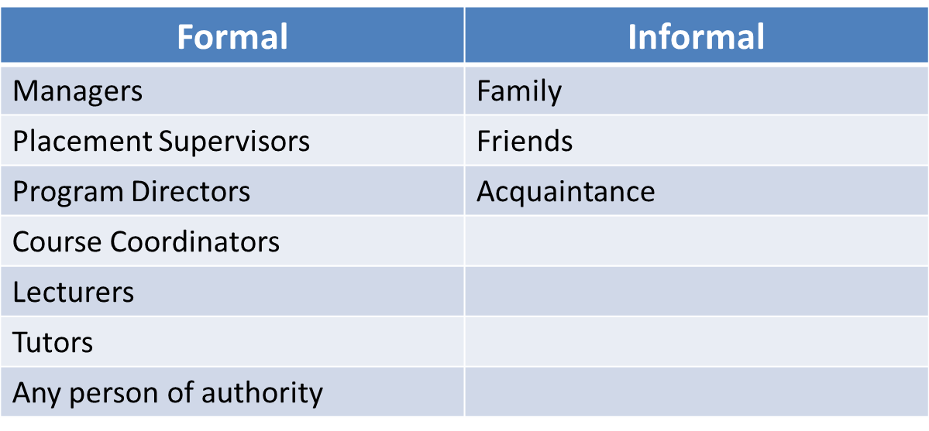
The email: Formal vs informal
Notes:
Slide 9: Email : Formal vs informal
On this slide you will see two columns identifying the type of email you would send to particular people. If you have to communicate with any of the people identified in the left hand column under the ‘formal’ heading, you would have to write formal emails. The tone and style of a formal email is quite different from an informal email that you would send to family and friends. For instance, you cannot begin your email with a ‘Hi’ or use their first name unless the person you are writing to has given you permission to do so. It is always a good idea to use their title and family name. For example, you could begin your email with ‘Dear Dr. Buchanan’ or Dear Dr. Hudson. You would also have to be very clear by providing as many details as possible so that the recipient knows who you are and what you are writing about. Your Program Directors, Course Coordinators, Placement Supervisors and Tutors deal with many other students and may not be able to identify who you are unless you make this clear. Remember the people specified in the left hand column are all very busy and would appreciate the efficient use of their time.

Slide 10
The email: Structure
Getting message upfront is usually the most suitable approach.
Consider using the MADE structure (Eunson 2012) for formal emails:
Message;
Action;
Details; and
Evidence.
Structure for informal emails will depend on who the message is intended for (family, friends, colleagues, etc.), familiarity and reason for communication (inform, share, request, etc.).
Notes:
Slide 10: Email: Structure
As was highlighted in the earlier slide, the people whom you would write formal emails to are usually very busy and thus would appreciate the efficient use of their time. It is usually a good idea to get the message across upfront. One technique is to use the MADE structure. This is an acronym for Message, Action, Details and Evidence. This means you would identify yourself and state the message at the beginning of the email. Next you would specify what you or the recipient ought to do, i.e. the action. This will be followed by the details of the required action. Finally you will provide evidence where necessary. The structure for informal emails would depend on who the message is intended for and why it is being written. The structure of informal emails would also depend on how familiar you are with the recipient.

Slide 11
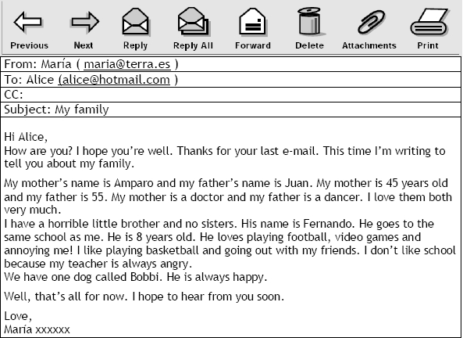
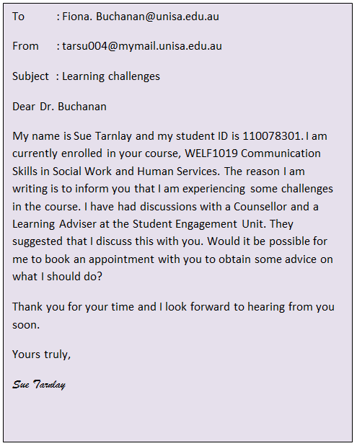
Example: informal and formal emails
Notes:
Slide 11: Example: informal and formal emails
On this slide you can see two examples, one is an informal email and the other, a formal email. Observe the structure, tone and style of both the emails.

Slide 12
The formal letter (250 words)
Notes:
Slide 12: Formal letter (250 words)
One of the tasks for this assessment is for you to write a formal letter of 250 words to Miss Smith, the Regional Manager in your organisation, to request for leave. Letters are often used in organisations to persuade others. One structure that is often used in persuasive documents is the AIDA which is the acronym for Attention, Interest, Desire and Action. You would begin the letter by evoking the reader’s attention. You would then try to maintain their interest in what you have to say and get them to read on. You would then motivate their desire to meet your request. Finally you would convince them to act upon your request. The tone and language employed in formal letters is formal and respectful.

Slide 13
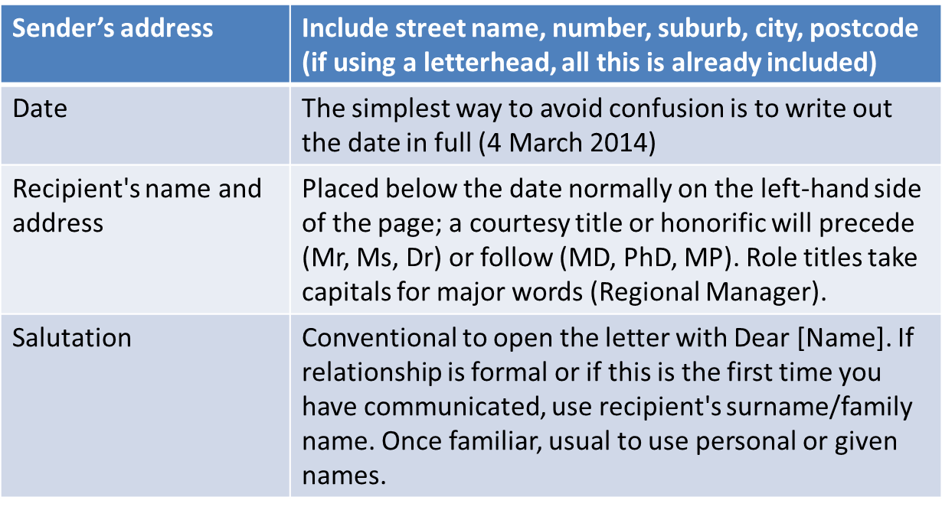
Components of formal letter
Notes:
Slide 13: Components of formal letter
On this slide, you will see the different components of a formal letter in the left-hand column. In the right hand column you are provided with some explanation as to what these components comprise.

Slide 14
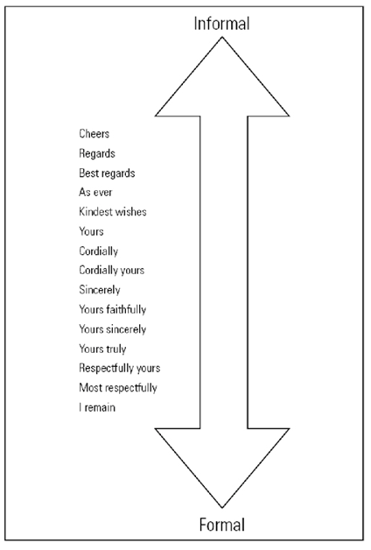
Components of formal letter (cont’d)
Subject line | A way of instantly telling the reader what the letter is about. It is placed between the salutation and the body.
Body of a letter | Contains the substance of communication. Style and structure are largely determined by the kind of letter you are sending
Close | A complimentary way of terminating your letter with courtesy. This will vary according to the situation and the tone appropriate to the situation
Signature block | Contains writer’s signature
(Eunson 2012, p. 26)
Notes:
Slide 14: Components of formal letter (cont’d)
This is a continuation of the previous slide. Look at the different components of a formal letter and what they comprise. On the right side of the slide you will see different ways of ending the letter. This ranges from a continuum of informal to formal.

Slide 15
The formal letter: An Example
Your contact information
Recipient's details
Date the letter was written
Salutation
Sometimes in big organisations the mail is opened by an assistant so it is good to specify
Subject
Close
Sign off with signature, full name and title
Dear Sir/Madam: Yours faithfully
Dear Ms. Smith: Yours sincerely
Yours truly works for either
Notes:
Slide 15: An example
The components highlighted in the previous two slides are illustrated in this example. How you close the letter depends on how you start. If you begin your letter with ‘Dear Sir/Madam’, then you would close it with ‘Yours faithfully’. However, if you begin with a name, for instance, ‘Dear Ms. Smith’, then you would close with ‘Yours sincerely’. ‘Yours truly’ works for either salutations.

Slide 16
The rationale (250 words each)
An explanation of why you composed your texts (text message, email, letter) in manner that you have.
An explanation of what you had to consider and why when composing your texts (guided by your research and readings).
Example
The text message in this assignment is short and concise as only 160 characters are allowed when sending SMSes (a reference here would be good). Furthermore, according to Tagg (2012) often text messages are used for convenience by busy people on the go. The reason emoticons and abbreviations have been used in the text above is because the writer is busy juggling work as well as studies and does not have the time to compose lengthy messages. Moreover, text messages are not free and cost money (Baron 2008). Thus it is important to keep the message short.
Notes:
Slide 16: Rationale (250 words)
Each of the three forms of communication you compose for this comparative study should include a rationale of 250 words. A rationale is an explanation of why you produced your communication in a particular manner. You have to specify what you had to consider when composing the different forms of communication and why. This should be guided by your research and readings on the different communication forms that you have to compose for this assessment. A rationale is a justification for doing something. It is not just a description of what your texts comprise. If you just list all the things you did, then you would not obtain good marks for this section. You have to highlight particular characteristics of the communication and why you composed it in this manner. Ensure that your communication forms are directed by characteristics highlighted in your readings. Do not forget to include the evidence or support for your discussion. A brief example has been provided on this slide to show you how the rationale should be written.

Slide 17
References
Baron, NS 2008, Always on language in an online and mobile world, Oxford University Press, Oxford.
Eunson, B 2012, Communicating in the 21st century, 3rd edn, John Wiley, Milton, Queensland.
Tagg, C 2012, The discourse of text messaging analysis of SMS communication, Continuum International, London.
Notes:
Slide 17: References
The information shared in this presentation has been adapted from the texts identified on this slide. You are strongly encouraged to do the course readings first before you refer to other texts.

