Slide 1
Report writing
Notes:
Slide 1: Introduction
As part of your assessment for this course, you will be required to write a report based on the online presence of a non-profit organization. A report is an informative piece of writing that responds to a specific brief. This presentation focuses on particular aspects of report writing such as the structure and style of a report. Examples of the different components of the report are also provided.

Slide 2
What is a report?
A well organised document that:
defines and analyses a subject or problem.
records a sequence of events and interprets its significance.
evaluates the facts or results of research presented.
discusses the outcomes of a decision or course of action.
concludes about a subject or problem based on evidence.
makes recommendations about a subject or problem.
Gould 2011
Birmingham City University
Notes:
Slide 2: What is a report?
A report is a well-organised document that defines and analyses a subject or problem. It records a sequence of events and interprets their significance. A report also evaluates the facts or results of research that is presented. It discusses the outcomes of a decision or course of action. A report also provides conclusions and makes recommendations about a subject or problem, based on evidence.

Slide 3
Characteristics of a report
Informative and fact-based
Formally structured
Has section headings
Often uses bullet points
Includes tables or graphs
Offers recommendations
Written with a specific purpose and reader in mind
Written in a style appropriate to each section
Shahabudin, Taylor, Turner, Reid 2016
University of Reading
Notes:
Slide 3: Characteristics of a report
A report can be differentiated from other forms of writing such as the essay in that it is informative and fact-based. It is also formally structured with section headings and sub-headings. The authors of reports sometimes use bullet points to make the discussion clear, concise and easy to follow. Where appropriate tables and graphs are also included to communicate statistics or concepts that are associated with the subject or problem that is being discussed. The report is written with a specific purpose and reader in mind and so the information that is discussed in the report is directed by this. Recommendations are also usually offered at the end of the report as possible solutions to the problem that had been raised and discussed in the document. The report is also written in a style that is appropriate to each section.

Slide 4
Initial preparation for writing a report
√ | Analyse your brief carefully to understand the topic or question.
√ | Know what the purpose of the report is. - Ask yourself this question when you are researching, planning and eventually writing.
√ | Know who it is being written for.
√ | Identify what your objective is in writing the report. - Is it to inform, to argue, to persuade or to evaluate?
√ | Understand what the reader wants to see in the report and what they will do with it.
Gould 2011
Birmingham City University
Notes:
Slide 4: Initial preparation for writing a report
There are particular things that you need to do before you begin writing the report. You have to begin by carefully analysing your brief or task in order to understand the topic or question. It would be a good idea to know what the purpose of the report is. You need to constantly ask yourself this question when you are researching, planning and eventually writing. This will ensure that you are on the right track and are addressing the requirements of the task. It is also important to know who it is being written for. This will direct the information that you write in the report. Along with knowing what the purpose of the report is, it also a good idea to know what your objective is for writing the report. Is the report to inform, to argue, to persuade or to evaluate? Knowing this will ensure that the appropriate style and tone is used to write the report. Do also understand what the reader wants to see in the report and what they will do with it. Knowing this information will help you decide on what information needs to be included.

Slide 5
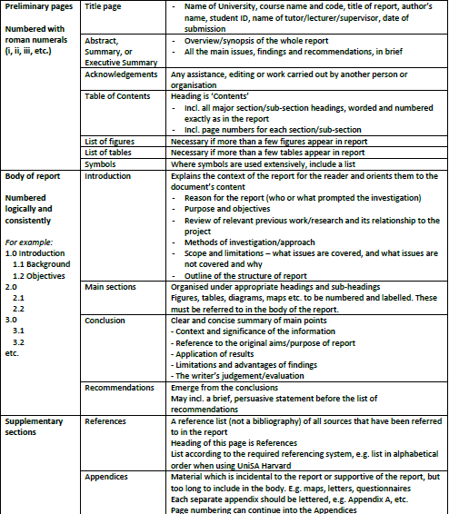
Structure of a report
Notes:
Slide 5: Structure of a report
A report is a document that is structured in a particular manner. On this slide you can see an example of how the different sections in a report have been organised. The preliminary pages of a report usually contain a title page, the abstract or the executive summary, acknowledgements, table of content, list of figures, list of tables and symbols. The preliminary pages are organised in roman numerals. The body of the report is organised and numbered logically and consistently. The main section of the report is divided into the introduction, body, conclusion and recommendations. The report is also appended with a reference list and any appendices that have been referred to in the main section of the report. The reference list details any sources that were cited in the discussion.

Slide 6
The main body
Substance of the report.
Structure will vary according to nature of material presented.
Headings and sub-headings are used to clearly indicate the different sections.
A ‘situation>problem>solution>evaluation’ approach may be appropriate.
A critical analysis of the subject/problem must be demonstrated.
Charts, diagrams and tables can reinforce the argument (place in the appendix if it is long and complicated).
Opinions, conclusions or recommendations are not included.
Gould 2011
Birmingham City University
Notes:
Slide 6: The main body
The main body of the report comprises the substance of the report. The structure will vary according to the nature of material that is presented. Headings and sub-headings are usually used to organise the body of the report and indicate the different sections. It would be a good idea to employ the ‘situation>problem>solution>evaluation’ approach to highlight your discussion. This means that you highlight the situation and then discuss the problem associated with it. Then you provide a solution and evaluate how the solution can best address the problem. This method of discussion in the report would provide the reader with coherence and cohesion. In writing your report, you have to demonstrate that you have undertaken a critical analysis of the subject or problem. A report that does not reflect any critical thought about the subject or problem would not get you high grades. You can use different elements such as charts, diagrams and tables to make your arguments in the report more reliable. However, if these are too long and complicated and do not need to be in the body of your report, you can move them to the appendix section of your report. Remember not to provide opinions, conclusions or recommendations in the body section of your report. These elements usually appear at the end of your report.

Slide 7
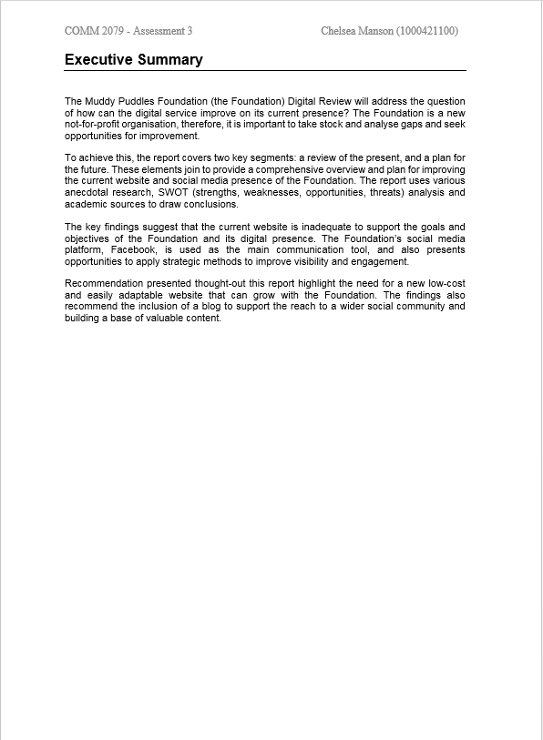
Title page & executive summary: example
The title page should normally include the title, your name and the course code, preferably the name of your tutor, date of submission and if applicable the name of the person and/or organisation that has commissioned the report.
The executive summary is a brief outline to inform the reader what it is about. It includes:
overall aims and specific objectives;
method/procedure used;
key findings; and
main conclusions and recommendations.
Gould 2011
Birmingham City University
Notes:
Slide 7: Title page and executive summary: example
On this slide, you can see an example of the title page and an executive summary sections of a report. The title page should normally include the title, your name and the course code. The title page should preferably also include the name of your tutor, date of submission and if applicable the name of the person and the organisation that has commissioned the report.
The executive summary is a brief outline that informs the reader what it is about. The executive summary includes the overall aims and specific objectives, methods or procedures used and key findings. It also specifies the main conclusions and recommendations. The two examples provided on this slide are solely to show you what these components look like. You are strongly advised not to copy these examples or produce similar versions as you may be penalised for doing so.

Slide 8
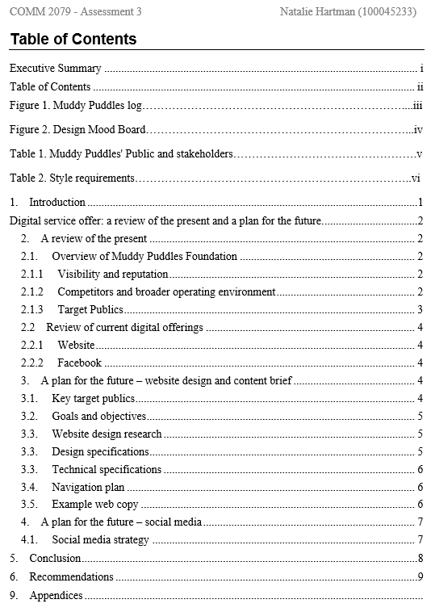
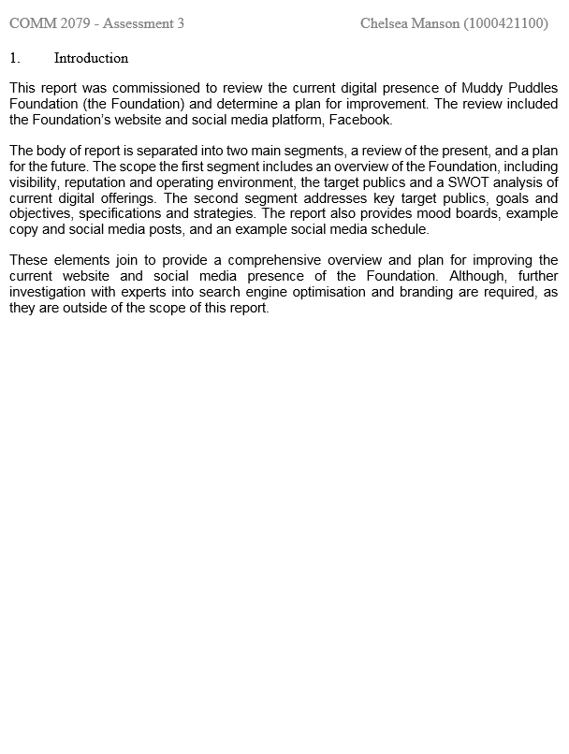
Table of contents & introduction: example
The contents page is a clear, well-formatted list of all the sections and sub-sections of the report. There should be page numbers and a separate list of tables, figures, illustrations and/or appendices after the main index.
The introduction should show that you have fully understood the task/brief and that you are going to cover everything required. Indicate the basic structure of the report. You should include just a little background/context and indicate why you are writing the report. You may also include the procedure/research methods if not covered elsewhere.
Gould 2011
Birmingham City University
Notes:
Slide 8: Table of contents and introduction: example
On this slide you can see an example of the table of contents and the introduction section of a report. The content page is a clear, well-formatted list of all the sections and sub-sections in the report. There should be page numbers and a separate list of figures, tables, illustrations and/or appendices after the main index.
The introduction should show that you have fully understood the task or brief and that you are going to cover everything required

Slide 9
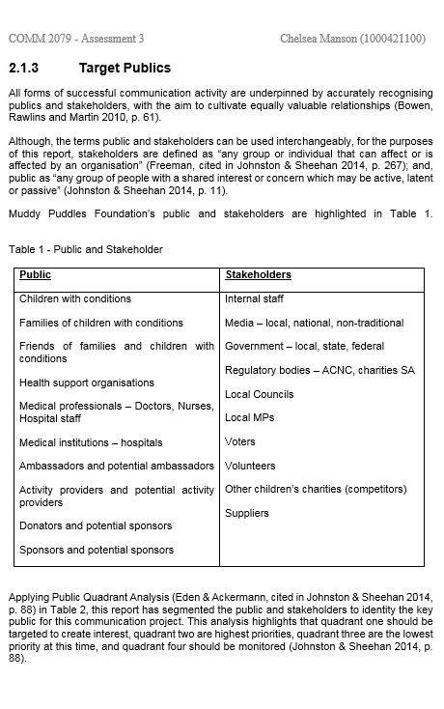
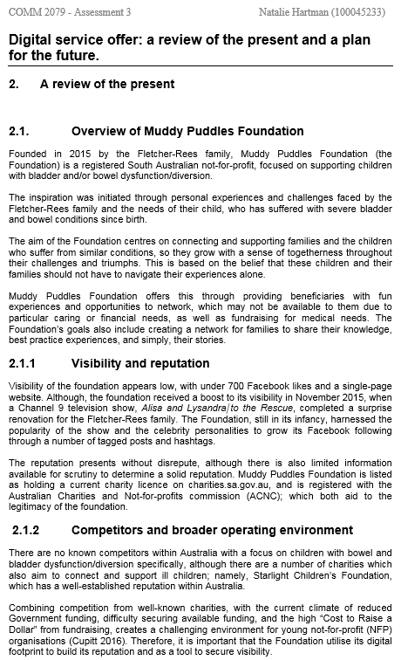
Body of report: example
The body of a report should be built around a single, simple statement. Called a thesis statement (the key idea), it unifies the entire report and helps you address the issue, point by point.
Gould 2011
Birmingham City University
Notes:
Slide 9: Body of report: example
On this slide you can see an example of how the body section of a report has been organised. The body section of a report is divided into different sections with headings and sub-headings. The body of the report should be built around a single, simple statement. This is usually the thesis statement or the main message of your report. The main message will unify the entire report and help you address the issue, point by point. Each point highlighted in the body section of the report should be developed and supported with pertinent facts.

Slide 10
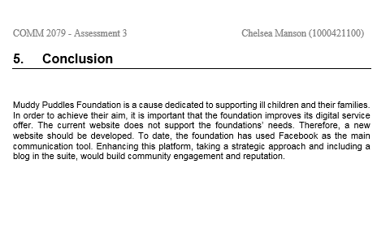
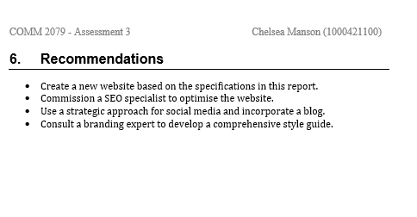
Conclusion & recommendations: example
The conclusion should draw out the implications of your findings, with deductions based on the facts described in the main body
Recommendations should follow on logically from your conclusion and be specific, measureable and achievable. They should propose how the situation/problem could be improved by suggesting action to be taken. A ‘statement of cost’ should be included if you are recommending changes that have financial implications. Recommendations can be numbered.
Gould 2011
Birmingham City University
Notes:
Slide 10: Conclusion and recommendations: example
The conclusions should follow naturally from any summary findings in the report. Sometimes recommendations will stem from your conclusions. Conclusions and recommendations should be stated clearly. The conclusions should draw out the implications of your findings, with deductions based on the facts described in the main body. Recommendations should follow on logically from your conclusion and be specific, measurable and achievable. They should propose how the situations or problem could be improved by suggesting action to be taken. A ‘statement of cost’ should be included if you are recommending changes that have financial implications. Recommendations can be numbered.

Slide 11
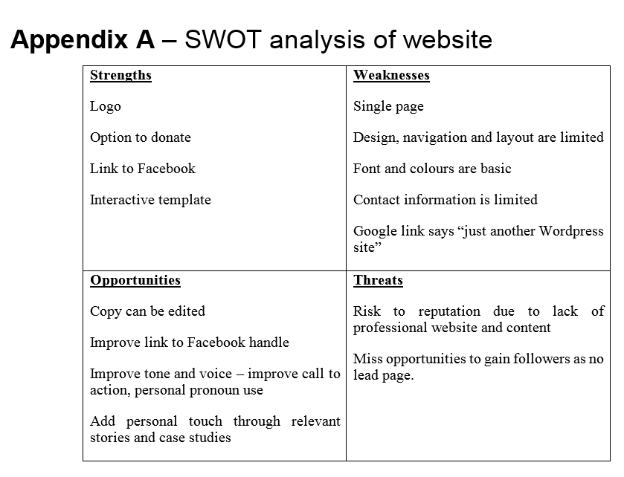
An appendix (plural: appendices) is detailed documentation of points you outline in your findings, for example, technical data, questionnaires, letters sent, tables, sketches, charts, etc. It is supplementary information which you consider to be too long or complicated or not quite relevant to include in your main body.
Appendix: example
Gould 2011
Birmingham City University
Notes:
Slide 11: Appendix: example
On this slide you can see an example of an appendix, the plural of which is appendices. An appendix is the detailed documentation of points you outline in your findings such as technical data, questionnaires or letters. It is supplementary information which you consider to be too long or complicated or not quite relevant to be included in the main body section of the report. It is important to mention the appendix in the main section of your report if you are going to include them in your report.

Slide 12
Style
Use clear, concise and formal language.
Develop each paragraph sufficiently.
Avoid using impersonal (I, my, we, etc.) language
Avoid using colloquial language or slang (go bananas, wanna, etc.).
Use passive verbs (this phenomenon was examined).
Use connecting words where appropriate to make to writing clear.
Check your grammar and spelling.
Gould 2011
Birmingham City University
Notes:
Slide 12: Style
It is important to ensure that you employ the appropriate style for writing the report. Do ensure that you use clear, concise and formal written language. It is also important to develop each paragraph sufficiently. Go beyond just mentioning things and moving on. Try to avoid using impersonal language such as I, my, we, etc. Do also avoid using colloquial language or slang. Where possible use passive verbs. Do use connecting words such as therefore, moreover and furthermore, to make the discussion clearer. Finally check your grammar and spelling. It is very important to edit and proofread your report before sending it off.

Slide 13
References
Gould, S 2011, ‘How to write a report’, Birmingham City University, viewed 12 November 2016, <http://library.bcu.ac.uk/learner/writingguides/1.02%20Reports.htm>
Newsom, D & Haynes, J 2014, Public relations writing: form and style, 10th edn, Wadsworth Cengage Learning, Boston, Massachusetts.
Shahabudin, K, Taylor, A, Turner, J & Reid, M 2016, ‘Features of good reports’, viewed 12 November 2016, http://libguides.reading.ac.uk/reports
Additional resources for report writing:
Reports: https://lo.unisa.edu.au/mod/resource/view.php?id=1156844
Technical writing: Features and conventions: https://lo.unisa.edu.au/mod/resource/view.php?id=1156845
Notes:
Slide 13: References
If you have used material from other sources, it is important to have a list of references at the end of the report. Do use the recommended referencing style to list your references. For more information on report writing do refer to the links specified on the slide.

