Slide 1
POLI1008: Governance and Citizenship
Interpreting task
Notes:
Slide 1: Interpreting task
This is a presentation on interpreting task. The very first thing that you have to do before you begin the actual writing process is to understand what the question requires and how you are expected to address the task. Interpreting the question is a very important component of the essay writing process. By interpreting the question correctly, you would be able to efficiently locate the sources and identify key issues discussed in the debates related to the topic.

Slide 2
Copyright
COMMONWEALTH OF AUSTRALIA
Copyright Regulations 1969
WARNING
This material has been produced and communicated to you by or on behalf of the University of South Australia pursuant to Part VB of the Copyright Act 1968 (the Act).
The material in this communication may be subject to copyright under the Act. Any further reproduction or communication of this material by you may be the subject of copyright protection under the Act.
Do not remove this notice.
Notes:
Slide 2: Copyright notice

Slide 3
The task
Format : Essay
Word limit : 2250 words
Weight : 50%
Choose one of the two topics and write an essay that demonstrates your understanding of the structure and processes of government in Australia as well as ability to critically discuss one of the contentious political debates in contemporary Australia.
3
Notes:
Slide 3: The task
In this task, you are required to write a 2250 word essay that is worth 50% of your grade for the course. Please refer to your course outline for the due date. *The task requires you to choose one of the two topics that are provided and write an essay on one of the contentious political debates. In order to obtain good marks for this essay, you have to do two things: 1) demonstrate your understanding of the structure and processes of government in Australia; and 2) critically discuss the political debate associated with your chosen topic. The topics provided in the following slides are for illustrative purposes only and are not the actual questions that you are expected to address for this assignment. Please refer to your course outline for the actual topics.

Slide 4
The example topics (questions from previous years)
1) Federalism as originally conceived in the constitution has changed considerably in the past century. Critically analyse why these changes were considered necessary, and how they were possible given the constitution has changed little since federation.
2) The principle of Parliamentary Sovereignty has been undermined by the Party system. Critically analyse this statement with reference to parliamentary representation and accountability. Illustrate your answers with examples.
Notes:
Slide 4: The example topics (questions from previous years)
The two topics presented on this slide are questions from previous years and are presented as examples only. Please do not write your essay to address either one of the topics presented here. *The first topic is: Federalism as originally conceived in the constitution has changed considerably in the past century. Critically analyse why these changes were considered necessary and how they were possible given the constitution has changed little since federation. *Topic No. 2 is: The principle of Parliamentary Sovereignty has been undermined by the Party System. Critically analyse this statement with reference to parliamentary representation and accountability. Illustrate your answers with examples.

Slide 5
Interpreting the task : Example 1
1) Federalism as originally conceived in the constitution has changed considerably in the past century. Critically analyse why these changes were considered necessary, and how they were possible given the constitution has changed little since federation.
Federalism
constitution
What?
How?
Why?
change
past century
Implications?
necessary
Factors?
possible?
Notes:
Slide 5: Interpreting the task: Example 1
The first thing you should do once you have chosen the topic is to identify the key words and phrases. This will help you locate the necessary resources for writing the essay. For example, if you choose topic No. 1, the following are important: ‘*federalism, *constitution, *change, *past century, *necessary and *possible’ as they form the crux of the question. Begin your reading to get a general understanding of what the debates are with regard to these concepts. Ask yourself the following questions: *‘What do these concepts mean’; ‘Has the constitution changed in the past century?’; *if yes, *‘Why has the constitution changed?’; *‘How has it changed?’; ‘What are the factors that constituted the change?’; ‘Was the change necessary?’; ‘How was the change possible although the constitution itself has changed little?; *‘What are the implications of this?’ Try and identify the issues that are discussed. This will help you to choose the four or five issues that you are required to address in your essay.
You can answer this question from many angles. You can agree with the statement, disagree or take the middle path. No matter which perspective you choose to present your argument, as long as you provide an-depth justification of your stand, you will be awarded the marks.

Slide 6
Interpreting the task : Example 2
2) The principle of Parliamentary Sovereignty has been undermined by the Party system. Critically analyse this statement with reference to parliamentary representation and accountability. Illustrate your answers with examples.
Parliamentary Sovereignty
What?
undermined
Why?
Party system
How?
representation
Implications?
Factors?
accountability
Notes:
Slide 6: Interpreting the task: Example 2
Similarly, if you choose topic No. 2, the following words and phrases need to be highlighted: ‘*Parliamentary Sovereignty, *undermined, *party system, *representation and *accountability’ as they are important concepts that need to be addressed in your essay. Once you have identified the key words and phrases, you should begin reading up on these issues to get a general understanding of the related debates. Ask yourself these questions: *‘What do these concepts mean’; ‘What is Parliamentary Sovereignty?’; ‘What is parliamentary representation?’ ‘What is parliamentary accountability?’ ‘Has Parliamentary Sovereignty been undermined by the Party System?’; *if yes, *‘Why has it been undermined?’; *‘How has it been undermined?’; ‘What are the factors that demonstrate that the Parliamentary Sovereignty has been undermined by the Party System?’; ‘What are the implications of this?’ Associate all of these questions to ‘Representation’ and ‘Accountability’
As with topic 1, you can answer this question from many angles. You can agree with the statement, disagree or take the middle path. No matter which perspective you choose to present your argument, as long as you provide an in-depth justification for your stand, you will be awarded the marks.
Once you have are aware of the debates in the field, you can then critically read about the four or five issues

Slide 7
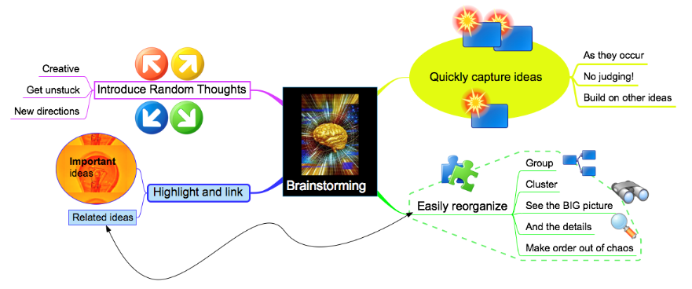
Resources for the planning stage of your assignment
https://lo.unisa.edu.au/mod/resource/view.php?id=298798
student.unsw.edu.au
https://lo.unisa.edu.au/mod/resource/view.php?id=298804
www.allmandlaw.com
https://lo.unisa.edu.au/mod/resource/view.php?id=298806
www.novamind.com
Notes:
Slide 7: Resources for the planning stage of your assignment
If you think that you may need some more help with the planning stage of your assignment, do click on the links provided on the slide which will take you to some resources that you may find useful. Otherwise, go to the next slide.

Slide 8
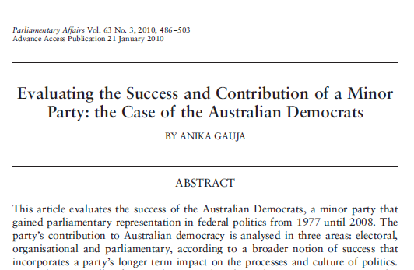
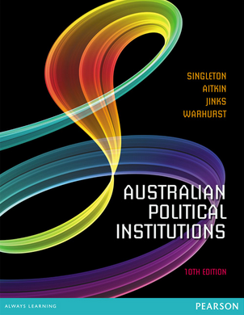
Quality references will help you get started
Key introductory and reference works will help you to interpret the task. Use these to define key terms and gain a general overview and understanding.
Introductory works
Broad overviews
General reading
Scope out key issues
Targeted reading
Focused works
Addressing an issue or aspect of an issue in depth
Notes:
Slide 8: Quality references will help you get started
General reading will help you to understand what you are being asked to do. *Start with general introductory works on government and politics in Australia to help you identify the key issues relating to your essay topic. Once you have identified these, you will need to locate books, articles and other references that focus on those issues or aspect of those issues in depth. These more detailed references will provide you with evidence needed to support your argument. For the moment, let’s focus on introductory and reference works that will help you get started.

Slide 9
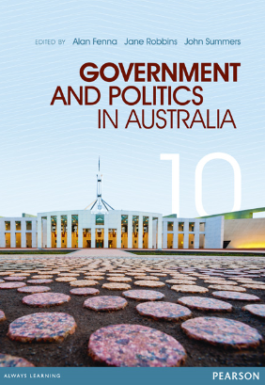
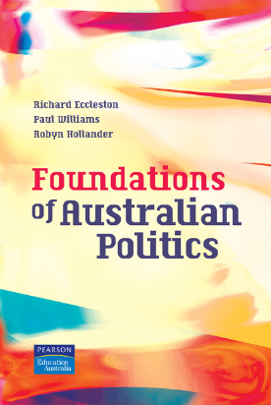
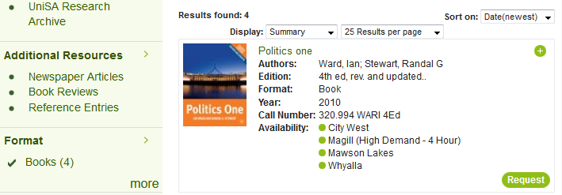
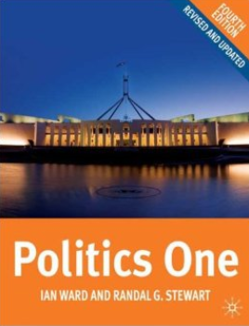
Locating quality references
Course information
Notes:
Slide 9: Locating quality references
Your course outline lists many books under learning resources including these. There are also journals listed, but journal articles are usually not a good source of introductory, foundational information, so we’ll leave these for the moment. *To find books listed in your course information, *search for the book title in the Library catalogue. Sometimes the book you are looking for is high in the list of results, *but if it is not easy to detect try limiting to Format> Book and if there are multiple editions, sort by date to find the most recently published (the most current).

Slide 10
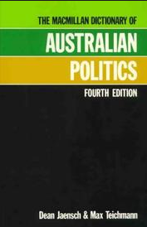
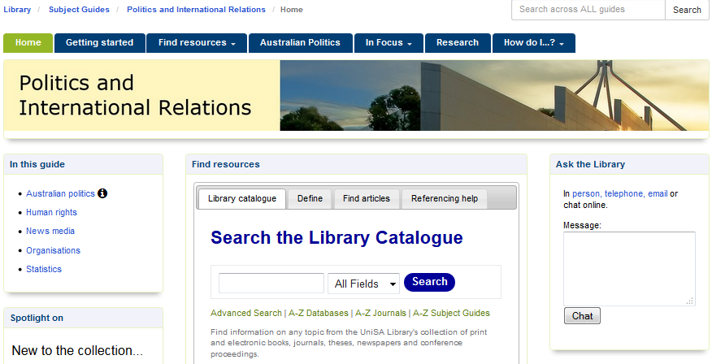
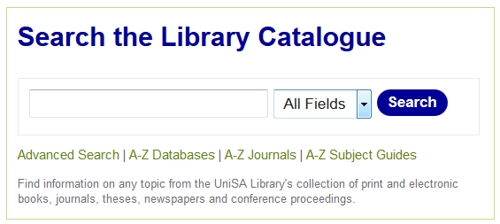
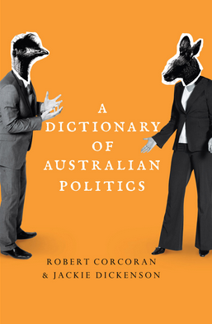
Locating quality references
Course information
Library Subject Guide
http://guides.library.unisa.edu.au/
Notes:
Slide 10: Locating quality references
The library Politics and International Relations Subject Guide also links to core references. *You can access the Guide via myCourse Library under Course Essentials on your course site, via the Library’s homepage A-Z Subject Guides or by going to this web address. *Go to the Australian politics tab to find links to dictionaries, introductory texts and authoritative websites which provide general information, such as the Parliament of Australia website.

Slide 11
Locating quality references
Course information
Library Subject Guide
Library Catalogue search
political parties australia
politics australia
parliament australia
federalism australia
Notes:
Slide 11: Locating quality references (continuation)
You can also search the Library Catalogue directly to find reference and introductory works on a topic. *For example, you can combine the term dictionaries with keywords for your core concepts to locate these. Otherwise, use general, broad terms and limit by Format>Books. *For example.

Slide 12
‘Quality’ references?
Currency
Relevance
Authority
Accuracy
Purpose
Notes:
Slide 12: ‘Quality’ references?
At this stage you are looking for foundational information to help improve your understanding of the broader area and provide direction for further searching, reading and ultimately construction of your argument.
While it can be tempting to simply read the first result that appears with a web search, it’s important to base these foundations on reliable information written by authors with expertise in the area. Consider the factors listed here…

