Slide 1
Reading strategies Social Work
Notes:
Slide 1: Introduction
As a student you will be expected to read widely and critically in order to complete the different assessments in your study program. This requires reading from different sources, understanding what you read, identifying and synthesizing key issues from various sources and seeing their link to the overall context. You also need to be critical about what you read. Being critical means to think more deeply about the information, interpret and evaluate, compare and contrast and assess the text’s credibility, purpose, relevance, currency, strengths and weaknesses. This presentation complements the ‘Reading for your essay’ presentation. While the ‘Reading for your essay’ presentation focused on the different stages of reading and reading critically, the ‘Reading strategies’ presentation draws your attention to some strategies that you could use to read more efficiently.

Slide 2
Reading for the assignment
Read for general understanding
Read extensively on the 3 or 4 issues
Identify key issues
Set boundaries by choosing 3 or 4 issues
Read up on issues
2
Notes:
Slide 2: Reading for the assignment.
You would not be able to produce a good quality assignment without doing extensive reading about the topic that you would be addressing. The starting point for doing your assignment is getting the reading done. Once you have understood the task and interpreted what is it that you are required to do, it would be a good idea to begin reading about the topic. This will give you a general understanding about the topic. This is very important as you will not be able to write a good argument if you do not know anything about the topic. Once you begin reading about the topic, you will be aware of the many issues that are related to the topic. Once you know what the issues are, then you can start reading up on the issues in detail. Generally, there will be many issues that are associated with a topic. You would not be able to discuss all of them in your assignment. Hence, you will need to select three or four issues that you will focus on in your assignment. This will of course depend on the word count of your essay. However, your instructors would rather you choose a few issues and do an in-depth discussion of the issues rather than have a laundry list of issues that are discussed superficially. Once you have selected the issues that you would be addressing in your assignment, you will then have to read widely about the issues. This is so that you are able to present an objective and critical argument about the topic. As you begin writing on your topic, you may realise that you do not have enough content and may have to start the process all over again. Remember, reading is a cyclical process. You will be reading throughout your writing process.

Slide 3
Reading for specific information
Understand
What is the text about? What do the terms mean?
Identify key points
What are the main ideas?
Note key points
Use a note-taking system to record main ideas and referencing details
Summarise key points
Restate main ideas in your own words
Distinguish the significance
Identify how the main ideas contribute to the overall context
Link key points to obtain a context
Synthesise key points from different sources to obtain a context
Notes:
Slide 3: Reading for specific information
Once you have identified the issues that you want to focus on in your assignment, then you would have to read for specific information. *The most important thing when you are reading is to understand what is it that you are reading about. Some texts are more difficult to read than others. Do not be discouraged by the difficulty level of the text. You could look for simpler texts that discuss the same issue. However, you cannot always read simple texts. So, you would probably need to know what the text is about and what the terms in the text mean. *Once you understand the discussion in the text, you would then be able to identify the key points. This will be able to help you identify the main ideas in the text. It is important for you to note the key points as you would be reading a lot and if you do not record what you read, you may forget where you got the information or not be able to find it when you look for it. *You can use a note-taking system that you are familiar with or one that works for you. Remember to note the details about the source such as the author’s name, year of publication, page number, etc. *It is not a good idea to copy word for word from the source. So do try to summarise what you read in your own words. This is a good way to test your understanding of the discussion. If you are able to restate something in your own words, then you probably understand what the author is communicating. Summarising or paraphrasing also comes in handy when you begin writing. Do also try to distinguish the significance of the key points to the overall context. How are they important to the topic? While you are reading, you would also have to link the key points to others that you have read about, compare and contrast and interpret what all of this means to the context that you are researching about.

Slide 4
Strategies for efficient reading
Read with a purpose
Practise different reading approaches
Practise active reading
Why am I reading this? What particular answers am I looking for?
Scanning, Skimming, Surveying, Light study reading, Detailed reading, Deep study reading
Underline, Highlight, Use margin to note key words/phrases, Find answers to questions, Summarise
Notes:
Slide 4: Strategies for efficient reading
As you will not have plenty of time to read, you need to make sure that the time you spend reading is used efficiently. *Always ensure that you are reading with a purpose. Be aware of why you are reading the text and what particular answers are you looking for in the text. It would be a good idea to have a list of questions that you want answered. You can come up with a list by looking at the headings, diagrams, etc. or as you are reading something you may come across a question that you want answered.
*Do practise using different reading approaches such as scanning, skimming, surveying, light study reading, detailed reading and deep study reading. You would scan when you want to find a particular item or information. You will skim when you want to gain a quick impression of a text or article. You would survey when you want to uncover the structure and overview of a text or article. When you do light study reading, you would read passively for factual information, general background, and/or with no specific purpose. You would do detailed reading when you read actively for specific knowledge acquisition or for grasp of pre-determined concepts, procedures or theories. When you read to make connections, meaning, consider implications and evaluate arguments, you would be practising deep study reading (Brown & Atkins, 2002, p. 174).
*You need to engage with what you are reading by practising active reading. Otherwise your mind will start wandering and you may lose concentration. Underline or highlight key points or main ideas. You can also use the margin of your text to note key word or phrases in order to summarise the main ideas. You can also actively try to find answers to the questions that you have with regards to the topic that you are reading about. Remember to summarise the information that you read about in your own words. Try not to look at the text when you do this.

Slide 5
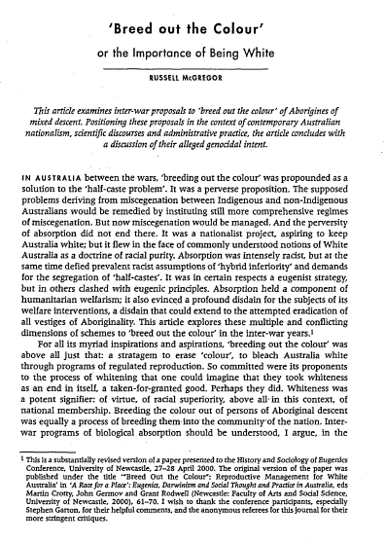
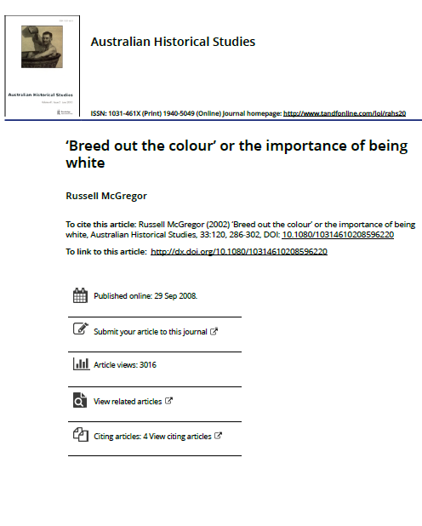
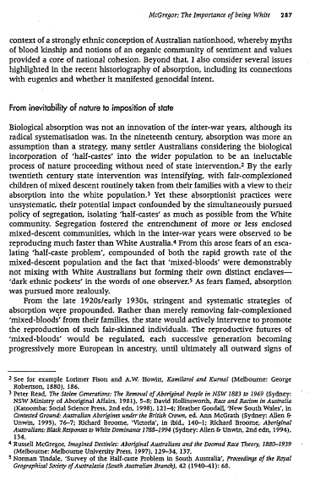
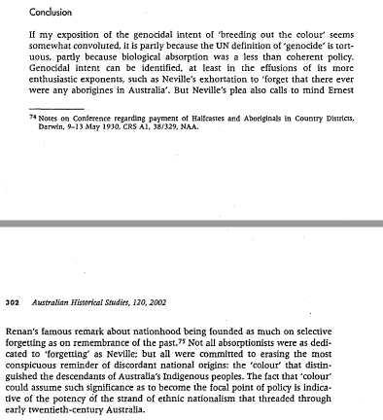
Structure of a text
Notes:
Slide 5: Structure of a text
Each text will have its own layout and structure. As you would be reading many journal articles, the example in this presentation refers to the structure of a journal article. *The title page carries information about the journal, the title of the article, the author and the year of publication. These details are important when you cite or refer to the information in this source.
Generally, you will not be able to read from cover to cover and every section of your text and still keep on top of all your reading. *For example, you may need to read a journal article titled ‘Breed out the colour by Russell McGregor’ in order to complete an assignment. You may have to read the title so that you would be able to identify the content through the key words. It would also be a good idea to read the abstract as it provides a brief overview of the discussion. If you are reading a report, the abstract is called the Executive Summary. You then would have to read the introduction as it provides the background, identifies the problem or gap in the discussion, states the aim of the discussion and outlines the structure of the argument. Reading all of these sections will help you decide if you could use the information to produce your assignment. However, sometimes you may find valuable information in the body of the article even though the introduction may not match what you are looking for. So, it is a good idea to quickly scan and skim the whole text.
*The body of the text presents the framework of the argument. It is usually divided into different sections with headings. Some articles will have a literature review, methodology, results, discussion and findings section in the body of the article. The methodology and results section is not important unless you want to replicate the study. In the ‘Breed out the colour’ article, you can see that the article does not have the methodology, results, discussion and findings section. The article is divided into different sections with headings that support the author’s arguments. Generally, unless specified by the journal where the article is published, there are no hard and fast rules as to how an author should organise their discussion in article.
*The conclusion restates the thesis statement or the main message and recaps main points identified in the body. In a report the conclusion is usually followed by recommendations. Reading the conclusion section helps the reader refocus on the argument or discussion raised in the text.
The author of this text has used the footnote citation style. They have not included a reference list at the end of their article. This is not recommended in your assignment. You should use the UniSA Harvard referencing convention for your assessments.

Slide 6
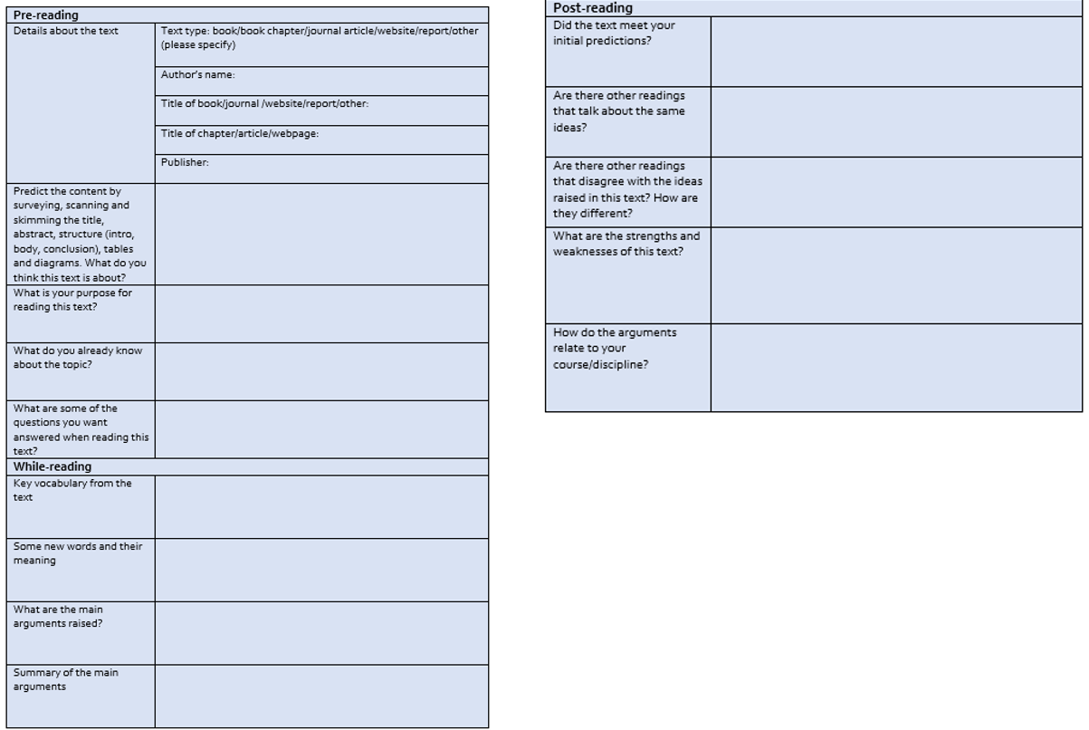
Use a reading log
Notes:
Slide 6: Use a reading log
Using a reading log certainly helps you read more efficiently. A reading log is like a journal that you maintain about the texts that you read. On this slide you can see an example of a reading log. In this reading log, the reading activity has been divided into three categories: pre-, while- and post-reading. Maintaining a reading log similar to the example provided here will also help you with your assignment as you do not have to keep going back to the texts that you read. A reading log will also help you read more efficiently.

Slide 7
Practise using the reading strategies
http://dx.doi.org/10.1080/10314610208596220
Notes:
Slide 7: Practise using reading strategies
The link on this slide will take you to the full article. Click on the PDF icon to access the article. Do use the article to practise the different strategies that have been introduced thus far. Do also watch the ‘Reading for the Essay’ presentation to identify how to read more critically. Use the reading log to guide you through your reading of the article. The next few slides will expand on the pre- and while-reading strategies.

Slide 8
Notes:
Slide 8: Pre-reading
Always begin by identifying why you are reading a particular text. This will help you find the answers or information that you are looking for. Reading without a purpose will make you waste a lot of time because you will not be able to find information that you want. Do not begin with detailed reading as soon as you obtain a text. Always scan the text quickly. In this instance, say for example, you are looking for the word ‘absorption’. Once you have found it then you have to skim the sentence quickly to identify if this is what you are looking for. So here, you will quickly run your eyes over the sentence that reads, ‘And the perversity of absorption did not end there’. You will only do detailed reading of the idea if it is something that you find useful. If it is not, then continue scanning the rest of the text. It will be useful to scan and skim the title of the text, the abstract, the introduction, the body of the text, the conclusion or any other visuals in the text. You would save a lot of time if you practise pre-reading strategies before you actually start reading because you will be able to screen through a lot of unwanted material right at the start. Do also use your background knowledge about the topic to engage with the text. Ask yourself what you already know about this topic. What do you need to look for or explore further, what are key terminologies, etc. Write down words or phrases associated with the topic and try to locate them in the texts while you scan. You may also want to work out the meaning of these words and phrases. This will give you some direction and you do not have to keep stopping to look for meanings of words or phrases while you read. Reading will become easier when you know what the terms mean. Try to predict the content of the article by looking at the headings and your background knowledge. If you look at the whole article and the length of the text, you may feel a little overwhelmed. Try to unpack one section at a time. Go through paragraph by paragraph. Look at the first sentence of every paragraph. This would be the topic sentence. The topic sentence introduces the main idea that will be discussed in the paragraph. By skimming through the topic sentences you would be able to roughly gauge what will be discussed in the paragraphs. Remember to scan and skim until you find the information you are looking for. Do detailed reading only when you have found the information that you are seeking.

Slide 9
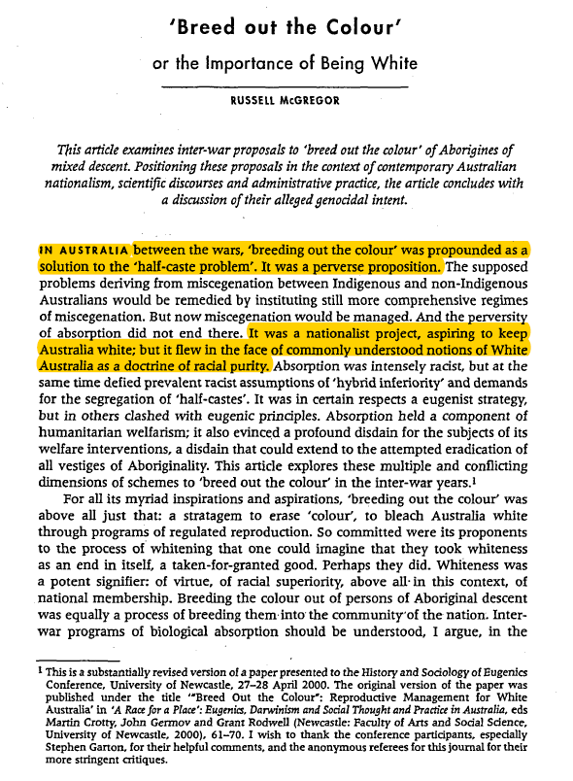
What is this article about?
What are the main points highlighted in this article?
What is the half-caste problem? What is the absorptionist strategy?
What is the difference between the absorptionist and eugenist strategy?
Problem supposedly arising from the union of Indigenous and non-Indigenous Australians
Breeding out colour was seen as a solution to the half-cast problem arising from the union between Indigenous and non-Indigenous Australians. The Absorptionist strategy implemented to overcome this was intensely racist
Breeding out colour: strategy to erase colour
Notes:
Slide 9: Practise active reading while you read
On this slide you can see examples of different active reading strategies that have been used to unpack the text. *Begin by scanning the text to identify new terminology, words or phrases. Use your dictionary to find the meaning. Have a glossary of these words. You can not only build on your vocabulary but also use these words in your assignment. *Having a list of questions before you read helps you focus and have a purpose. You will be engaging with the text as you will be actively trying to find answers to the questions you have. Underlining or highlighting key ideas in the text is another strategy that you could use while you are reading. However, you do have to be careful so as not to highlight and underline everything on the text. A lot of what is presented in a text comprises examples to make a main idea clearer. This is usually not important. *You can also use the margin of a text to summarise key ideas. You can use two or three words to restate the key ideas in your own words. This will be very useful when you are citing this information in your assignment as you have already paraphrased or summarised the information. *Finally a good strategy to use would be to summarise what you read. This will ensure that you have understood the writer’s arguments. Try not to look at the text when you summarise but do remember to check to see if you have captured the meaning correctly. There are other techniques that you could use such as mind-mapping, using visuals, tables, etc. to help you unpack the discussion.

Slide 10
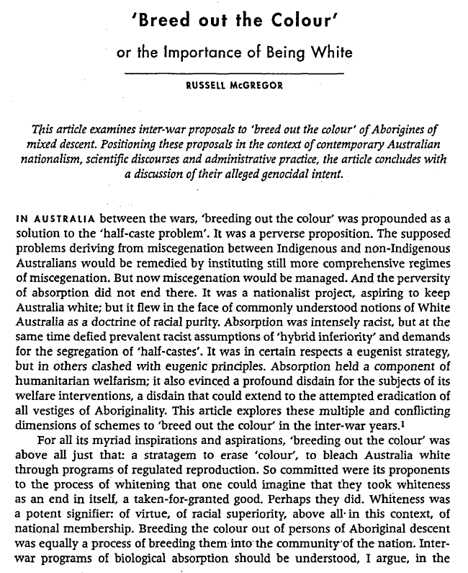
Look at the title. What can you predict about the content from the title? What do you already know about this topic?
Look at the abstract. What is the author’s purpose? From which perspectives is the author going to address his main argument?
Look at the topic sentence. What is the main point that will be discussed in this paragraph? How does the author support his main point in this paragraph?
Is the author supporting the absorption strategy? Which statement tells you this? How do you predict this argument will unfold?
What is the aim of the author? How does the author plan to communicate his main message?
Notes:
Slide 10: Unpacking the text
Let’s look at the text now. *Begin by examining the title of this text. The title reads ‘Breed out the colour or the importance of being White’. The key words and phrases here are ‘breed out, colour and importance of being white’. What do you think this article will discuss? What do you already know about the article?
*Let’s move to the abstract. What do you think is the author’s purpose for writing this paper? From which perspectives do you think the author is going to present the argument? Why do you think he has chosen to present his discussion from these perspectives?
*Let’s now look at the topic sentence which is the first sentence that introduces the main idea that will be discussed in the paragraph. The topic sentence is ‘In Australia between the wars, ‘breeding out the colour’ was propounded as a solution to the ‘half-caste problem’. Based on the topic sentence, what do you think will be the main idea that will be discussed in this paragraph? How does the author support the main point highlighted in the topic sentence?
*From the discussion thus far, do you think the author is supporting the absorption strategy? Which statement tells you this? How do you predict this argument will unfold in the paper?
*What do you think is the author’s aim in this paper? How does he intent to communicate his main message? Having read the introduction thus far, is the author discussing a new issue or have you come across this in the past? Is the perspective the author taking similar or different from what you have come across previously about this topic? How similar or different is it?
This is how you read an academic article. You would go through each section and identify the main points. You would then evaluate the main points for their credibility, relevance, currency, strength and weakness. You would then try to see the link between the ideas presented in your current text with those that you have read or come across previously. You would try to compare and contrast these and relate to the overall context that you are trying to address in your assignment. The next step would be for you to read the article and identify the main ideas highlighted in the text incorporating all the strategies and techniques that have been introduced in this presentation.

Slide 11
Notes:
Slide 10: Some key points
So, did you manage to identify the key points? Here are some that I have identified. Do not worry if yours do not match these. Different people interpret the same text differently. Do, employ the skills that you have picked up in this presentation whenever you are reading.

