Slide 1
How to write a professional brief
Notes:
Slide 1: Introduction
As part of your Assessment 2, you are required to write a brief to a Chief Executive Officer or the Manager of an organization about the benefits of setting up an online newsroom or media kit. This presentation provides you with information about what a briefing paper is, components of a briefing paper, its structure and an example.

Slide 2
What is a briefing paper?
A summary of facts pertaining to an issue and often includes a suggested course of action.
Comprises a summary of an issue, explanation of a situation that needs to be addressed, identification of any financial implications and recommendation of a course of action including arguments for and against the suggested action.
Example:
An executive assistant may provide a briefing paper to a Manager or Chief Executive Officer (CEO) explaining why the organisation needs an online newsroom and/or media kit.
2
TN 21 n.d.
Notes:
Slide 2: What is a briefing paper?
A briefing paper is a concise summary of research findings, written for an informed, although not necessarily an expert audience. Briefing papers are targeted toward a specific audience and for a specific purpose. *Briefing papers update readers on an issue's current status and get readers up-to-speed on the background of an issue. Typically, briefing papers are presented as a four to five page summary. However, it can be shorter depending on it purpose. Each briefing paper reaches a clear conclusion based on evidence and concise argument. This tends to result in a pace of writing that could best be described as “swift”. Yet, coherency and substance are the hallmarks of a briefing paper. Carefully worded subheadings that point the reader to more detailed information and bulleted points that highlight quick overviews of essential information are two writing conventions that facilitate the swift style of the briefing paper.
*For Assessment 2, you are required to write a briefing paper to convince the Chief Executive Officer or the Manager of an organisation to set up an online newsroom or a media kit. There are particular conventions to writing a briefing paper. The briefing paper should be thorough but also succinct, and this requires a writer to judge what information to include and what to leave out. A writer must explain an issue in enough detail so that a reader gains a full understanding in a few pages. Subheadings are useful for organizing a briefing paper because they force a writer to focus, and they enable readers to extract information quickly. Direct quotes from individuals are not used in a briefing paper unless the specific wording of the quote is important. The brief is a formal document and thus it is important to ensure that a professional and formal tone be used to write it. Do try to use the reported and passive form of speech rather than use the first or second person pronoun such as ‘I’ or ‘you’. So rather than say ‘I suggest’ you might say ‘It is recommended that’.

Slide 3
Components of a briefing paper
Name | A note to identify who the briefing paper is for
Date | The date of preparation of the briefing paper
Subject | The topic or issue of the briefing paper
Background | Provides a summary of past and/or current events that provide a context for the topic or issue, including any policies or past practices.
Analysis | Identifies significant aspects of the topic or issue. Identifies the options or courses of action that should be considered, including details about the advantages and disadvantages of each. Identifies actions currently taken or recommended to address the issue.
Cautionary notes | Identifies any sensitive aspects of the topic or issue that may affect a person or organization in a negative way.
Contact | Presents the name and contact information of the writer of the briefing paper.
TN 21 n.d.
Notes:
Slide 3: Components of a briefing paper
On this slide you are presented with the different components that are usually included in a briefing paper. These are only suggestions and your tutor may recommend a different structure. Do confirm with your tutor about the structure before you begin as you are limited by the number of words that is allowed for the assignment.

Slide 4
Points to consider before writing
√ | Why is the online newsroom or media kit necessary?
√ | Why does the Chief Executive Officer (CEO) or Manager of the organisation have to deal with this now?
√ | Given the purpose, context and scenario, why exactly does the CEO or Manager really need to know about this?
√ | What is the strategy to convince them of the need for your chosen medium?
√ | Have I identified the various stakeholders, issues or options and outlined the stated and unstated agendas as well as captured the strategic considerations?
√ | What is the bottom line? Can I identify or position the benefits right up front in the brief?
√ | What are the pitfalls for the CEO or Manager? What is missing? Who else could I be obtaining information about this from?
√ | Would the level of detail I am providing be appropriate for the subject and situation at this time? Would every word and paragraph be essential? What can I edit out?
Public Sector Writing n.d.
Notes:
Slide 4: Points to consider before writing
On this slide you can see a checklist of questions that you need to consider before you begin writing your professional brief. Whether you choose an online newsroom or a media kit, it is important to consider why it would be beneficial for the organisation. It is also important to consider why this issue is important for the CEO/Manager to act on now and not at a later stage. What are the important details that they need to know? How are you going to convince them of the need for the online newsroom or media kit depending on which you choose? Have you thought about this from the different perspectives, issues or options? Are you missing something. Would you be able to identify the benefits of having your chosen medium right at the beginning of your brief? What are the benefits of setting up this medium for the CEO or Manager? Have you thought about everything so that the CEO/Manager is convinced? Would the level of detail be appropriate. How much do you really need to say? Is there something that is not important?

Slide 5
Style and structure of a brief: The Opening
The Purpose approach:
Begin the brief with a clear statement identifying the purpose of the brief. Why is the CEO/Manager reading this? This is a preferred approach, particularly if you are presenting options and recommendation because you will be alerting the reader right up front that this is a ‘decision’ brief.
or
The Issues approach:
You can just begin the brief with a clear and concise statement of the issue. This is a common format if, for example, the note will go into a briefing book along with other notes for a meeting or event where the purpose is defined somewhere else in the book. This format is not recommended if presenting options and recommendation.
Public Sector Writing n.d.
Notes:
Slide 5: Style and structure of a brief: The Opening
There are various types of briefing notes depending on the purpose of the communication. Some are for information only while others provide recommendations and seek decisions. The brief you are writing to the CEO or Manager is one that explains the benefits of developing an online newsroom or a media kit. Do remember that the main sections or elements of the brief will vary depending on the purpose and type of note that is being written. Do confirm with your tutor if the style and structure recommended in this presentation is acceptable. The opening of the brief generally begins with a purpose section or an issues section.
*If you decide to begin with a purpose approach, then do start your brief with a clear statement identifying the purpose of the brief. Highlight the reasons why the CEO/Manager is reading the brief. This is generally the preferred approach that is used, especially if you are presenting options and recommendations. You will be alerting the reader right at the start that this is a decision-oriented brief.
*If you choose to use the ‘Issues’ approach, you will begin your brief with a clear and concise statement of the issue. This is a common format that is used, especially if the brief will go into a briefing book along with other briefs that will be tabled at a meeting or event. This approach is not recommended if you are presenting options and recommendations in your brief.

Slide 6
Style and structure of a brief: The Body
The Background section:
Begins with the most recent developments (rather than a chronological ordering of events culminating in the issue of the day). The purpose is not so much to provide a chronology of events but to identify and frame issues and problems.
The Current Situation section:
Provides a snapshot of where we are right now (it is not a chronological story or a sequence of events).
Key Considerations:
Provides an outline of the variables to be taken into consideration regarding the issue. The various ‘advantages and disadvantages’ are presented.
Conclusions or Next Steps (softer than recommendations):
Presents the writer’s opinion or a conclusion that flows from the preceding sections, without necessarily offering a comprehensive or balanced case.
Public Sector Writing n.d.
Notes:
Slide 6: Style and structure of a brief: The Body
The structure of your brief will depend on the content and the purpose it is being written for. The body section of your brief may include any combination of ‘Background’, ‘Current Situation’, ‘Key Consideration’ and ‘Conclusions or Next Steps’. These are only suggestions and it is recommended that you consult your tutor on what needs to be included.
*The background section of your brief usually presents the recent developments associated with the topic. The purpose of this section is to identify and frame the issues or problems related to the topic you are addressing in the brief. *The current situation section of the body would ideally provide a snapshot of where we are right now with regards to the topic that is being addressed. *The key considerations section will provide an outline of the variables to be taken into consideration regarding the issue. You will also provide the advantages and disadvantages related to the topic here. *The brief needs to be concluded with a conclusion section where the writer would provide their opinion or a conclusion that follows from the previous sections. This is a softer build-up to the recommendations section that you will end your brief.
It needs to be emphasised that you do not need to use every section identified in this slide. What you use will depend on the aim of your brief, what your tutor expects and the word count.

Slide 7
Style and structure of a brief: The Options and Recommendations
Presents a more formal, balanced and objective presentation of the choices and preferred course of action. If the brief provides recommendations, they should be preceded by an options section outlining the pros and cons of each option with one or more of this becoming the recommendations.
Public Sector Writing n.d.
Notes:
Slide 7: Style and structure of a brief: The options and recommendations
This is the section in the brief where the writer presents a more formal, balanced and objective presentation of the choices and the preferred course of action. Generally, the recommendations section will be preceded by an options section outlining the pros and cons of each one which will then culminate into recommendations.

Slide 8
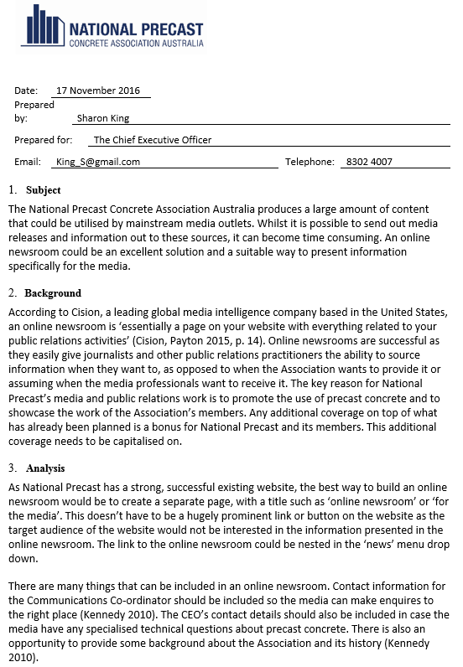
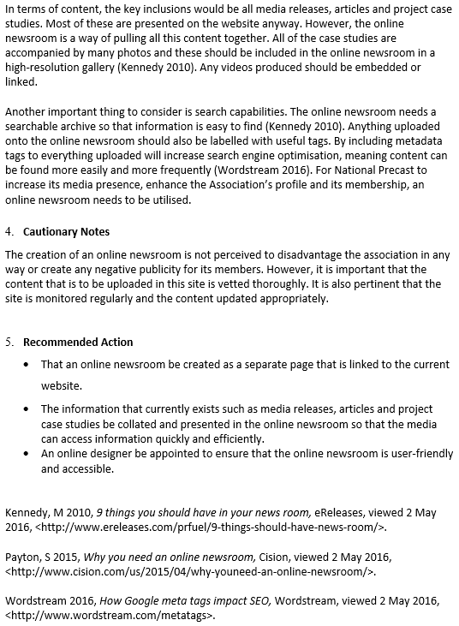
An example: Briefing paper
Notes:
Slide 8: An example: Briefing paper
It is pertinent that you learn to write the different texts required of you in the profession as you will be expected to write them once you are in the workplace. You will only be able to do so if you practise writing them. This assessment task is set so that you can demonstrate to your tutor that you have mastered these skills. On this slide you have been presented with an example briefing paper. It is important to note that this is an example only and you are not required to follow the format. It is also important to know that you cannot copy or reproduce the example in your assignment. Students who reproduce this example even though with amendments may be penalised with a failing grade.
If you examine the example, you will notice that the writer has organised their brief in a manner that is easy to read and follow. The brief is coherent and cohesive. They have used a formal and professional tone. They have used the passive form to convince the reader of the need for an online newsroom. You will notice that the writer has not used first or second person pronoun such as ‘I’ and ‘You’. The writer has demonstrated that they have undertaken internal and external research on the topic. They have presented a sound argument based on evidence. They have also provided references as to where the reader can source the information if they further needed to read about these issues.

Slide 9
Reference
Public sector writing n.d., ‘How to write briefing notes’, viewed 17 November 2016, <http://www.publicsectorwriting.com/?page_id=6>.
TN 21 n.d., ‘Developing a briefing paper’, viewed 17 November 2016, <www.edu.gov.mb.ca/k12/cur/socstud/frame_found_sr2/tns/tn-21.pdf>.
Notes:
Slide 9: Reference
The information presented in this presentation had been obtained from the sources listed on this slide. For further information on how to write a professional brief, please refer to the texts.

