Slide 1
Writing a media backgrounder COMM2079
Notes:
Slide 1: Introduction
One of the tasks you are required to complete for Assessment 2 is to write a media backgrounder. This presentation provides you with information on what a backgrounder is, its uses, how to write one and an example.

Slide 2
What is a media backgrounder?
A backgrounder is an in-depth informational piece, providing as the name implies, background information on a specific issue. They often accompany press releases and provide additional information not found in the releases.
Gives the press or other interested parties a more detailed background of an issue, event, person of interest or launch.
Provided because other media documents such as media advisories and media releases are necessarily kept short and succinct
Provides more information to journalists or media outlets without compromising the readability or standard format of the media advisory or media release.
2
Tapia 2015
Notes:
Slide 2: What is a media backgrounder?
*A media backgrounder is an in-depth informational piece that provides background information on a specific issue. Backgrounders usually accompany press releases and provide additional information that is often not found in media releases. For this assessment task, you are required to write a media backgrounder that will accompany a media release. *The aim of the backgrounder is to provide the press or other interested parties with a more detailed background of an issue, event, person of interest or launch. *This document is provided along with the media release because other documents such as the media release or media advisories are kept short and succinct and are not able to provide in-depth details about the topic. *The backgrounder is able to provide more information to journalists or media outlets without compromising the readability or standard format of the other documents.

Slide 3
What are the uses?
Collateral material for partner groups
Talking points for an interview
Preparation documents for a media interview
Inclusion in an online or print media toolkit
3
National Association of Social Workers 2008
Notes:
Slide 3: What are the uses?
The backgrounder has many uses. It is sometimes used as collateral material for partner groups. It is also used as talking points for interviews. In other instances, a media backgrounders are also used as a preparation document for media interviews. Finally, the backgrounder is a document that is often included in online or print media toolkits.

Slide 4
How to write a backgrounder
Usually written in narrative style.
Can be longer than a media release (sometimes 3-4 pages)
Good idea to use the ‘5Ws (What? When? Where? Why? Who?) and H (How?)’ to help you work out what you need to say
Start with a concise statement on the issue or subject of the topic accompanying the press release. For example: “Clinical social workers provide the majority of the nation’s mental health services.”
Follow the opening statement with a historical overview of the issue. Trace the issue’s evolution—how it came to be—and the major events leading up to it. You can utilize
outside information in this section. However, cite your statements within the text, according to the appropriate style guidelines of the publication you are sending it to.
Explain why this issue is important TODAY. State its significance and back that statement, as appropriate.
Present the implications of the issue. Support that statement with facts.
4
Use clear and concise language and use sub-headings where appropriate to make reading easier.
National Association of Social Workers 2008
Notes:
Slide 4: How to write a backgrounder
*A media backgrounder is usually written in a narrative style and is about 3 to 4 pages long. It is a good idea to use the ‘5W and H’ approach to write a backgrounder. *Always start your backgrounder with a concise statement on the issue or subject of the topic accompanying the press release. *The opening statement is usually followed with a historical overview of the issue that has been highlighted. It will be a good idea here to trace the issue’s evolution or how it came to be and any major events leading up to it. External information derived from your reading and research can be used in this section to make your argument more credible. However, if you do so, it is important that you cite the sources from which you obtained the information. Generally, the recommended style guidelines of the publication you are sending it to, is used. However, since you will be completing this task for your assessment, it is advised that you use the UniSA Harvard referencing convention. Please check with your tutor to confirm this. *Ensure that you emphasise why the issue that you are addressing in the backgrounder is important today. Do state its significance and back the statement as appropriate.
*Do also present the implications of the issue and support the statement with facts. *Use clear and concise language and sub-headings where appropriate to make reading easier. Do not forget to proofread and edit your document as this is a professional text and your readers may form negative impression of you if grammatical errors and typos are found in the backgrounder.

Slide 5
Specifics of a backgrounder
Has a heading that indicates what it is about | Usually produced on an organisation’s letterhead
Is broken up with subheadings | Includes graphs and charts where appropriate
Sometimes refers readers to other sources of information | Uses internal and external (should be cited) sources as in-depth research for the content
Written in an appropriate style and tone | Although contains all the specifics should not be too long or beat around the bush
Targeted for the specific media outlet
5
Mahoney 2013
Notes:
Slide 5: Specifics of a backgrounder
There are particular specifics to producing a media backgrounder as can be observed on this slide. A backgrounder always has a heading that indicates what it is about which is then broken up with subheadings. Reference is also made to external sources of information. A backgrounder is written in a professional manner and uses a formal tone. The backgrounder is targeted for specific media outlet and audience. The writing is tailored for this. Generally, the backgrounder is produced on an organisation’s letterhead and includes graphs, charts and statistics where appropriate. Its content is directed by internal and external sources of information that is derived from extensive research. Although, the backgrounder contains all the details, it should be concise and straight to the point.

Slide 6
Writing the backgrounder
Focus squarely on the audience. What do they already know and what do you need them to know? Structure the piece to emphasize primary points you want to stick in readers’ minds
Use concise sentences and paragraphs. Avoid flowery or unnecessary words or phrases. Get straight to the point to make things memorable but don’t let the writing get boring.
Call attention to people when possible because we relate better to humans than to companies. You want to personalize the story.
Make it clean. Any errors in grammar, spelling or style will reflect badly on the story or brand that is being profiled. Be sure to reread carefully to ensure everything is correct
6
Culver, Duncan, Forster & Wagner 2016
Notes:
Slide 6: Writing the backgrounder
When writing the backgrounder, it is important to focus squarely on the audience. Do reflect on what they already know and what is it that you want them to know. Do structure the backgrounder to emphasise the main points that you want the readers to take away. Ensure that you write using concise sentences and paragraphs. Avoid any flowery or unnecessary words or phrases and get straight to the point. Do not beat around the bush. It is important, however, to make sure that your writing does not become boring. Wherever appropriate call readers’ attention to people rather than organisations as this would make your story more personable. Ensure that your backgrounder is of high quality and is error free as you want readers to believe in the credibility of what you are communicating.

Slide 7
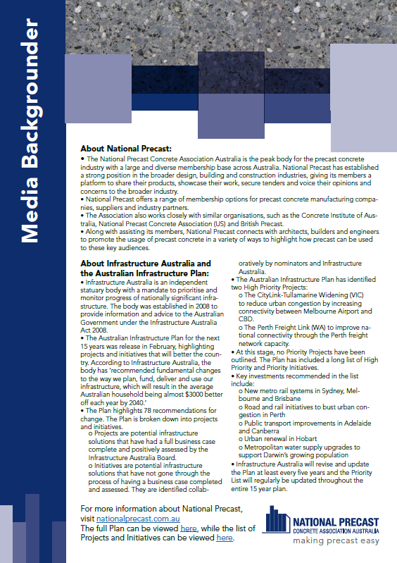
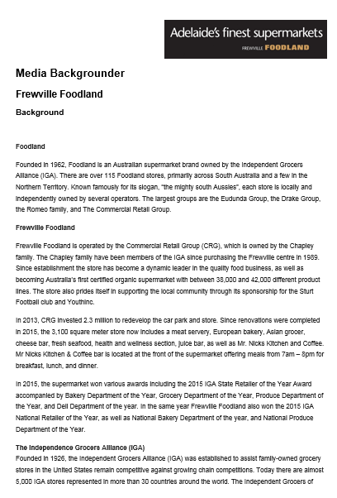
Example: Media backgrounder
7
Notes:
Slide 7: Example: Media backgrounder
On this slide, you are presented with two examples of media backgrounders. Notice how the styles in the two texts are different. One writer has used bullet points to present their discussion and the other has written their backgrounder in paragraph form. It is up to you to choose which style you want to use in your own backgrounder. Do make sure that your backgrounder addresses a particular audience, is based on well-researched content, is structured coherently and cohesively, is clear and concise, maintains a formal tone and communicates the main message. Most importantly do ensure that your text is has been edited and is error free.
It is important not to reproduce any one of these examples as your own as this may affect your grades. Do attempt to incorporate all the information presented to you in this presentation to produce your own media backgrounder as this is one of the texts that you may be asked to write in the workplace. Do also remember to use the concepts introduced in the course when writing your backgrounder. Your final piece should demonstrate that you have learnt how to write a good media backgrounder.

Slide 8
Reference
Culver, K, Duncan, M, Forster, S & Wagner, M 2016, ‘Corporate backgrounders’, viewed November 2016, https://handbook.journalism.wisc.edu/corporate-backgrounder/.
Mahoney, J 2013, Public relations writing, Oxford University Press, Australia.
National Association of Social Workers 2008, ‘How to write and use an effective backgrounder in public relations’, viewed 4 November 2016, https://www.socialworkers.org/pressroom/mediaToolkit/.../WriteBackgrounder.pdf.
Tapia, A 2015, ‘Backgrounder example’, viewed 4 November 2016, https://www.thebalance.com/backgrounder-example-136071.
8
Notes:
Slide 8: Reference
The information shared in this presentation was accessed from the sources listed on the slide. For additional information on writing media backgrounders, do refer to the texts.

