Slide 1
Exam Preparation
Dr. Shashi Nallaya

Slide 2
Copyright
COMMONWEALTH OF AUSTRALIA
Copyright Regulations 1969
WARNING
This material has been produced and communicated to you by or on behalf of the University of South Australia pursuant to Part VB of the Copyright Act 1968 (the Act).
The material in this communication may be subject to copyright under the Act. Any further reproduction or communication of this material by you may be the subject of copyright protection under the Act.
Do not remove this notice.

Slide 3
What are exams?
Exams are:
tests of your deep learning, knowledge and understanding of material.
opportunities to demonstrate how you use the information that you have learned.
challenges/opportunities to demonstrate what you know.
3

Slide 4
Types of exams
Multiple choice questions | Open book
Short answers | Take home
Essays | Seen or open questions
Case study | Practical

Slide 5
Questions types (Closed book)
10 Multiple choice questions (20 marks)
7 Short answer questions (28 marks)
6 Matching definitions (6 marks)
6 True/false questions (6 marks)
1 Case Study (40 marks)

Slide 6
Multiple Choice Questions (MCQs)
Test a broad range of topics
Test students’ knowledge of content area
Scoring is objective and reliable
No points are awarded for partial information

Slide 7
Characteristics of MCQs
Objective Questions:
Stem: question or incomplete statement
Options: suggested answers or completions
Distracters: incorrect responses
Key: correct response

Slide 8
Sample MCQS
SECTION 1: MULTIPLE CHOICE – Circle the correct answer
1. The first step in the engagement phase is:
a) prioritise problems.
b) work with your client.
c) establish goals.
d) evaluate levels of intervention. 2 marks
2. The final phase of the Miley’s Generalist Social Work Practice Intervention Model involves:
a) saying goodbye to the client.
b) setting goals.
c) specifying objectives.
d) working with the client.
e) reflecting and evaluating on the intervention process and the worker’s own intervention skills and knowledge and Identifying (where to from here). 2 marks

Slide 9
Sample answers
SECTION 1: MULTIPLE CHOICE – Circle the correct answer
1.The first step in the engagement phase is:
a) prioritise problems.
b) work with your client.
c) establish goals.
d) evaluate levels of intervention. 2 marks
2. The final phase of the Miley’s Generalist Social Work Practice Intervention Model involves:
a) saying goodbye to the client.
b) setting goals.
c) specify objectives.
d) working with the client.
e) reflecting and evaluating on the intervention process and the worker’s own intervention skills and knowledge and Identifying (where to from here). 2 marks

Slide 10
Sample MCQS
SECTION 1: MULTIPLE CHOICE – Circle the correct answer
3. What is the actual ‘doing’ of social work and human service work?
a) Engagement.
b) Planning.
c) Evaluation.
d) Assessment. e) Intervention. 2 marks
4. Micro level skills include:
a) Basic relationship building and interviewing skills used with individual action.
b) Skills for changing agency policies.
c) Group process skills.
d) Concluding that there is no hope for the client.
e) Making appropriate referrals. 2 marks

Slide 11
Sample answers
SECTION 1: MULTIPLE CHOICE – Circle the correct answer
3. What is the actual ‘doing’ of social work and human service work?
a) Engagement.
b) Planning.
c) Evaluation.
d) Assessment. e) Intervention. 2 marks
4. Micro level skills include:
a) Basic relationship building and interviewing skills used with individual action.
b) Skills for changing agency policies.
c) Group process skills.
d) Concluding that there is no hope for the client.
e) Making appropriate referrals. 2 marks

Slide 12
Section 2: Short answer questions - example
5. What is the purpose of Social Work and Human Service Work? 4 marks
6. What is meant by the term cultural competency and briefly discuss how we would incorporate a cultural competency framework? 3 marks
7. Define the Strengths Perspective and discuss the relevance to intervention in social work and human service work. 3 marks
enhance problem solving skills
link people with resources
promote effective and humane operations of these human service systems
influence and improve social policies
Refers to ensuring that all systems, agencies, structures and professionals working closely together to ensure that services are more responsive to cultural diverse communities, families and individuals.
Using cultural knowledge, cultural awareness and skills and competencies to demonstrate acceptance of difference and diversity.
Culturally competent human service workers recognise strengths in the traditions, values and beliefs from which cultural group members rely on for shared identity and community belonging.
Every individual has family; group has strengths; Trauma and struggle may be injurious, but they may be able to be sources of challenge and opportunity; Upper limits of capacity to grow and change is unlimited, group and community aspirations should be taken seriously; Every environment has resources.

Slide 13
Section 3: Matching definitions- example
8. Match the following roles with the appropriate definitions:
a) Educator
b) Organiser
c) Broker
d) Case manager
a
often involved in teaching people about resources and how to develop particular skills, such as effective communication, self management skills, preventive strategies and self awareness and good parenting skills.
b
involved in many levels of community organisation and action groups, and promote community awareness to bring about change.
c
involved in the process of making referrals to link individuals and families to needed resources and also follow up to be sure the needed resources are attained.
d
involved in locating services and assisting clients to access those services. Case management is especially important for complex situations and where clients need access to multiple services.

Slide 14
Section 4: True/False Questions - example
SECTION 4: TRUE OR FALSE - Circle the correct answer
9.
a) In order to solve problems involving organisations or communities, mastery of both micro and mezzo level skills are necessary.
b) The foundation for generalist practice always involves knowledge, skills and values.
c) A social worker and/or human service worker cannot intervene unless a problem exists.
d) Assessment is a continuous activity.
a) T or F
b) T or F
c) T or F
d) T or F

Slide 15
Section 4: True/False Questions - example
SECTION 4: TRUE OR FALSE - Circle the correct answer
9.
a) In order to solve problems involving organisations or communities, mastery of both micro and mezzo level skills are necessary.
b) The foundation for generalist practice always involves knowledge, skills and values.
c) A social worker and/or human service worker cannot intervene unless a problem exists.
d) Assessment is a continuous activity.
a) T or F
b) T or F
c) T or F
d) T or F

Slide 16
Section 5: Case Study : Example
You are a human service worker working at ABC Counselling Service and located in regional country town in South Australia. Your manager asks you to see a new client who has been referred by the local doctor.
Alan 55 has been living at home alone for the past 3 days since his wife Ellen, died. He is severely mourning the death of his wife as she passed away suddenly. They were childhood sweethearts and met on the lands in the far north of the state of SA. Both Alan and Emily experienced being part of the Stolen Generation. Following being removed from their families, they were both placed in institutions. Alan experienced severe physical, sexual and psychological abuse whilst placed in an institution for 5 years and then for the rest of his adolescent years with a non-Aboriginal family.
He is of Aboriginal descent and has two daughters in their 20’s.Vivian, who lives close by in a domestic violent relationship with her Aboriginal partner and often arrives unannounced in the middle of the night. She has 2 children and is currently under investigation for neglect of these children through Families SA. The other daughter, Karen who lives with her father, Alan, has a mental health issue and suffers from bi-polar disorder.

Slide 17
Section 5: Case Study : Example
In writing your response to this case study you need to consider the following:
1. The best way to engage with Alan and what engagement skills are necessary in working with his family.
2. Identify key issues in your assessment.
3. A cultural responsive approach to working with Alan and his family.

Slide 18
How to answer case-type questions
Link theory to practice
use of knowledge of existing codes of practice/theories to decide what ought to be done
Plan your answer
use headings from questions to write your answers
write your answer in a logical order
Write your answer:
introduction
body: answer questions regarding the case
conclusion : draw together all main points
Review your answer

Slide 19
Say something about what social workers need to consider when engaging with clients
Maybe something about the delivery of service
Briefly state some issues that need to be considered when dealing with Alan
Introduction
general proposition (statement about the topic)
issue(s) related to the topic
aim (what)
Body
Identify engagement skills necessary when dealing with Alan.
Specify key issues in your assessment of Alan.
Discuss a cultural responsive approach to working with Alan and his family.
Conclusion
restate thesis statement
recap key points
concluding statement
It was identified that Alan had many issues arising from factors such as grief, loss, health, isolation, etc. It is important that a strong relationship, trust and rapport are built to explore the Aboriginal culture and cultural identity… Alan would be continuously monitored to ensure that he and his family receive support to manage their challenges.

Slide 20
Points to consider
The length of time for the exam;
The number of questions you will need to answer; and
The type of questions.

Slide 21
During the exam
1) Carefully read the instructions and questions .
2) Identify the directives (how to answer).
3) Identify how many questions you have to answer and allocate time for each.
4) Brainstorm the plan (outline) for the answer.
5) Answer questions that you are familiar/confident of first.
6) Structure your answer in the format required (case study, etc.).
8) Write clearly and concisely (do not over answer).
9) Do not go over the allocated time for each answer.
10) Review your answer.
e.g. compare, contrast, define, discuss, evaluate
2 hours for five sections approximately ? mins for each
Introduction, body, conclusion

Slide 22
Using time during exam
Time per question needs to be divided between:
preparation time;
writing time; and
reviewing time.
Read
Plan
Write
Review

Slide 23
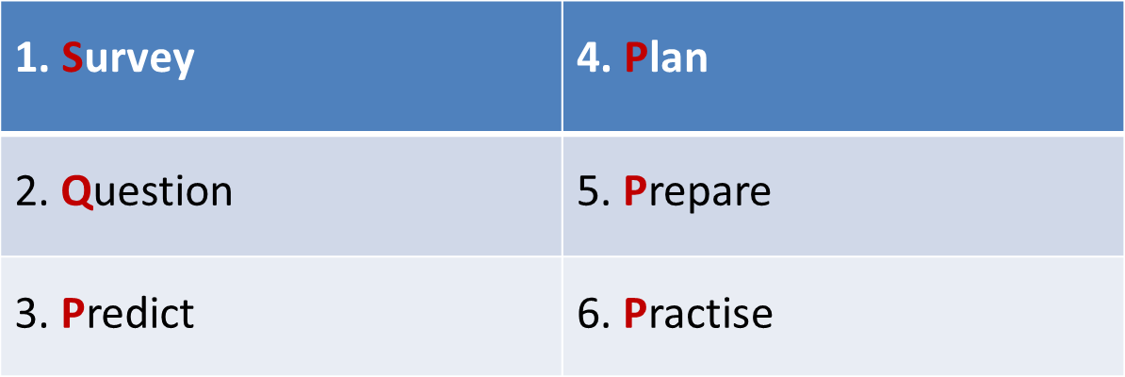
Strategies for exam preparation : SQ4P

Slide 24
Thank You
Q & A

