Slide 1
Critical Analysis Essay –
Dr. Shashi Nallaya

Slide 2
Copyright
COMMONWEALTH OF AUSTRALIA
Copyright Regulations 1969
WARNING
This material has been produced and communicated to you by or on behalf of the University of South Australia pursuant to Part VB of the Copyright Act 1968 (the Act).
The material in this communication may be subject to copyright under the Act. Any further reproduction or communication of this material by you may be the subject of copyright protection under the Act.
Do not remove this notice.

Slide 3
The Task : Critical analysis essay
What are some of the key principles of stage performance?
Drawing on the course activities inside and outside of class as well as the readings, write an analysis of the course experience.
Describe your practical experience of some of the exercises, improvisations, rehearsals and performances.
Relate your practical experience to the dramatic principles outlined in the course e-readings.
You should select ‘magic’ moments from your course experience to discuss and analyse:
Magic moments refer to moments of self-awareness, revelation and creative breakthroughs.

Slide 4
Things to address before you begin writing
Read up on all the principles of stage performance (e-readings)
Reflect on all of your course activities (in and out of class)
Select a few of the practical experiences which you could analyse
Consider the improvisations, rehearsals and performances for these activities.
Analyse which of the principles identified in the readings match your practical experience
Identify your ‘magic moments’ while undertaking these practical experiences.

Slide 5
What this assignment requires?
A critical analysis of your experience of the course
You need to incorporate the introduced theories/concepts to the actual practical activities
You need to consider the following in your discussion:
How did the practical experiences contribute to your understanding of the course?
How did the dramatic principles contribute to the practical experiences?
When did you experience your magic moments?
Did they change your understanding of the course?
What have you learnt from the course about stage performance (principles to consider)

Slide 6
Descriptive vs Critical
Descriptive
Define
Describe
Summarise
Give examples
Critical
Analyse
Compare
Contrast
Critique
Evaluate Examine

Slide 7
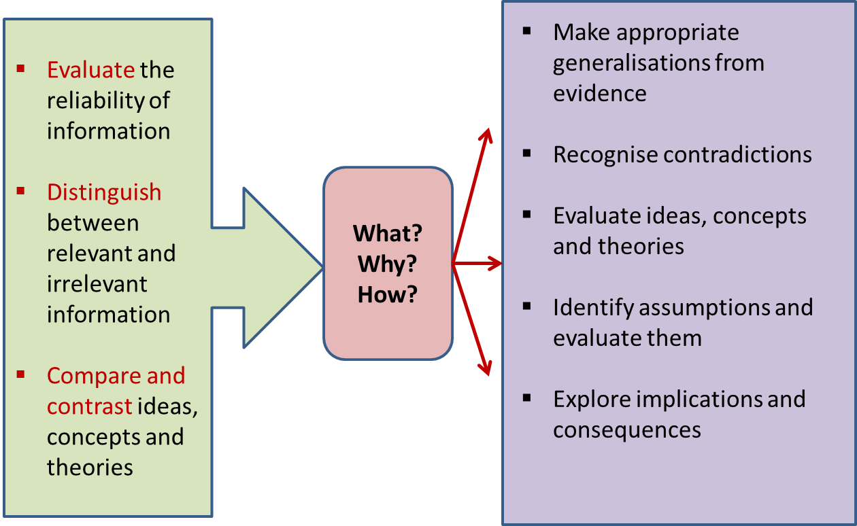
What does it mean to be critical?

Slide 8
Essay : Structure
Introduction (10% of word count)
Introduce the topic (general statement)
Identify key issues/problems
State your thesis statement (your proposition)
Identify aims (What is the purpose of the paper)
Provide the scope (How is the discussion organised)
Body (80% of word count)
Topic sentence (introduce key point)
Expand point with supporting statements (evidence & justification)
Provide example (if appropriate)
Conclusion (10% of word count)
Restate thesis statement (main message)
Interpret/recap key ideas
Conclude argument
8

Slide 9
Intro : Example
There are particular principles that govern successful stage performances. Lighting, performance and text are a few aspects that are considered in any stage performance. This essay will critically analyse some key principles associated with stage performance, namely, ………; …………; ……… by analysing some practical experiences undertaken inside and outside the classroom. The discussion will first highlight the practical experiences that will be used in the analysis of the principles. Next, the key principles associated with the experiences will be discussed in-depth…
General introduction to the topic
One/two key issues associated with the topic
The aim of the essay (what)
The scope of the essay (how)

Slide 10
Body : Example
Uncovering the world within the character and the actor by going beyond mere words and language of the script is a significant principle of stage performance. Berry (2008) suggests that an actor’s connection to the words they speak during performance, augment the utterance of them. This was observed in the practical exercise where displacement strategies were employed during the rehearsals for…
Topic sentence (key point that will be discussed in this paragraph
Expansion of key point with evidence

Slide 11
Conclusion: Example
Nearly all the elements discussed in the above sections such as body, voice, text and stage, play an important role in stage performance. The ultimate performance is a collective presentation of each one of these principles. This course has managed to provide many insights about stage performance through the various practical exercises that were undertaken individually and in teams… Conclude with a statement about the implications/suggestions for future research or just a thought-provoking statement.
Reiterate main message (thesis statement)
Recap key points discussed in the body section (do not introduce any new points)
Concluding statement

Slide 12
Different ways of integrating evidence
Quoting (Direct voice) | Lecoq (2001, p. 29) indicated that ‘replay involves reviving lived experience in the simplest possible way’.
Paraphrasing (Indirect voice) | It has been highlighted that replay involves the reawakening of past experienced encounters in the easiest manner (Lecoq 2001).
Summarising (External voice) | It is often advocated that stage performance required three elements, mainly, actors, play and audience (Evans 2006; Lecoq 2000; Slattery 2013)

Slide 13
Where to place your evidence
Author prominence
Lecoq (2001) suggested that replay involves the reawakening of past experienced encounters in the easiest manner.
Information prominence
It has been highlighted that replay involves the reawakening of past experienced encounters in the easiest manner (Lecoq 2001).

Slide 14
Academic writing
Discussion is logical, coherent and cohesive
Uses a topic sentence to introduce the key point that will be discussed in this paragraph (writer’s critical voice)
Appropriate referencing convention is used
Appropriate reporting words used (suggests, highlight, etc.)
Expansion of main point with evidence
Grammatically correct with no errors
Writer’s critical voice

Slide 15
Additional resources for your writing
https://lo.unisa.edu.au/course/view.php?id=4074 (L3 resource hub)
https://lo.unisa.edu.au/course/view.php?id=4077 (L3EASS discipline specific resources)
https://lo.unisa.edu.au/course/view.php?id=3839 (referencing resources)

