Slide 1
Critical thinking and analysis
Notes:
Slide 1: Introduction
This is a presentation on critical thinking and analysis. In many of your courses you would be expected to demonstrate critical thinking and analysis in your reading and writing. Sometimes you would also be required to undertake a critical analysis of a text, website or some other form of visual or non-visual object. In order to do this, you may need to apply theories or concepts that have been introduced in your course. This presentation focuses on aspects of critical thinking and analysis such as what it comprises and the processes that are involved. The presentation also illustrates two examples of critical analysis of a resume which is one of the assessment tasks in COMM1060.

Slide 2
What is critical thinking?
A cognitive activity associated with using the mind. When we learn to think in critical, analytical and evaluative ways, we use particular mental processes such as attention, categorisation, selection and judgement.
2
Cottrell 2005, p. 2
Notes:
Slide 2: What is critical thinking?
Critical thinking is an activity that is associated with using the mind. When we learn to think in critical, analytical and evaluative ways, we use particular mental processes such as attention, categorisation, selection and judgement.

Slide 3
Critical thinking skills involves:
Identifying other people’s positions, arguments and conclusions.
Evaluating the evidence for alternative points of view.
Weighing up opposing arguments and evidence fairly.
Being able to read between the lines, seeing behind surfaces and identifying false or unfair assumptions.
Recognising techniques used to make certain positions more appealing than others (e.g. false logic and persuasive devices)
Reflecting on issues in a structured way (logic and insight)
Drawing conclusions about whether arguments are valid and justifiable, based on good evidence and sensible assumptions.
Presenting a point of view in a structured, clear, well-reasoned way that convinces others.
3
Cottrell 2005, p. 2
Notes:
Slide 3: Critical thinking involves:
There are range of skills and attitudes that are associated with critical thinking. When you are critical, you identify your own as well as other people’s positions, arguments and conclusions. You would also evaluate the evidence for alternative points of view and weigh up opposing arguments and the evidence fairly. When someone is critical, they would also be able to read between the lines and see behind surfaces and identify false or unfair assumptions. They would also be able to recognise techniques used to make certain positions more appealing than others. Being critical also means the capacity to reflect on issues in a structured way. Besides this, you should also be able to draw conclusions about whether arguments are valid and justifiable based on good evidence and sensible assumptions. Finally, critical thinking also involves presenting a point of view in a structured, clear, well-reasoned way that convinces others. Often, when reading or completing your assignments, you would be expected to demonstrate these skills.

Slide 4
Critical thinking and reasoning
Have reasons for what we believe and do
Critically evaluate our own beliefs and actions
Present to others the reasons for our beliefs and actions
4
Cottrell 2005, p. 3
Notes:
Slide 4: Critical thinking and reasoning
Critical thinking is associated with reasoning or our capacity for rational thought. The word ‘rationale’ means using reasons to solve problems. On this slide you will see some skills that are related to reasoning. It is important to examine the basis of our own beliefs and reasoning as these will be the main vantage point from which we begin any critical analysis. For example, when we challenge why we believe that something is true, it becomes obvious to us that we haven’t really thought through whether what we have seen or heard is the whole story or just one point of view.

Slide 5
Critical analysis of others’ reasoning
Identify their reasons and conclusions
Analyse how they select, combine and order reasons to construct a line of reasoning
Evaluate whether their reasons support the conclusions they draw
Evaluate whether their reasons are well-founded, based on good evidence
Identify flaws in their reasoning
5
Cottrell 2005, p. 2
Notes:
Slide 5: Critical analysis of others’ reasoning
Often you would be expected to analyse the reasoning of others. In order to do that, you would first need to identify their reasons and conclusions. Then you would need to analyse how they had selected, combined and ordered their reasons in order to construct their line of reasoning. You would also need to evaluate whether their reasons support the conclusions they have drawn. Besides this, you would also need to evaluate whether their reasons are well-founded and based on good evidence. You would also need to identify the flaws in their reasoning.

Slide 6
Questions for analysis
Theoretical questions
How does the author understand the situation
What is their theoretical background?
How would this influence their view of the situation?
Are all the concepts in the text clear?
Does the author define a concept vaguely to allow it to travel across different situations?
If a concept can related two seemingly different situations, is the concept meaningful?
Definitional questions
Evidence questions
Does the author’s evidence support their argument?
Do they have enough specific evidence to prove the more general point?
Implication/Policy relevance questions
What are the implications of this argument?
Are the implications positive or negative?
How has the author dealt with the issue?
Is the author’s argument consistent throughout?
Does the author’s background have important implications for their argument
Do specific language choices of the author betray a certain ideology or bias, or frame the argument in a particular way?
Other questions
6
JSIS Writing Center n.d
Notes:
Slide 6: Questions for analysis
There are particular questions that you could ask to undertake a critical analysis of something whether it is a text, website, poster or audio-visual presentation. On this slide you can see some example questions that will allow you to practise critical thinking and analysis.

Slide 7
Structure of a critical analysis
1. Introduction | Identify the work being critiqued Present thesis – argument about the work Preview your argument – what are the steps you will take to prove your argument
2. Short summary of the work | a. Does not need to be comprehensive – present only what the reader needs to know to understand your argument
3. Your analysis | Your argument will probably involve a number of sub-arguments – mini-theses you prove to support your larger argument. Your instructor wants to read your argument about the work that you are analysing, not a summary
4. Conclusion | Reflect on how you have proven your argument Point out the importance of your argument Note potential avenues for additional research or analysis
7
Notes:
Slide 7: Structure of a critical analysis
Your instructor will usually specify the structure of the assessment task that they want you to produce. It is a good idea to confirm the structure of the task before you begin writing it. On this slide you can see a general structure of a critical analysis. This may not be the structure that your instructor expects you to follow but if they have not specified a particular structure, you could follow this. It is recommended that you begin your analysis with an introduction. In this section you would identify the work that is being analysed. You would also present the thesis or your main message or argument about the work. You will then briefly outline the steps you will take to prove your argument. In other words, you need to specify how you will prove your argument.
The introduction is followed by a short summary of the work that you will be analysing. This section does not need to be comprehensive. You only need to present what the reader needs to know in order to understand your argument. The summary is followed by your analysis which is the main part of your writing. Your argument in this section may be developed with a number of sub-arguments which are mini theses that you prove in order to support your larger argument. Remember this must be a proper critical analysis of the work and not just a description or a summary.
Finally, you would need to include a conclusion section. This is where you would reflect on how you have proven your argument and point out its importance. If appropriate, you could also point out any potential avenues for additional research or analysis in the area of work that you have examined.
Even though you are potentially only referring to one source, you may still need to cite your information using the recommended referencing style.

Slide 8
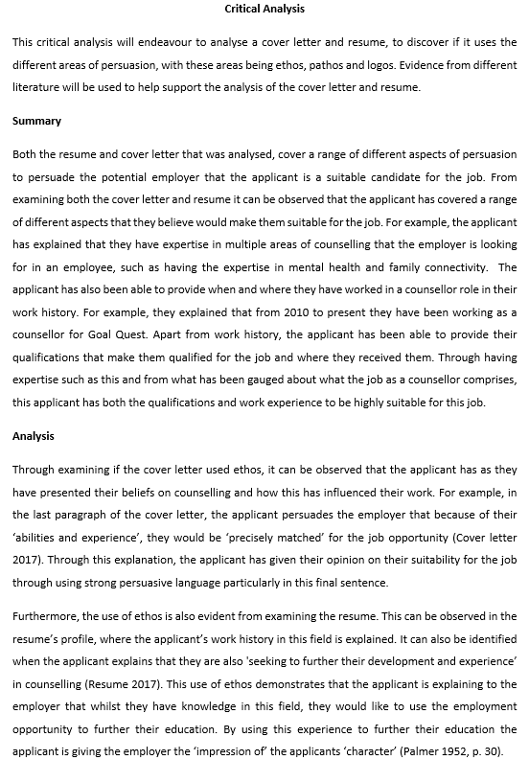
Introduction
Summary
Analysis
Conclusion
Notes:
Slide 8: Example 1 of a critical analysis of a cover letter and resume
On this slide, you can see an example of a critical analysis of a cover letter and a resume, one of the assessment tasks that you are required to produce for COMM1060. Do notice the different sections that were identified in Slide 7. Remember, this is an example only and you are not required to produce an exact version. You are advised to come up with a better critical analysis than the one presented in the example. Please do not reproduce the analysis that is presented in the example as this may result in you failing the assessment. Do also remember that as this is only an example, some sections of the text have been left out due to the limitation of space. In your own task, you would be expected to write more to meet the 900 words requirement. You will also notice that the writer uses particular concepts that they had learnt in the course to help them analyse the cover letter and resume. Often you would be expected to use the theories and concepts that were introduced in your course to undertake a critical analysis of something.

Slide 9
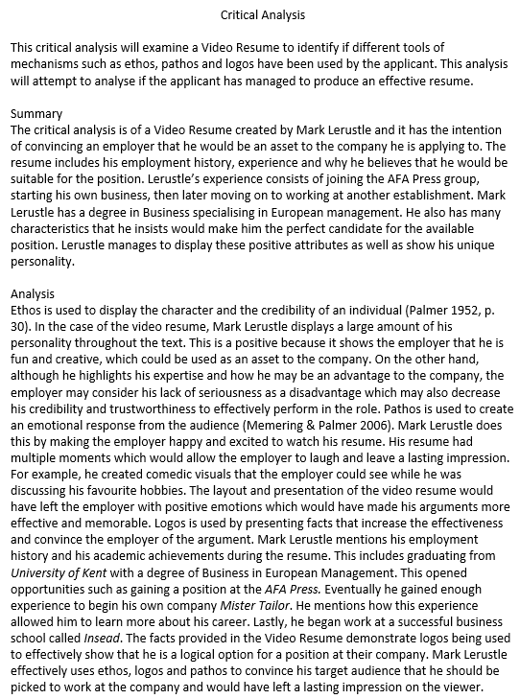
Introduction
Summary
Analysis
Conclusion
Notes:
Slide 9: Example 2 of a critical analysis of a video resume
On this slide you will see an example of a critical analysis of a video resume. As was indicated previously, this is an example only and you are encouraged to produce a better critical analysis than the one presented on this slide. Do ensure that you do not reproduce the example shown and meet the 900 words requirement in your own task.

Slide 10
References
Cottrell, S 2005, Critical thinking skills, Palgrave Macmillan, New York.
JSIS Writing Center n.d. ‘Writing critical analysis papers’, viewed 19 June 2017, https://depts.washington.edu/pswrite/Handouts/CriticalAnalysisPapers.pdf
Notes:
Slide 10: References
The information shared with you in this presentation was obtained from the texts listed on this slide. For more information on critical analysis, you are advised to refer to the texts.

