Slide 1
Pronunciation
Notes:
Slide 1: Introduction
As a student you will be expected to read widely and critically in order to complete the different assessments in your study program. This requires reading from different sources, understanding what you read, identifying and synthesizing key issues from various sources and seeing their link to the overall context. You also need to be critical about what you read. Being critical means to think more deeply about the information, interpret and evaluate, compare and contrast and assess the text’s credibility, purpose, relevance, currency, strengths and weaknesses. This presentation complements the ‘Reading for writing’ presentation. While the ‘Reading for writing’ presentation focused on the different stages of reading and reading critically, the ‘Reading efficiently’ presentation draws your attention to some strategies that you could use to read more efficiently.

Slide 2
Overview
This workshop will address the following:
Pronunciation
Pausing and Chunking
Word stress

Slide 3
Why is pronunciation important?
Miscommunication can occur when someone:
speaks too fast
says words incorrectly
has a strong accent
hesitates too much when they speak

Slide 4
Activity
Read this poem aloud. What do you sound like? Does your partner understand you?
To sit in solemn silence in a dull, dark dock, In a pestilential prison, with a life-long lock, Awaiting the sensation of a short, sharp shock, From a cheap and chippy chopper on a big black block! To sit in solemn silence in a dull, dark dock, In a pestilential prison, with a life-long lock, Awaiting the sensation of a short, sharp shock, From a cheap and chippy chopper on a big black block! A dull, dark dock, a life-long lock, A short, sharp shock, a big black block! To sit in solemn silence in a pestilential prison, And awaiting the sensation From a cheap and chippy chopper on a big black block!
by W.S. Gilbert of Gilbert and Sullivan from The Mikado

Slide 5
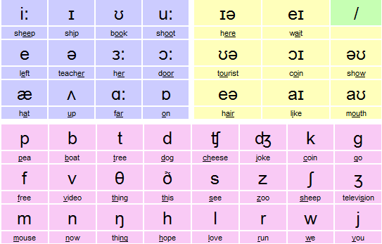
Phonemic Chart: Sound vs Spelling

Slide 6
Pronunciation Activity 1
Look at the phonemic chart and say out the sounds. Have you got them right?
http://www.teachingenglish.org.uk/activities/phonemic-chart

Slide 7
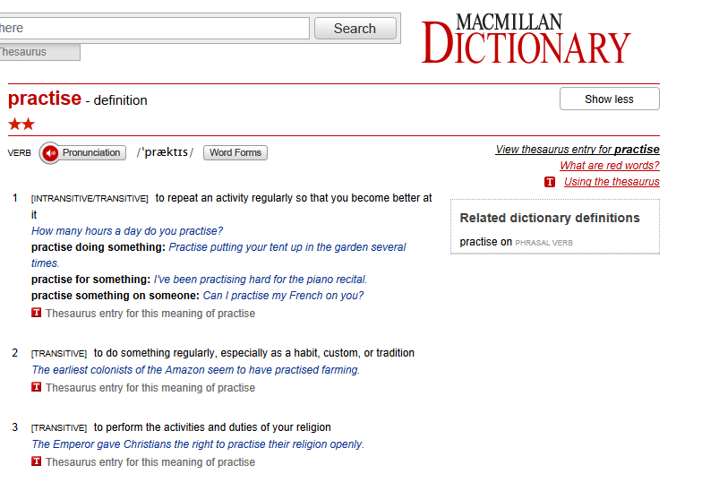
Online Dictionary for Pronunciation
http://www.macmillandictionary.com/dictionary/british/colleague

Slide 8
Activity 2: Pronounce these words
accessary | accessory
ail | ale
allowed | aloud
bald | bawled
band | banned
cast | caste
censor | sensor
dear | deer
desert | dessert
earn | urn
fair | fare
flour | flower
gorilla | guerrilla
groan | grown
hall | haul
hear | here
idle | idol
in | inn
key | quay
knot | not
laps | lapse
lead | led
main | mane
scene | seen

Slide 9
Pausing and Chunking
Pauses and chunks are strategies that speakers use to communicate information in manageable bits
Sample 1 | Sample 2
Does it really matter whether people speak with an accent as long as they can be easily understood many people now believe that in an increasingly globalised world we should accept variations in pronunciation that is accent. however there's no point in speaking with an accent if people can't understand you is there? | Does it really matter / whether people speak with an accent / as long as they can be easily understood?// Many people now believe / that in an increasingly globalised world / we should accept variations in pronunciation / that is / accent. // However / there's no point in speaking with an accent / if people can't understand you / is there?//
http://www.ssu.uts.edu.au/helps/resources/pronunciation/pausing.html

Slide 10
Word Stress
Stress is used in speech to highlight important information
Stress in the wrong place can cause confusion
https://www.uts.edu.au/current-students/support/helps/self-help-resources/pronunciation/stress

Slide 11
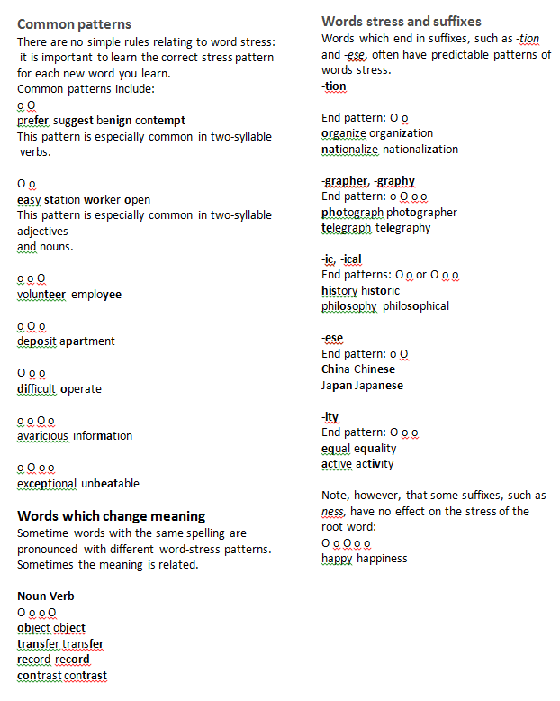
Word Stress: Examples

Slide 12
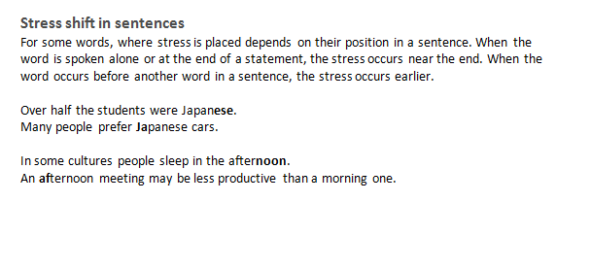
Word Stress

Slide 13
Activity: Say these words with the correct word stress
abbreviate | Arabic | epitome
abbreviation | association | facet
also | autobiography | indistinct
although | category | metaphor
analogy | compound (noun) | morpheme
analyse | contents | morphology
analysis | decade | mosaic
analyst | decadent | narrate
appalling | differentiate | narrative
appropriately | display | narrator

Slide 14
Sample Answer
abbreviate | Arabic | epitome
abbreviation | association | facet
also | autobiography | indistinct
although | category | metaphor
analogy | compound (noun) | morpheme
analyse | contents | morphology
analysis | decade | mosaic
analyst | decadent | narrate
appalling | differentiate | narrative
appropriately | display | narrator

Slide 15
Summary
Use the phonemic chart to learn how to pronounce words correctly.
Use the online dictionary to learn correct pronunciation
Learn how to apply the appropriate word stress in speech.
Practise regularly to perfect pronunciation.
Listen to proficient speakers to emulate correct pronunciation.

Slide 16
References
British Council 2010, Phonemic chart, viewed 12 April 2013, < http://www.teachingenglish.org.uk/activities/phonemic-chart>.
ESL Flow n.d., Pronunciation teaching ideas for ESL teachers, viewed 12 April 2013, <http://www.eslflow.com/pronunciationlessonplans.html>.
Underhill, A 1994, Sound foundations: learning and teaching pronunciation, Macmillan, Australia.
University of Technology Sydney 2013, Pronunciation, viewed 10 April 2014, http://www.ssu.uts.edu.au/helps/resources/pronunciation/stress.html

