Slide 1
Verb Tenses

Slide 2
Copyright
COMMONWEALTH OF AUSTRALIA
Copyright Regulations 1969
WARNING
This material has been produced and communicated to you by or on behalf of the University of South Australia pursuant to Part VB of the Copyright Act 1968 (the Act).
The material in this communication may be subject to copyright under the Act. Any further reproduction or communication of this material by you may be the subject of copyright protection under the Act.
Do not remove this notice.

Slide 3
Verb tenses
Source: Sinclair (2010, p. 42)

Slide 4
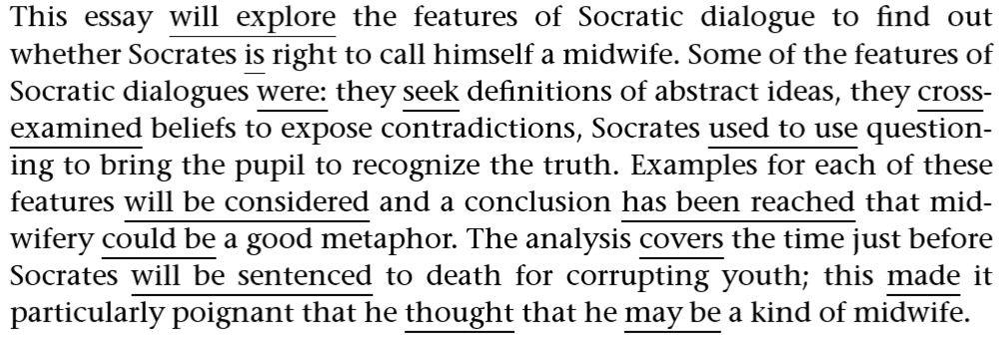
Confusion created by inappropriate tense use
will explore (future)
is (present)
were (past)
seek (present)
cross-examined (past)
used to use (past)
will be considered (past)
Source: Sinclair (2010, p. 43)
4

Slide 5
Tenses and time reference
Past
Present
Future
Simple
Continuous
Simple Perfect
Perfect continuous
Simple
Continuous
Simple Perfect
Perfect continuous
Simple
Continuous
Simple Perfect
Perfect continuous
 | Simple | Continuous | Perfect | Perfect Continuous
Present | take(s) | am/is/are taking | has/have taken | has/have been taking
Past | took | was/were taking | had taken | had been taking
Future | will/shall take | will be taking | will have taken | will have been taking

Slide 6
How to figure out the appropriate tense
The student who received their paper with the ‘Tenses!’ comment from the tutor rationalised in the following manner:
The essay exists for the reader so I’ll write about it in the present tense. I will say, ‘This essay explores features of Socratic dialogue…’
Socratic dialogue also exists for the reader, so I’ll write about that in the present too, ‘Some of the features of Socratic dialogue are…’
If I want to write about something that happened at a specific time, I’d better put that in the past, ‘Socrates died in 399 BC’
If I am talking about Socratic dialogue before Socrates died, I have to decide whether I’m writing about an event that is over and in the past or about the ideas that are still there for the reader to see.
A mixture of tenses will be okay if I’m clear about whether it’s an event that’s in the past or a theory that can be currently read.
Source: Sinclair (2010, p. 45)

Slide 7
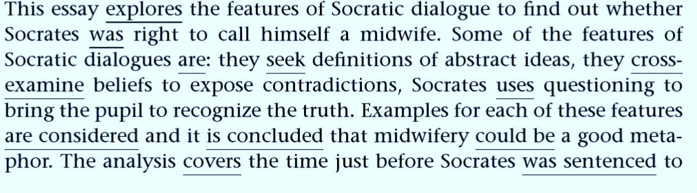
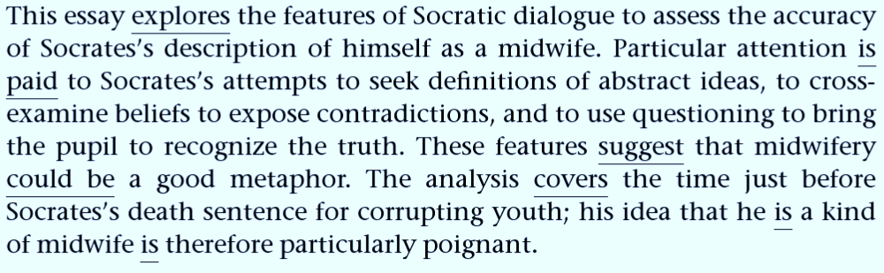
The revised versions
Source: Sinclair (2010, pp. 50-51)
Source: Sinclair (2010, pp. 51)

Slide 8
Verb tense examples : Present
Example | Tense | Usage
The student writes essays well. | Simple present | This is used for actions that happen all the time or regularly. It is also used for habitual actions.
The student is writing the essay. | Continuous present (or can be future) | It may be an action that is currently happening, or it may express intention for the immediate future.
The student has written an excellent essay. | Present perfect | This describes something completed at an unspecific time. Though the action is in the past, the effect is in the present.
The student has been writing an essay. | Continuous perfect | This describes something that began in the past, is still happening and may continue in the future
Source: Sinclair (2010, p. 46)

Slide 9
Verb tense examples : Past
Example | Tense | Usage
The student wrote an essay last week. | Simple past | It happened in the past.
The student was writing an essay when the fire started. | Continuous past | It happened in the past at the same time as something else.
The student had written the essay when the fire started. | Past perfect | It happened in the past and was completed before something else
The student had been writing the essay before the fire started. | Continuous past perfect | It began in the past and was ongoing, but was completed before something else.
Source: Sinclair (2010, p. 46)

Slide 10
Verb tense examples : Future
Example | Tense | Usage
The student will write an essay. | Simple future | It has not happened yet, but will happen in the future.
The student will be writing an essay about literacy. | Future continuous | This is continuous action, implying a particular period of time in the future.
The student will have written the essay before the tutorial. | Future perfect | It will happen and be completed before some other future event.
The student will have been writing the essay for three months by then. | Future perfect continuous | It will happen, it will be ongoing, it will still be happening at a specified time.
Source: Sinclair (2010, p. 46)

Slide 11
Reference
Sinclair, C 2010, Grammar a friendly approach, 2nd edn, McGraw-Hill Education, England.

