Slide 1
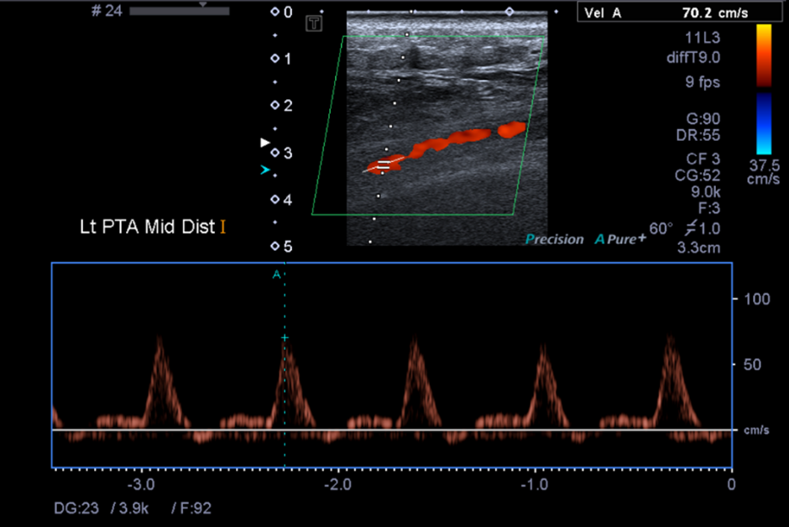

Slide 2
Given the clinical details of “pain in the lower part of the body” without any other information it would be difficult to determine whether the pain was as a result of a physical injury which would require Musculoskeletal imaging, an Inguinal or Femoral hernia, also requiring musculoskeletal imaging, Deep Vein Thrombosis which would require assessment of the deep and superficial venous system in the lower limb(s?) or stenosis / occlusion of an artery requiring assessment of the Arterial System of the lower limb(s?).

Slide 3
Based strictly on the clinical information provided and assuming the pain was at least narrowed down to the lower limbs a Dr would likely refer the patient for DVT and Arterial imaging first since this would be considered urgent and should be ruled out first before addressing the possibility of musculoskeletal factors in the lower limb.
Both Lower Limb DVT studies and Leg Arteries studies can be indicated as necessary based on Lower Limb Pain (Constans, J, et al, 2001) and Ultrasound is considered the gold standard for the investigation of these suspected conditions

Slide 4
2. A. An 11L3 transducer is being used. This is a linear array which is best suited for Peripheral Vascular (lower leg, carotid), Small Parts and Musculoskeletal imaging (Canon Medical Systems USA 2018, p. 3).
This is the best choice for this examination since it appears to be a lower limb arterial study which falls under the manufacturers suggested uses for the transducer. It is high frequency which is ideal for arteries and veins located fairly superficially. It also allows for beam steering when adjusting the doppler angle during spectral analysis.
The most appropriate system preset would vary from machine to machine depending on how they have been set up by the manufacturer but it would likely be labelled “Leg Arteries” or “Vascular”. This is most appropriate since the machine would be optimised in terms of tissue harmonics and other signal processing features by the manufacturer specifically for this type of imaging.

Slide 5
3. A. It is difficult to tell based on a still image if the settings can be optimised since dynamic assessment is such a large part of Sonography.
When assessing arteries the vessels should be assessed in B mode making sure the image is optimised to visualise the vessel lumen and check for any thickening or plaque deposits.
After this the scale should be adjusted until the centre of the vessel appears to show aliasing before readjusting so that the centre of the vessel shows a flash of yellow which fades to red towards the edges of the vessel. This indicates that the scale is set correctly in relation to the nyquist limit and optimised for laminar flow.

Slide 6
The colour gain should be set by increasing until the colour begins to “bleed” outside of the vessel and then reducing it so that the colour accurately fills the entire vessel.
It should be noted that if there has been any pathology visualised during B mode interrogation of the vessel then this optimisation process will be affected since aliasing is an important demonstration of stenosis as is a lack of colour fill in an area of the vessel that is occluded for example.
During spectral analysis the sample window should be placed in the centre of the vessel where the velocity is the highest
Angle correction should be in relation to the flow of blood in the vessel and should not exceed 60 degrees due to the increased potential error in the measured doppler shiftT

Slide 7
The velocity scale of the spectral analysis window should be adjusted so that the PSV being displayed takes up a reasonable amount of the graph rather than having it set too high so that the peaks are difficult to see or too low so that they are cut off by the top of the window.
In the image we can see that the PSV being measured in this patient’s Posterior Tibial Artery appears to be within the range of normal (67-71cm/s) (Gregory, L.M, 2020) and the waveform appears to be triphasic with sharp systolic upstroke, early diastolic flow reversal and then late diastolic forward flow which is expected in lower limb arteries at rest. (Ji, Y.H, 2017)

Slide 8
For this reason it appears that the sonographer needs to further optimize the image, specifically the colour scale and gain as detailed before since currently it appears abnormal
B. There does not appear to be any obvious image artefacts. If the image was optimised correctly then there are some artefacts that would be helpful such as aliasing at the site of a stenosis as mentioned before.

Slide 9
4. I have acquired my own image for this part of the presentation.
The image is of a Common Carotid Artery
I have optimised the image as explained on slides 7 and 8
The colour scale was adjusted until the centre of the vessel appeared to show aliasing before readjusting so that the centre of the vessel showed a flash of yellow which fades to red towards the edges of the vessel.
The colour gain was set by increasing until the colour begins to “bleed” outside of the vessel and then reducing it so that the colour accurately fills the entire vessel.
For the spectral analysis the sample window was placed in the centre of the vessel where the velocity is the highest
I angle corrected and utilized beam steering in relation to the flow of blood in the vessel making sure the angle did not exceed 60 degrees

Slide 10
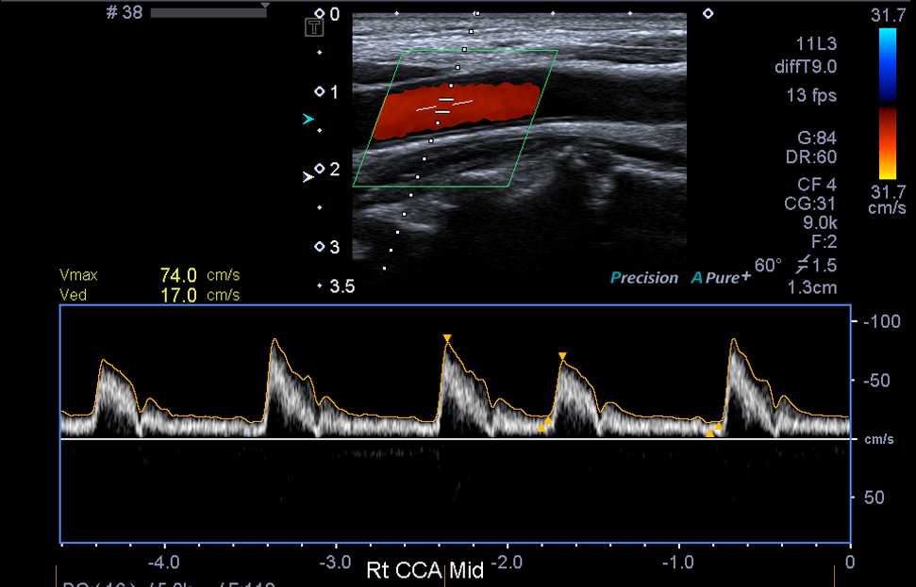

Slide 11
Power Doppler
Since power doppler only displays the strength of the power doppler signal rather than the speed and direction it is best used in scenarios where the sonographer wants to assess the level of blood flow to an area rather than the haemodynamic properties of the flow
A good example of this would be in the assessment of ovarian / testicular torsion. Power doppler is more sensitive to flow (Martinoli, C, 1998) and in the case of torsion the sonographer wants to assess the overall level of blood flow to the gonad

Slide 12
References
Constans, J, et al, 2001, 'Clinical Prediction of Lower Limb Deep Vein Thrombosis in Symptomatic Hospitalised Patients', Thrombosis and Haemostasis, vol. 86, no. 4, pp. 985–990.
Canon Medical Systems USA 2018, Transducers for Ultrasound Systems, Canon Medical Systems USA, viewed 13 April 2023,<https://www.google.com/url?sa=t&rct=j&q=&esrc=s&source=web&cd=&cad=rja&uact=8&ved=2ahUKEwiRp_rA8af-AhX0-TgGHSZdB7oQFnoECA8QAQ&url=https%3A%2F%2Fus.medical.canon%2Fdownload%2Ful-br-aplio-transducers.pdf&usg=AOvVaw2tvJ2VT-tx1KtwZ5dDS1Z6>.
Gregory, L.M, 2020, 'Tibial Artery Velocities in the Diagnosis and Follow-up of Peripheral Arterial Disease ', Seminars in Vascular Sonography, vol. 33, no. 3-4, pp. 65–68.
Ji, Y.H, 2017, 'Doppler Ultrasonography of the Lower Extremety Arteries: Anatomy and Scanning Guidelines', Ultrasonography, vol. 36, no. 2, pp. 111–119.
Martinoli, C, 1998, 'Power Doppler Sonography: Clinical Applications', European Journal of Radiology, vol. 27, no. 2, pp. 133–140.

