Slide 1
OSCE Online Viva
Clinical Sonography Portfolio
Notes:
weloc

Slide 2
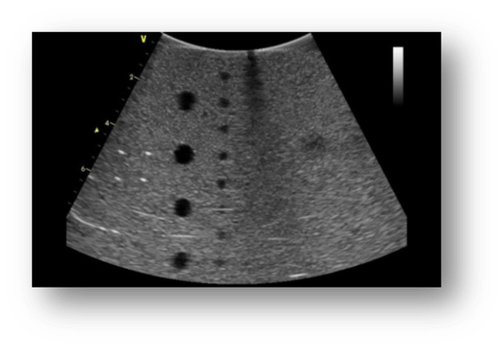
Introduction
Identity card
Audio /video check

Slide 3
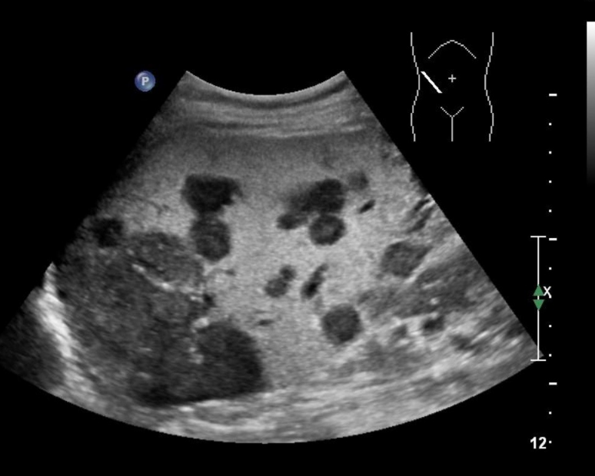
Image discussion
Describe this image
Name the organ and anatomy seen

Slide 4
You have a 73-year-old female for a thyroid scan.
She has back pain and is suffering from vertigo.
How would you set your room up for scanning?

Slide 5
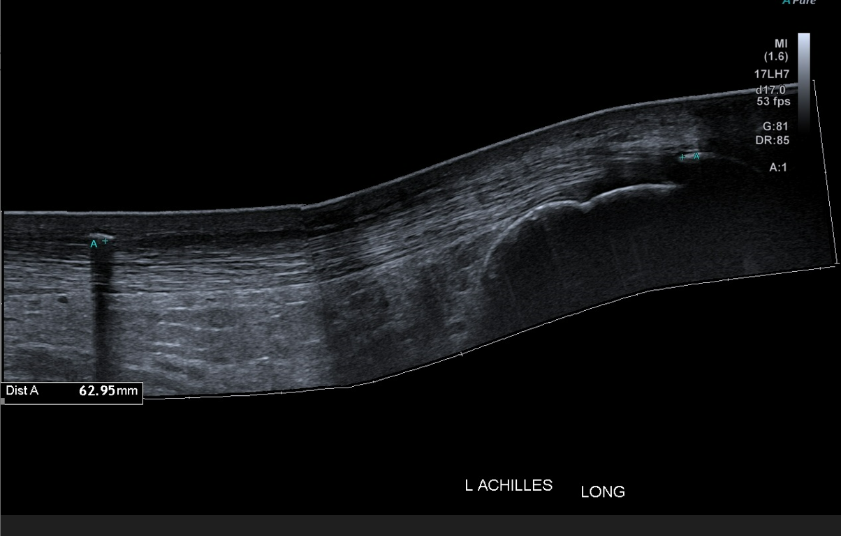
We are going to discuss this image

Slide 6
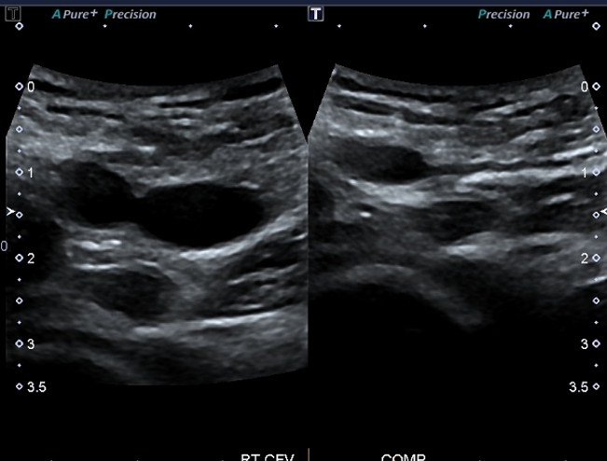
Describe the sonographic findings in this image

Slide 7
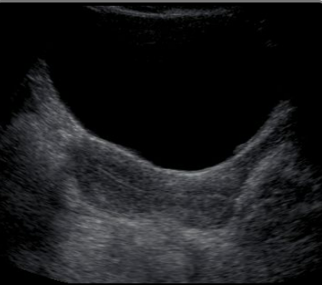
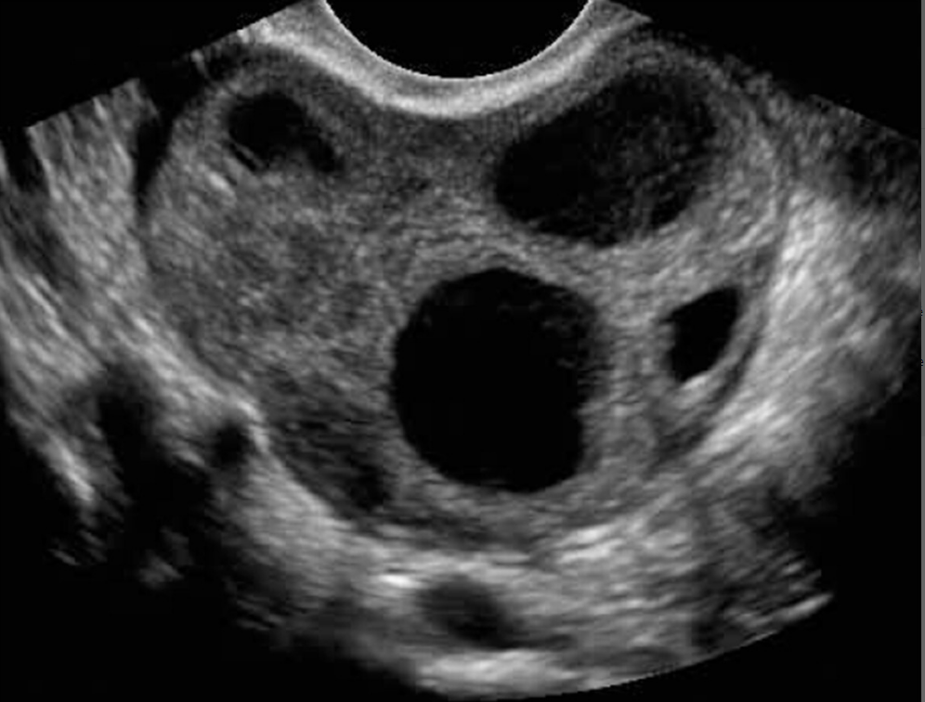
A
B
How are these images connected

Slide 8
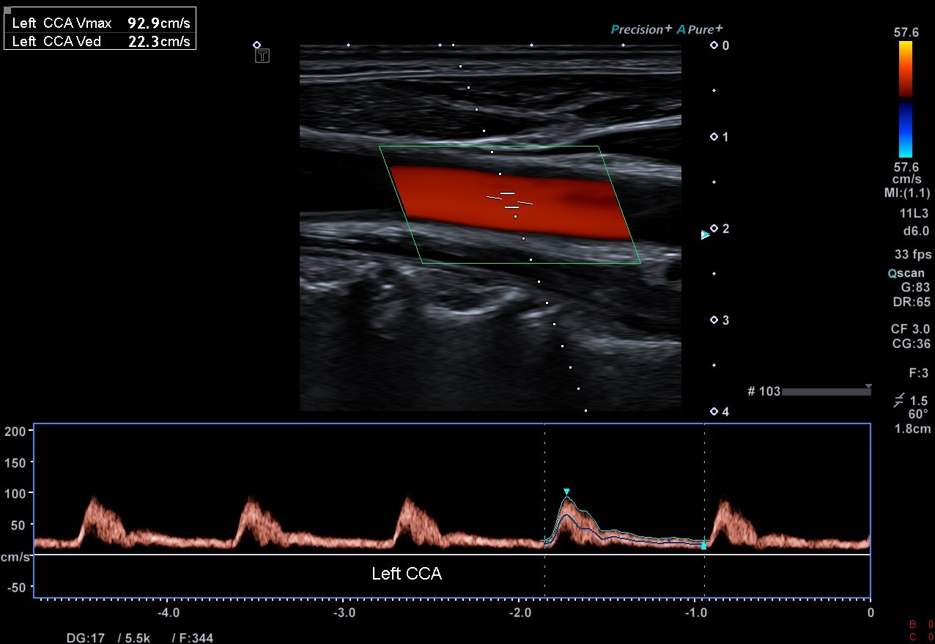
Final image –

Slide 9
End of viva
Results will be collated with the other two OSCE components
Please provide valuable feedback, specific feedback on online vivas: will email link and on learn-online site (helps to inform future assessments)
Appreciate your feedback on the teacher and course evaluation.
Best wishes!

