Slide 1
OSCE Online Viva
Clinical Sonography Portfolio

Slide 2
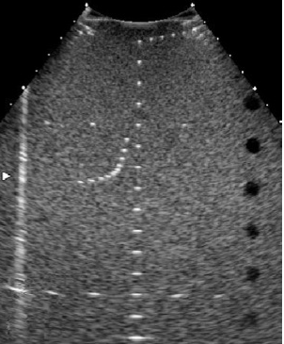
Introduction
Identity card
Audio /video check

Slide 3
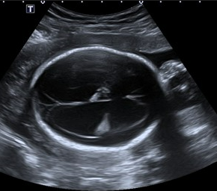
Consider this image

Slide 4
Your patient is 44 years of age, you have a request says the following
“recent fall from bike, painful shoulder, query injury rotator cuff”
Shoulder ultrasound and Xray

Slide 5
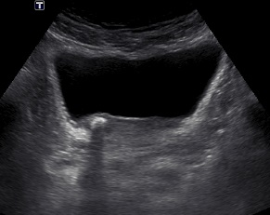
Describe this image

Slide 6
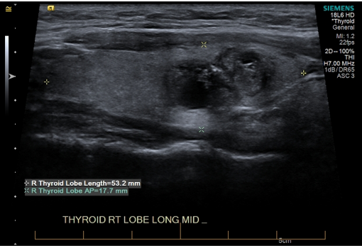
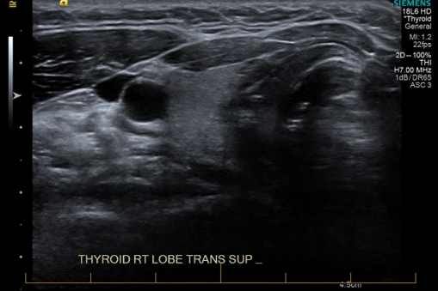
B
A

Slide 7
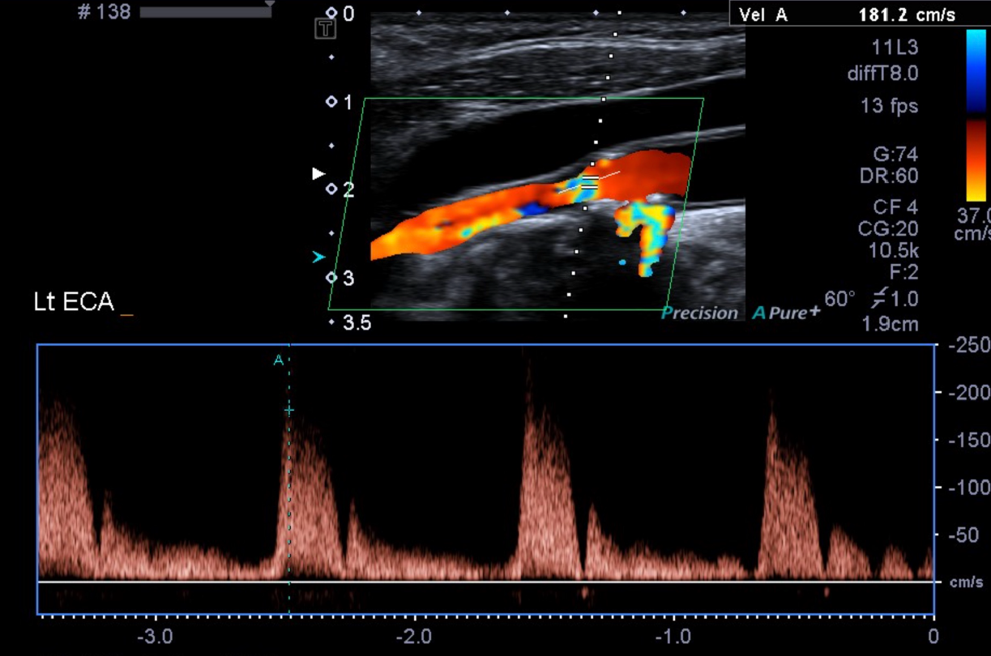
Vascular

Slide 8
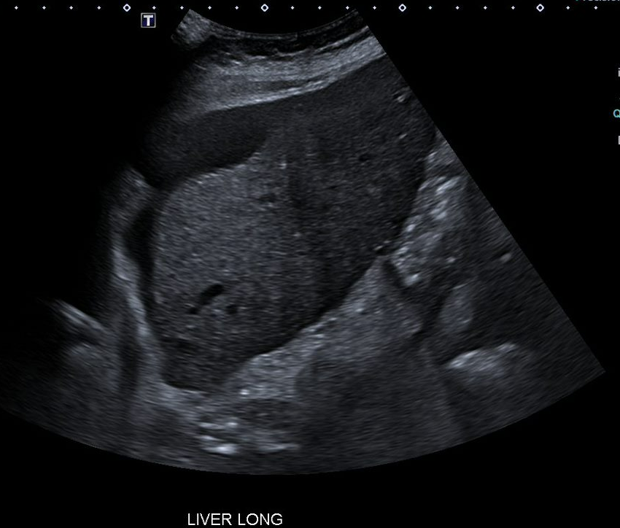
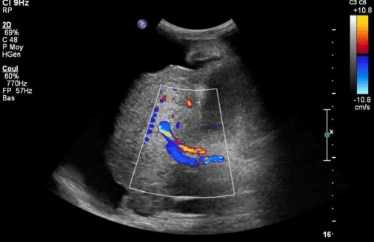
Abdominal imaging

Slide 9
End of viva
Results will be collated with the other two OSCE components
Please provide valuable feedback, specific feedback on online vivas: will email link and on learn-online site (helps to inform future assessments)
Appreciate your feedback on the teacher and course evaluation.
Best wishes!

