Slide 1
OSCE Online Viva
Clinical Sonography Portfolio

Slide 2
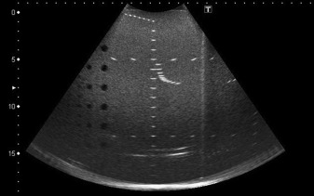
Introduction
Identity card
Audio /video check

Slide 3
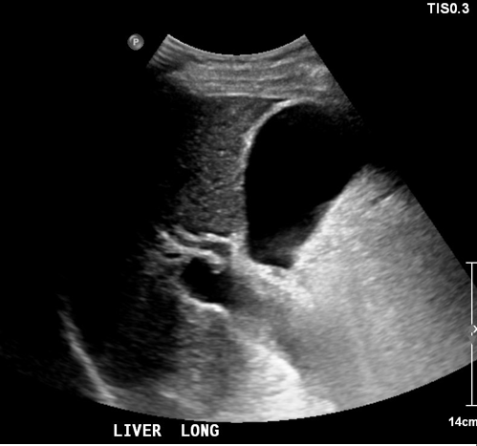
Let’s talk about this image

Slide 4
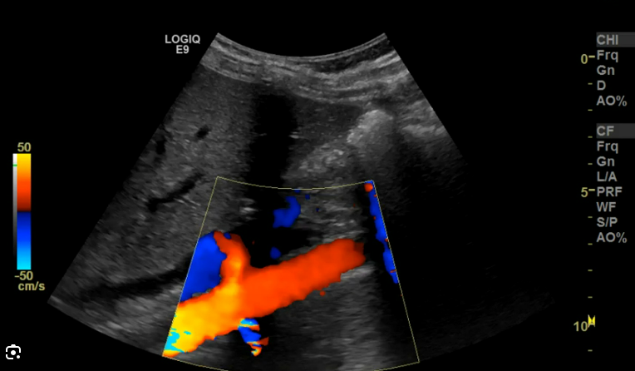
Abdominal imaging

Slide 5
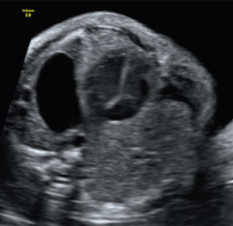
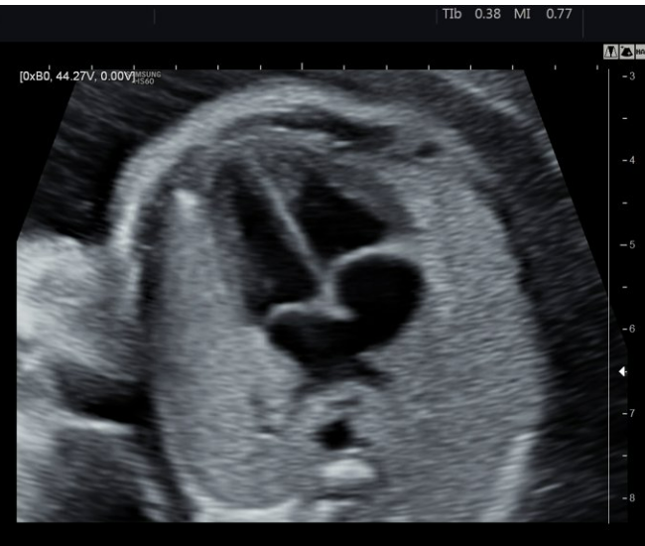
What are we scanning with these images?

Slide 6
Your next request form is for a patient who is 23 years of age with positive bHCG and lower tummy pain.
What would you be expecting to scan in this instance?

Slide 7
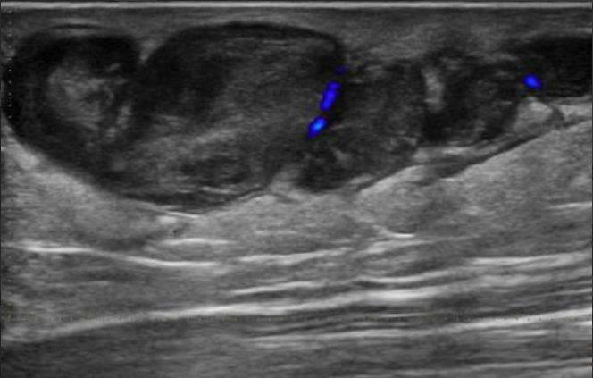
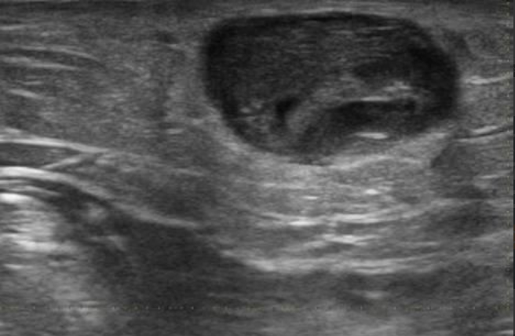

Slide 8
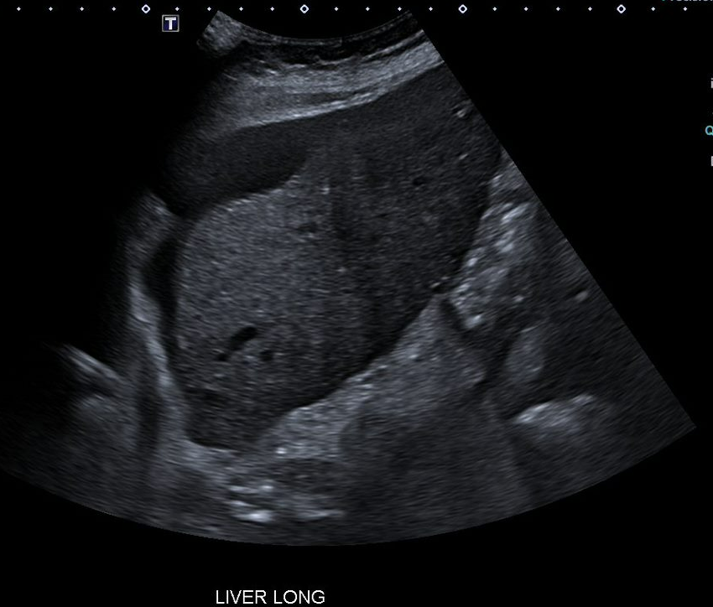
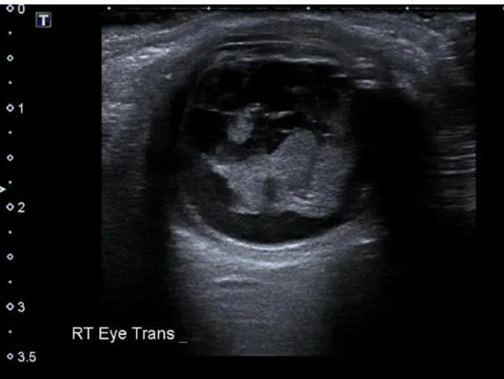
How do you set up your patient for this type of scan?

Slide 9
End of viva
Results will be collated with the other two OSCE components
Please provide valuable feedback, specific feedback on online vivas: will email link and on learn-online site (helps to inform future assessments)
Appreciate your feedback on the teacher and course evaluation.
Best wishes!

