Slide 1
OSCE Online Viva
Clinical Sonography Portfolio

Slide 2
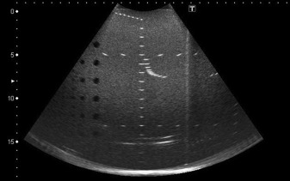
Introduction
Identity card
Audio /video check

Slide 3
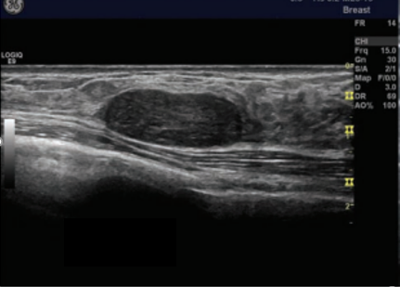
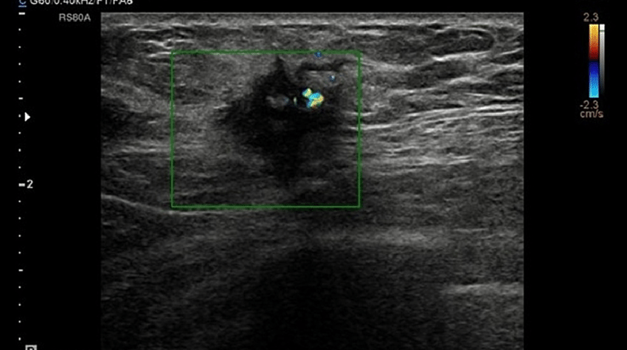
A
B

Slide 4
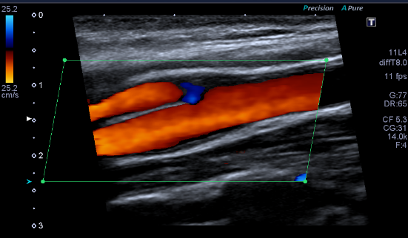
Vascular

Slide 5
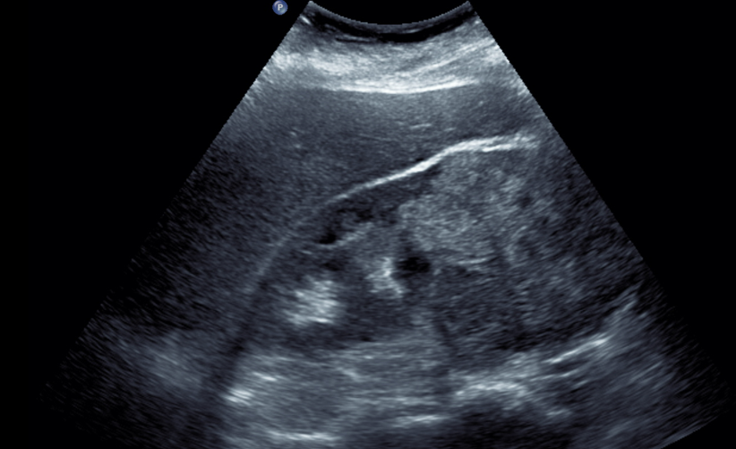
The request states that the patient has “recent weight loss, onset of hypertension and microscopic haematuria.
Pain noted over right renal fossa. Recent CXR shows multiple lung lesions.

Slide 6
Your next patient presents for a morphology scan.
You can see they are anxious – but the fetal lie is not in a great position
Explain how you would proceed

Slide 7
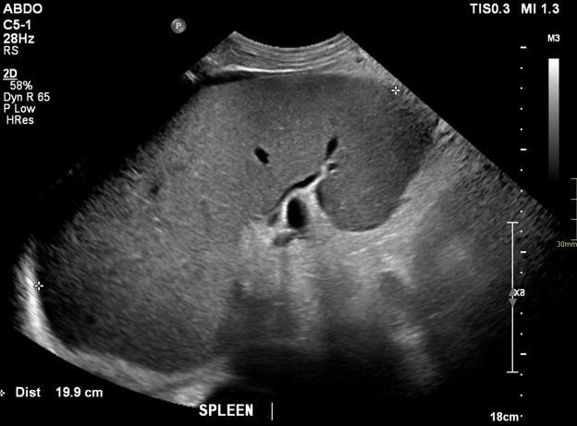
Upper quadrant imaging

Slide 8
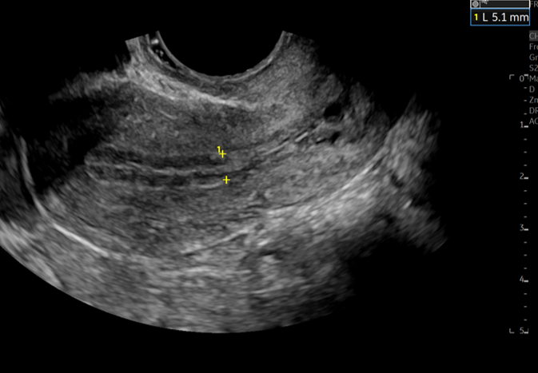
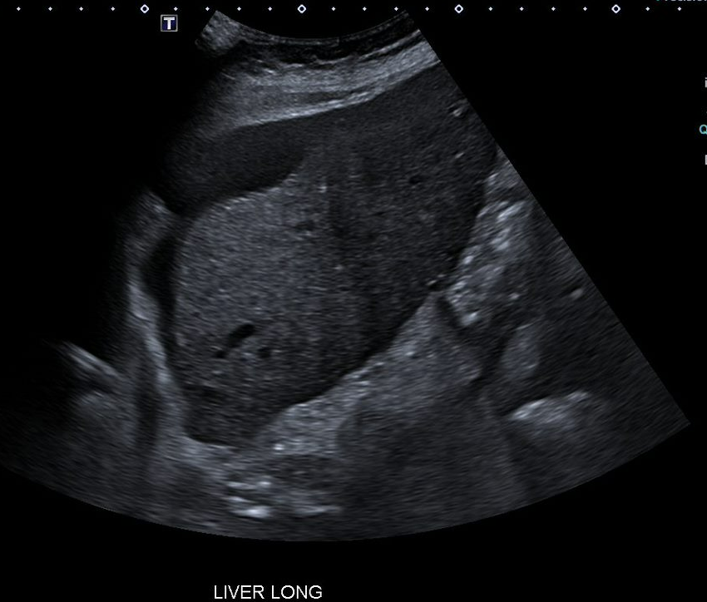
Describe the image

Slide 9
End of viva
Results will be collated with the other two OSCE components
Please provide valuable feedback, specific feedback on online vivas: will email link and on learn-online site (helps to inform future assessments)
Appreciate your feedback on the teacher and course evaluation.
Best wishes!

