Slide 1
Module 1 Introduction to Materials
ENR116 Engineering Materials
Dr Andrew Michelmore
School of Advanced Manufacturing and Mechanical Engineering
Notes:
ENR Engineering Materials
Module 1 Introduction to Materials

Slide 2
Copyright Notice
Do not remove this notice.
COMMMONWEALTH OF AUSTRALIA
Copyright Regulations 1969
WARNING
This material has been produced and communicated to you by or on behalf of the University of South Australia pursuant to Part VB of the Copyright Act 1968 (the Act).
The material in this communication may be subject to copyright under the Act. Any further reproduction or communication of this material by you may be the subject of copyright protection under the Act.
Do not remove this notice.

Slide 3
Crystal structure
Notes:
Crystal Structure

Slide 4
Intended Learning Outcomes
At the end of this section, students will be able to:-
Describe with examples the four different crystal structures.
Derive the relationships between unit cell edge length and atomic radius for face-centred cubic and body-centred cubic crystal structures.
Calculate the packing densities for face-centred cubic, body-centred cubic and hexagonal close-packed materials.
Notes:
The intended learning outcomes of this lecture summary are that
You will be able to describe the four different metallic crystal structures
Derive relationships between the unit cell and atomic radii for BCC and FCC structures
Calculate packing densities for FCC, BCC and HCP materials

Slide 5
Materials and Packing
Crystalline materials...
• atoms pack in dense periodic, 3D arrays
• typical of:
-metals
-many ceramics
-some polymers
crystalline SiO2
Noncrystalline materials...
Si
Oxygen
• atoms have no periodic packing
• occurs for:
-complex structures
-rapid cooling
"Amorphous" = Noncrystalline
noncrystalline SiO2
Adapted from Fig. 3.23, Callister & Rethwisch 8e.
Notes:
Materials fall into two different categories
First are the Crystalline materials – where the atoms pack in dense, periodic 3D array. For example, all metals, many ceramics and some polymers fall into this category.
Shown here is an example of crystalline silicon dioxide. Note that each silicon atom is surrounded by three oxygen atoms in a dense, periodic array. For Non-crystalline materials – the atoms have no periodic packing. This occurs for complex structures and under conditions of rapid cooling. Sometimes the term amorphous is used as a substitute for non crystalline.
In the second example shown here, for non crystalline silicon dioxide, each silicon atom is still surrounded by three oxygen atoms, but in a this time in a random manner

Slide 6
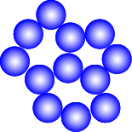
Energy and Packing
• Non dense, random packing
Energy
typical neighbor
bond length
typical neighbor
r
bond energy
• Dense, ordered packing
Energy
typical neighbor
bond length
typical neighbor
r
bond energy
Notes:
So now lets look at the relationship between the atomic packing and the interatomic energies within materials. Shown in blue here is an example of a non dense, randomly packed, non crystalline material. On the right is a plot of the interatomic energy vs distance of separation between the atoms.
For non crystalline materials, there is no 3d periodic arrangement of the atoms and therefore the typical neighbor bond energy will not be at the bottom of the energy trough, as shown here.
However, when we look at dense , ordered packing the atoms are now arranged as close as possible to each other and therefore, the neighbour bond energy will fall at the bottom of the energy trough
How does this influence the properties of the material, for example, the melting temperature?
As a general rule, crystalline materials have higher melting temperatures than non crystalline materials, as more energy is required to separate the atoms.

Slide 7
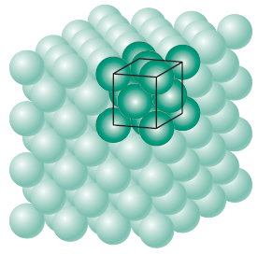
Basic concepts
Crystal structure: The manner in which atoms, ions, or molecules are spatially arranged within the unit cell.
There are extremely large number of different crystal structures.
Fig. 3.01 Callister & Rethwisch 8e.
Can be relatively simple as in metals to exceedingly complex ones, as displayed by some of the ceramic and polymeric materials.
Notes:
Some basic concepts about the Crystal structure. Crystal structure is defined as the manner in which atoms, ions or molecules are spatially arranged within the unit cell. There are a very large number of different crystal structures possible and in this lecture summary we will discuss four.
Crystal structures can be relatively simple, as for metals, but can also be extremely complex, as for some ceramic and polymeric materials.

Slide 8
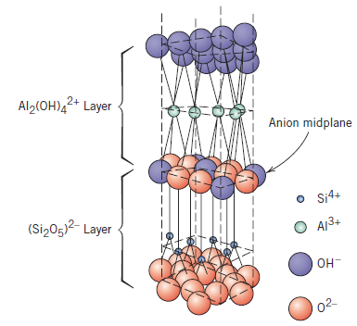
Basic concepts
Crystal lattice: Three-dimensional array of points coinciding with atom positions.
Atomic hard sphere model:
Atoms are represented by spheres.
Nearest-neighbour atoms touch one another.
The structure of kaolinite clay
Notes:
Some more basic concepts. Crystal lattice is defined as the three-dimensional array of points coinciding with atomic positions within the crystal. Atomic structure is usually represented by the atomic hard sphere model, and in this model the atoms are represented as spheres. Nearest neighbour atoms can touch each another, but not overlap. The example on screen now shows a hard sphere representation of the structure of kaolinite clay.

Slide 9
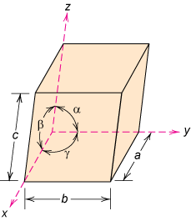
Unit cell
Unit cell: Smallest repetitive entity in the crystal.
The unit cell is the basic structural unit or building block of the crystal structure.
The unit cell defines the crystal structure by virtue of its geometry and the atom positions within.
Fig. 3.01 Callister & Rethwisch 8e.
a, b, c – edge lengths (lattice constants)
α, β, γ - interaxial angles
Fig. 3.04 Callister & Rethwisch 8e.
Notes:
The unit cell is the smallest repetitive entity in the crystal and is therefore the basic structural unit or the basic building block of the crystal structure. An example of a unit cell is shown in green on the right.
The unit cell defines the crystal structure by virtue of its geometry and the atomic positions within it. The unit cell is defined by its edge lengths, a, b and c, also known as lattice constants, and also by the interaxial angles, alpha, beta and gamma.

Slide 10
Metallic Crystal Structures
Metals tend to be densely packed.
Reasons for dense packing:
Typically, only one element is present, so all atomic radii are the same.
Metallic bonding is non-directional.
Nearest neighbor distances tend to be small in order to lower bond energy.
Electron cloud shields cores from each other.
Fig. 3.01 Callister & Rethwisch 8e.
Metals have the simplest crystal structures.
Notes:
Metals tend to be densely packed and there a number of reasons for this. Typically metals are made up of only one type of element, and therefore all the atomic radii are the same. Metallic bonding is also non-directional.
Nearest neighbor distances tend to be small, in order to lower bond energy between the atoms, and the electron clouds shield the cores from each other. Metals have very simple crystal structures, and in this lecture summary we will discuss four examples.

Slide 11
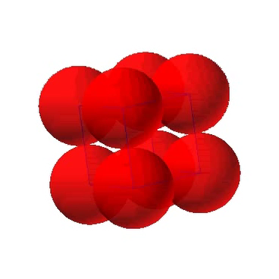
Simple Cubic Structure (SC)
Rare due to low packing density (only Po has this structure)
Coordination Number = 6
(the number of nearest neighbors or touching atoms)
(Courtesy P.M. Anderson)
Notes:
Here we start with the simplest crystal structure possible. This is the simple Cubic Structure. It consists of eight atoms, which are arranged into a cube. This structure is not common due to its low packing density. In fact, only one element, polonium, has this crystal structure.
An important characteristic for all crystal structures is the coordination number, which is defined as the number of atoms, or nearest touching atoms, within the crystal. If we consider the atom in red, here on the right, we can see that it has six nearest neighboring atoms and the coordination number for the simple cubic structure is therefore six.

Slide 12
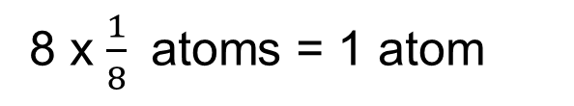
Simple Cubic Structure (SC)
a is equal to 2R
Unit cell volume= a³ = (2R)³
How many atoms are in a simple cubic unit cell?
R
a
2R
Adapted from Fig. 3.24, Callister & Rethwisch 8e.
Notes:
Lets now look at some other important parameters of the simple cubic unit cell. The length of the cell edge, or lattice parameter a, is equal to two times the atomic radius. You can see this in the illustration on screen. This edge length is also the close packed direction for the simple cubic cell, that is, the direction within the cell in which the atoms are touching.
As this is a cubic unit cell, the volume of the cell is given by a³
A second important parameter is the number of atoms withinthe unit cell. The simple cubic structure contains eight atoms, each shared eight ways with other surrounding unit cells. 8 x 1/8 gives us the equivalent of one atom within the cell.

Slide 13
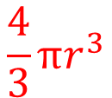
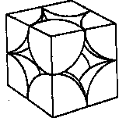
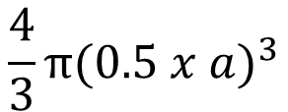
Atomic Packing Factor (APF)
Volume of atoms in unit cell*
APF =
Volume of unit cell
Volume
of sphere
*assume hard spheres
volume
atom
2R
atoms
unit cell
1
APF =
(2R)
3
volume
Adapted from Fig. 3.24, Callister & Rethwisch 8e.
unit cell
APF for a simple cubic structure = 0.52
Notes:
Another important characteristic of crystal structure is the Atomic Packing Factor. The atomic packing factor gives you the density, or how close the packing of the atoms is in the crystal. The packing factor is defined as the volume of the atoms in the unit cell, divided by the volume of unit cell.
So to determine the atomic packing factor, we need to know the dimensions of the unit cell, and the number of complete atoms within the unit cell.
So for the simple cubic structure, the atomic packing factor is given by the number of atoms within the unit cell, which is one, multiplied by the volume of each atom. As we are modelling the atoms as hard spheres, this is just the usual equation for volume of a sphere, where the radius is the atomic radius. These are then divided by the total volume of the unit cell.
For a simple cubic structure, this comes out to be 0.52, which is relatively low.

Slide 14
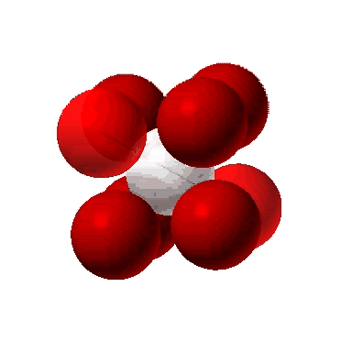
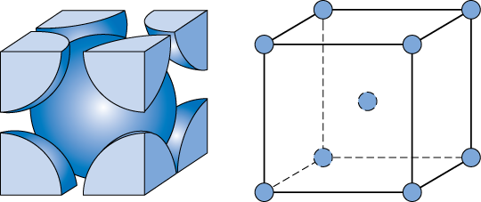
Body Centered Cubic Structure
(BCC)
Atoms touch along cube diagonals.
ex: Cr, W, Fe (α), Tantalum, Molybdenum
Adapted from Fig. 3.02, Callister & Rethwisch 8e.
(Note: All atoms are identical; the center atom is shaded differently only for ease of viewing).
Coordination No = 8
Notes:
The next more complex structure for metals is the body centered cubic structure. In this cubic structure, the atoms touch each other along the diagonal of the unit cell.
This crystal structure is typical for several elements, including chromium, tungsten, iron, tantalum and molybdenum.
To determine the coordination number of the body centered cubic structure, if we now look at the atom in red it is surrounded by the eight blue atoms at the corners of the unit cell, and the coordination number is therefore 8.

Slide 15
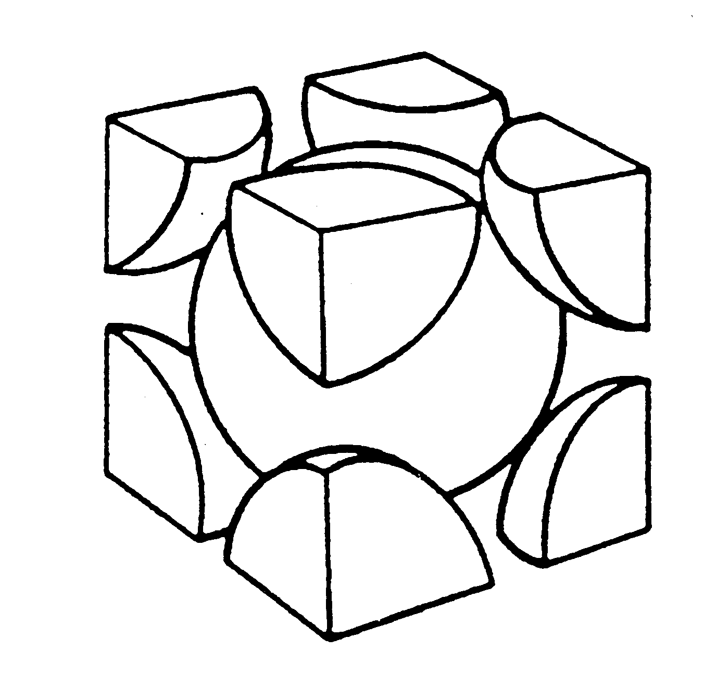
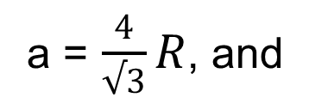
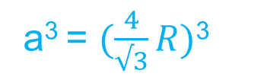
Body Centered Cubic Structure
(BCC)
Unit cell volume
4R
a
2
a
R
a
How many atoms are in a BCC unit cell?
2 atoms
Notes:
We’ll now look at the close packed directions and unit cell volume for the body centered cubic structure.
The schematic on screen shows the unit cell, with a right angled triangle making up one of the edge lengths and two diagonals across the bottom face, and the centre of the cell. As the atoms touch along the central diagonal, we know that the distance of this line is 4 time the atomic radius. We can use this information along with Pythagoras’ theorem ,to get a value for a in terms of r, the atomic radius. The result is a equals 4 divided by the square root of 3, multiplied by r. The unit cell volume is given by cubing this result.
Next we consider how many atoms are within the unit cell. In the centre of the cell we have one complete atom, shown in blue, whereas in the corners we have eight atoms shared eight ways with neighbouring cells. These are highlighted here in green. When we account for their contribution, we end up at a total of 2 atoms per unit cell.

Slide 16
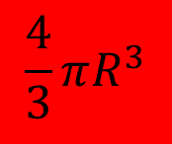
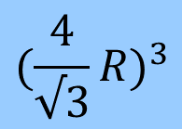
Atomic Packing Factor: BCC
atoms
volume
unit cell
2
atom
R
APF =
a
volume
unit cell
Adapted from Fig. 3 pg 50, Callister & Rethwisch 8e.
APF for a body-centered cubic structure = 0.68
Notes:
We can now determine the atomic packing factor for the BCC structure. There are two atoms per unit cell, and the volume of a sphere is 4/3 pi r cubed, as before. This is divided by the volume of the unit cell to give an atomic packing factor of 0.68.

Slide 17
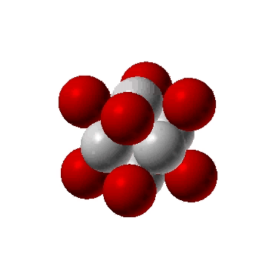
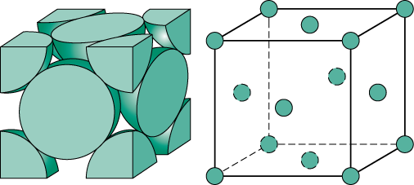
Face Centered Cubic Structure
(FCC)
Atoms touch along face diagonals.
ex: Al, Cu, Au, Pb, Ni, Pt, Ag
Adapted from Fig. 3.02, Callister & Rethwisch 8e.
(Note: All atoms are identical; the face-centered atoms are shaded differently only for ease of viewing.)
Coordination No = 12
Notes:
The next crystal structure is face centered cubic. In this crystal structure, the atoms touch each other along the face diagonals. This crystal structure is again typical for several elements, such as aluminum, copper, gold, lead, nickel, platinum and silver.
The coordination number for this crystal structure is 12.

Slide 18
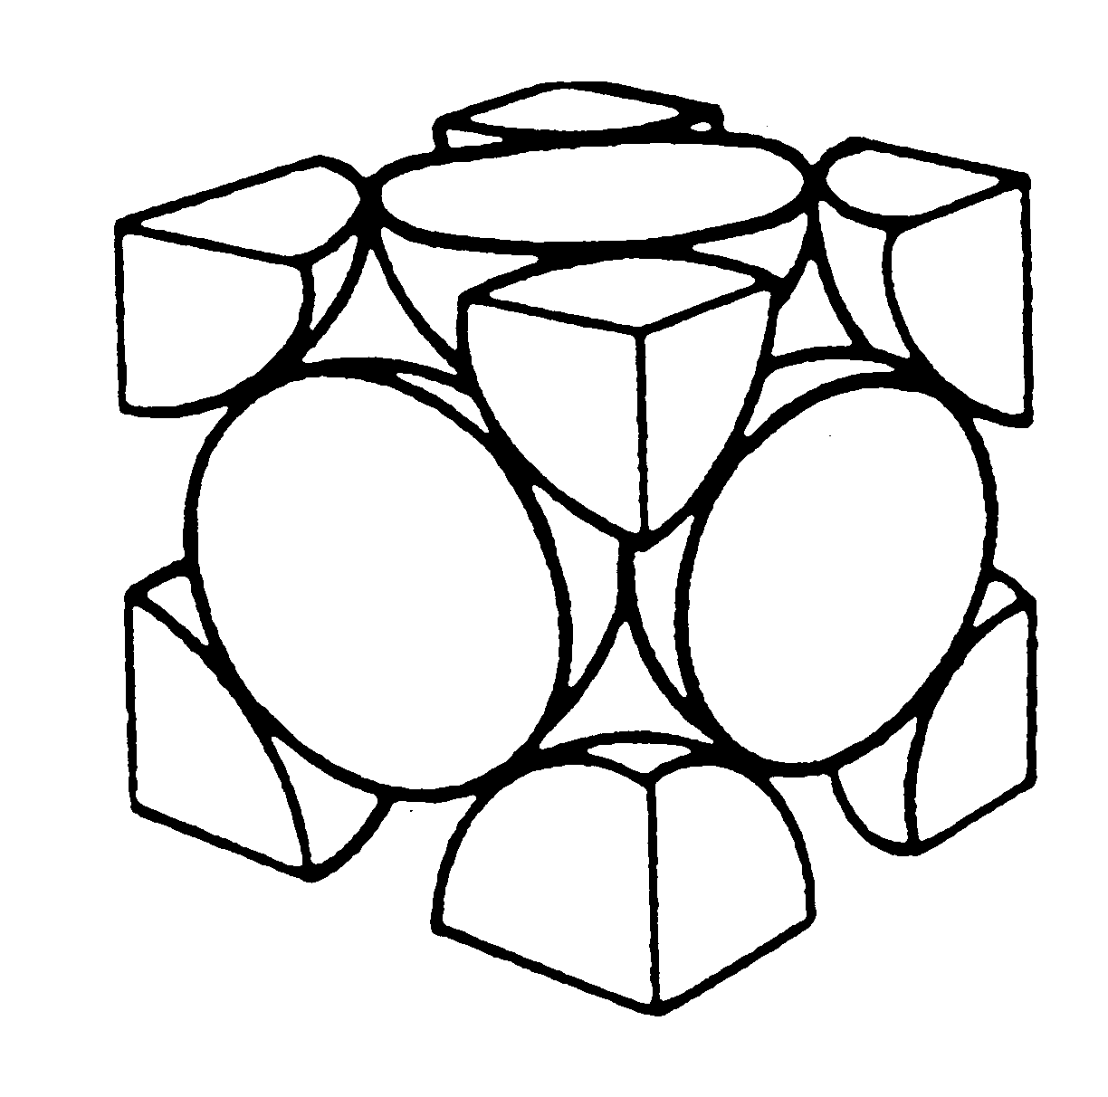
Face Centered Cubic Structure
(FCC)
Unit cell volume
4R
a
a
a = 2√2(R),
a³ = 16√2(R)³
How many atoms are in a FCC unit cell?
4 atoms
Notes:
As the atoms in a face centred cubic structure touch along the face diagonals, we can construct a right angled triangle with a diagonal equal to 4 time the radius of the atom, and two sides equal to a, the lattice parameter. Using Pythagoras theorem, we can determine a value for a in terms of r, and this is two time the square root of 2 times r. Cubing this value gives us the unit cell volume.
Now we’ll determine how many atoms are in a face centred cubic cell. We have half atoms at each of the six faces, highlighted here in purple, plus eight corner atoms, shown in green. This gives us a total of 4 atoms per unit cell.

Slide 19
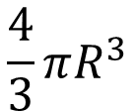

Atomic Packing Factor: FCC
atoms
volume
unit cell
4
atom
APF =
volume
a
unit cell
Adapted from
Fig. 3.1(a),
Callister & Rethwisch 8e.
APF for a face-centered cubic structure = 0.74
maximum achievable APF
Notes:
So again, we now determine the atomic pacing factor, this time for a face centered cubic structure. We already know that the number of atoms per unit cell this time is 4, and this is multiplied by the volume of each atom, and again divided by the volume of the unit cell. The result is an atomic packing factor of 0.74.
This is actually the highest possible or maximum achievable atomic packing factor for materials.

Slide 20
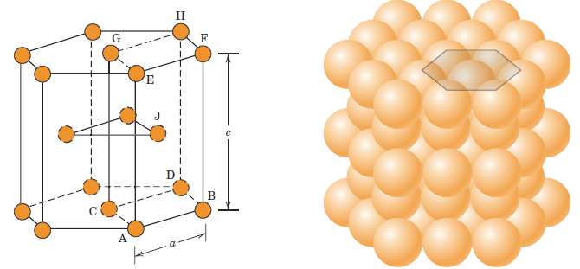
Hexagonal Close-Packed Crystal
Structure (HCP)
Cadmium, Cobalt, Zinc, Titanium
Fig. 3.03, Callister & Rethwisch 8e.
c
a
c/a ratio is 1.633
Coordination number = 12
6 atoms per unit cell
APF = 0.74
Notes:
The last crystal structure that we will discuss is the hexagonal close packed crystal structure. This structure is typical for cadium, cobalt, zinc and titanium.
It consists of two planes of atoms on the top and the bottom, each with six atoms arranged in a regular hexagon, surrounding one atom in the centre. In between these two planes there are three atoms, as highlighted here.
The edge length ratio for this crystal structure, the distance c divided by a, is typically 1.633.
We have six atoms per unit cell and the coordination number is 12.
The atomic packing factor is the same as for the face centred cubic structure, 0.74.

Slide 21
Theoretical Density, ρ
Mass of Atoms in Unit Cell
Density = ρ =
Total Volume of Unit Cell
n
A
ρ =
N_{A}
V_{C}
where n = number of atoms per unit cell
N_{A} = Avogadro’s number = 6.023 x 10²³ atoms/mol
A = atomic weight
V_{C} = Volume of unit cell
Notes:
Using the unit cell, we can also calculate the theoretical density of materials. The basic equation for the density is the mass of the atoms in the unit cell, divided by the total volume of the unit cell.
To determine the mass of the atoms in the unit cell, we take the number of atoms in the cell, divided by avogadros number to obtain the moles per unit cell, and multiply by the atomic weight.
We then divide this by the volume of the unit cell.

Slide 22
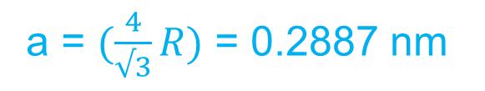
Theoretical Density, ρ
Adapted from Fig. 3.02, Callister & Rethwisch 8e.
Cr (BCC)
A = 52.00 g/mol
R = 0.125 nm
n = 2
R
a
atoms
ρ_{theoretical}
g
= 7.18 g/cm³
unit cell
2
52.00
mol
ρ_{actual}
= 7.19 g/cm³
ρ =
a
3
6.023 x 10²³
volume
atoms
unit cell
mol
Notes:
So here is an example. We are asked to calculate the theoretical density for Chromium, given that it has a body centered cubic structure, and the atomic weight is 52g per mole. We are also given the atomic radius of 0.125 nm. We know from previous slides that the number of atoms per unit cell is 2, and we can calculate the unit cell edge length in terms of R.
Therefore the theoretical density is the number of atoms per unit cell, which is two, divided by Avogadros’ number, multiplied by the atomic weight of chromium, divided by the volume of the unit cell. If we do this we get a value of 7.18 g per cm3, which is in good agreement with the actual measured value.

Slide 23
Densities of Material Classes
In general
Metals/
Graphite/
Composites/
Alloys
Ceramics/
Polymers
fibers
ρ
>
ρ
>
ρ
Semicond
metals
ceramics
polymers
30
2
0
Platinum
*GFRE, CFRE, & AFRE are Glass,
Gold, W
Carbon, & Aramid Fiber-Reinforced
Metals have...
close-packing (metallic bonding)
often large atomic masses
Tantalum
Epoxy composites (values based on
10
Silver, Mo
60% volume fraction of aligned fibers
Cu,Ni
in an epoxy matrix).
Steels
Tin, Zinc
Zirconia
5
Titanium
3
4
Al oxide
(g/cm )
Diamond
Ceramics have...
less dense packing
often lighter elements
3
Si nitride
Aluminum
Glass
-
soda
Glass fibers
Concrete
PTFE
ρ
2
Silicon
GFRE*
Magnesium
G
raphite
Carbon
fibers
Silicone
CFRE
*
PVC
A
ramid fibers
PET
AFRE
*
1
PC
H
DPE, PS
PP, LDPE
Polymers have...
low packing density (often amorphous)
lighter elements (C,H,O)
0.5
Wood
0.4
0.3
Data from Table B.1, Callister & Rethwisch, 8e.
Notes:
Here we shown the densities of different material classes. As you can see, in general the density of metals is greater than that of ceramics, which is greater than that of polymers.
Composities generally have intermediate values of density.
The reason for this is that metals have close packing due to their metallic bonding and often have large atomic masses.
Ceramics generally have less dense packing, and are often made of lighter elements such as silicon and oxygen.
Polymers have low packing density as they are often amorphous, and contain light elements such as carbon and hydrogen.

Slide 24
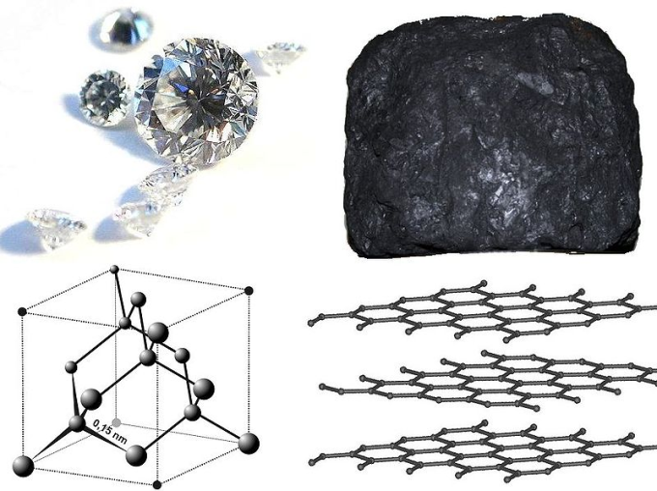
Polymorphism
Two or more distinct crystal structures for the same material (allotropy/polymorphism)
Carbon
Iron system
liquid
  diamond graphite
1538°C
BCC
δ-Fe
1394°C
FCC
γ-Fe
912°C
BCC
α-Fe
Notes:
It is also possible for a material to have two or more distinct crystal structures. This is known as polymorphism. A god example of this is carbon. When carbons are arranged in a tetrahedral fashion, as in diamond, the material is extremely hard. Graphite on the other hand is composed of sheets of carbon, arranged in a hexagonal packing structure.
Not only does graphite look completely different to diamond, but it is also extremely flexible.
Another example is iron. Depending on processing conditions, the structure of iron can be body centered cubic, or face centered cubic, depending on the temperature.

Slide 25
Summary
Crystal structures are specified in terms of unit cells.
Most metals exist as one of three simple crystal structures.
Features of crystal structure include the number of nearest-neighbour atoms and the atomic packing factor.
Notes:
In summary,
Crystal structres are specified in terms of the unit cell
Most metals exist as one of three simple crystal structures
Features of crystal structure include the number of nearest neighbour atoms, or coordination number, and the atomic packing factor

Slide 26
Thank you
Notes:
If you have any questions or desire further clarification please post a question or comment on the Discussion Forum.

