Slide 1
Revision for Mechanics of Materials
Dr. Xing Ma

Slide 2
What is “Mechanics of Materials”?
Objective: to study load-carrying capacity of a member from the following standpoints:
Strength
The ability to resist fracture or permanent deformation.
We need know the maximum stress in the member.
Stiffness
The ability to resist deflection/deformation.
We need know the maximum strain/deflection in the member.
Stability
The ability to remain equilibrium configuration.
We need know the critical stress/load of the member.

Slide 3
Contents in “Mechanics of Materials”
Axially loaded members
Bending and shear (beam theory)
Torsion
Column buckling
Combined loadings
Indeterminate structures
Stress transformation

Slide 4
Requirement for “Axially loaded members”
To understand the concept of normal force and normal stress
To be able to calculate the normal stress and normal deformation
Important formulas

Slide 5
Requirement for “Bending and shear”
To understand the concept of bending, shear
To understand the normal stress due to bending and shear stress due to shear force
To be able to draw Shear Force Diagram (SFD), and Bending Moment Diagram (BMD)
To be able to draw normal stress distribution (maximum tensile normal stress and maximum compression normal stress) due to moment and shear stress (maximum shear stresses) distribution due to shear force
To be able to calculate maximum deflection due to lateral loadings
To be able to calculate centroid and I values for composite sections

Slide 6
Important formulas for “Bending and shear”
Deflection for beams
Point Load at mid-span Δ=PL³/(48EI)
Uniform Load Δ=5qL⁴/(384EI)

Slide 7
Centroid and Moment of Inertia

Slide 8
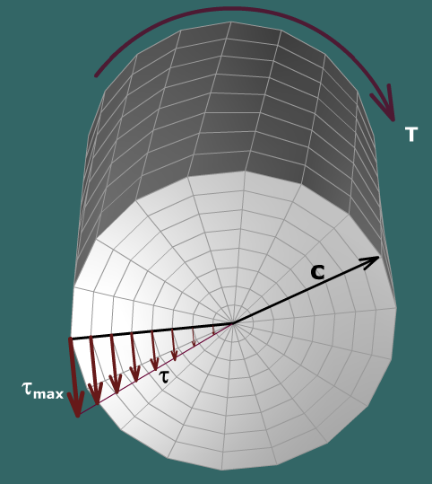
Requirement for “Torsion”
To understand the distribution of shear stress due to torque
To be able to calculate the maximum shear stress using given formulas

Slide 9
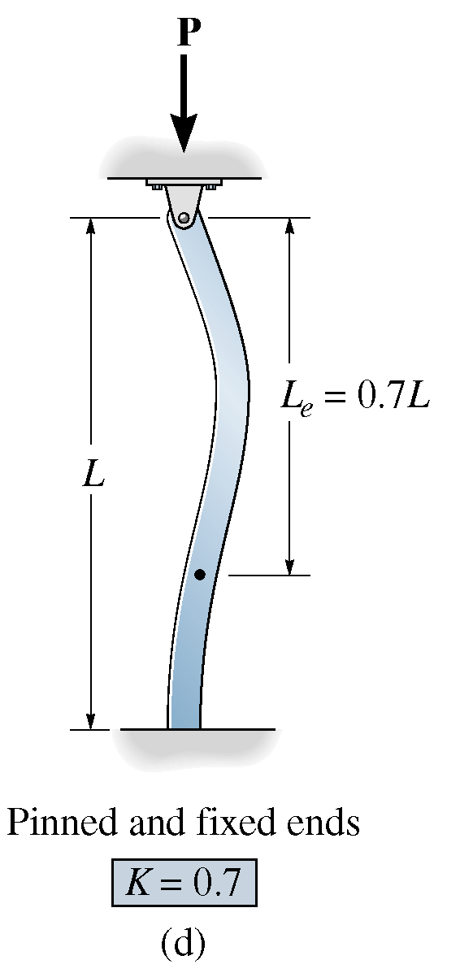
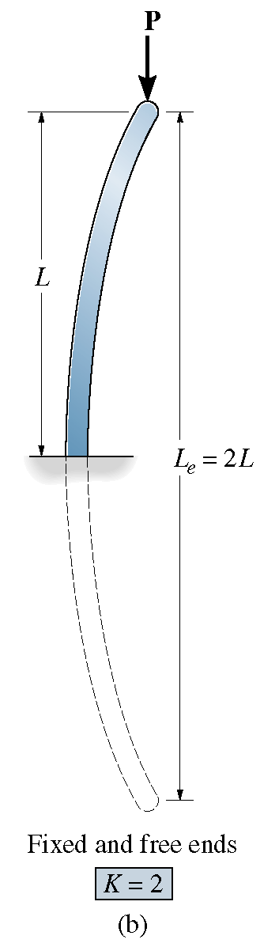
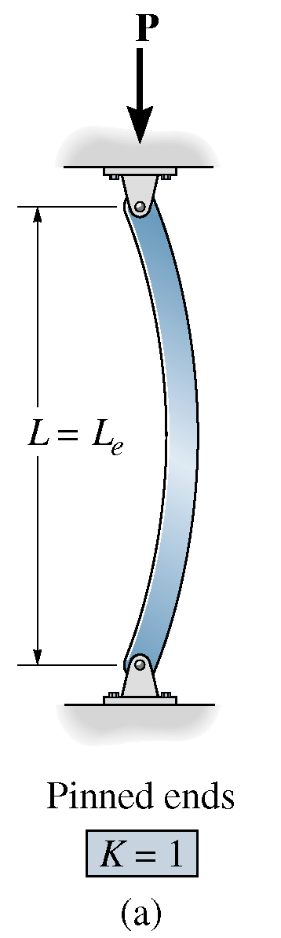
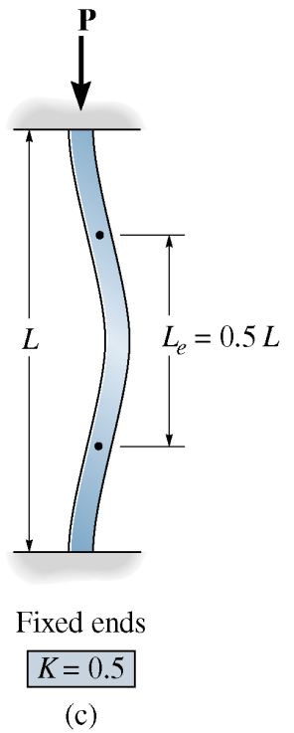
Requirement for “Column buckling”
To understand the concept of column buckling
To be able to calculate critical load based on given formulas
To understand the concept of “effective length” due to end conditions
L_{e} = KL

Slide 10
Requirement for “Combined loadings”
To be able to calculate internal actions (normal force, shear force, bending moment and torque) on a cross section due to complex loads
To be able to calculate the maximum compressive and maximum tensile stress due to combination of normal force and bending moment
To be able to calculate maximum shear stress due to combination of shear force and torque
Review practical project 4 “design of a signpost”

Slide 11
Requirement for “Indeterminate structures”
To be able to solve indeterminate problems using combination of equilibrium equations and compatibility conditions
To be able to solve the following two types of questions
Q1. One bar with two ends fixed
Q2. Several bars support one rigid beam/plate

Slide 12
Requirement for “Stress transformation”
To be able to calculate principle stresses using given formulas

